Slide 1
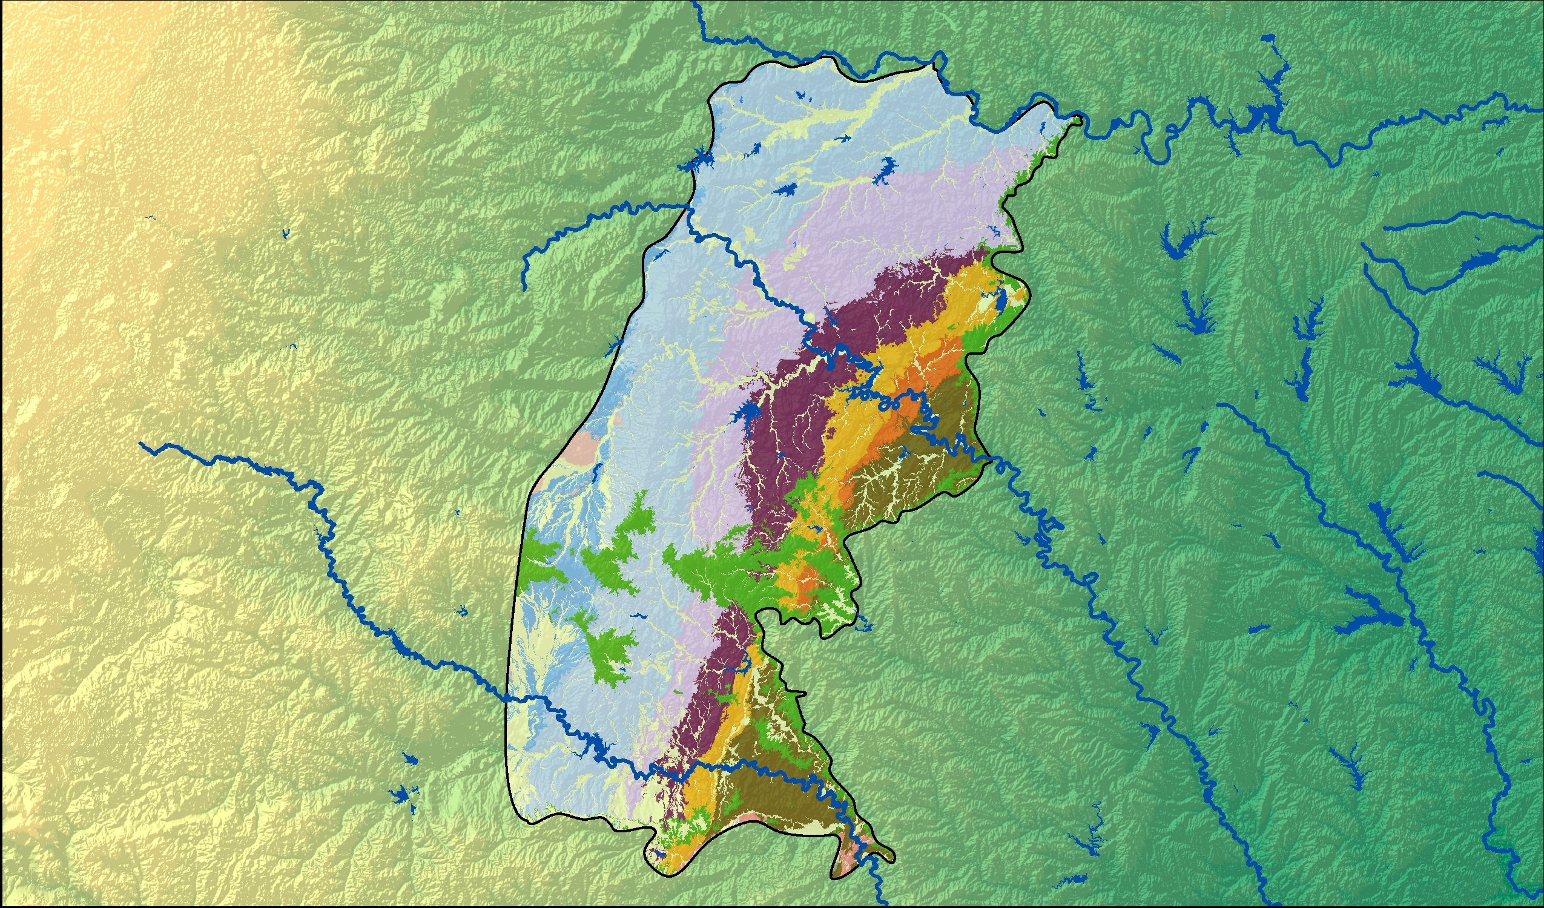
Cross Timbers Aquifer
Groundwater Availability Model (GAM)
Stakeholder Advisory Forum 1| April 2023
1

Slide 2
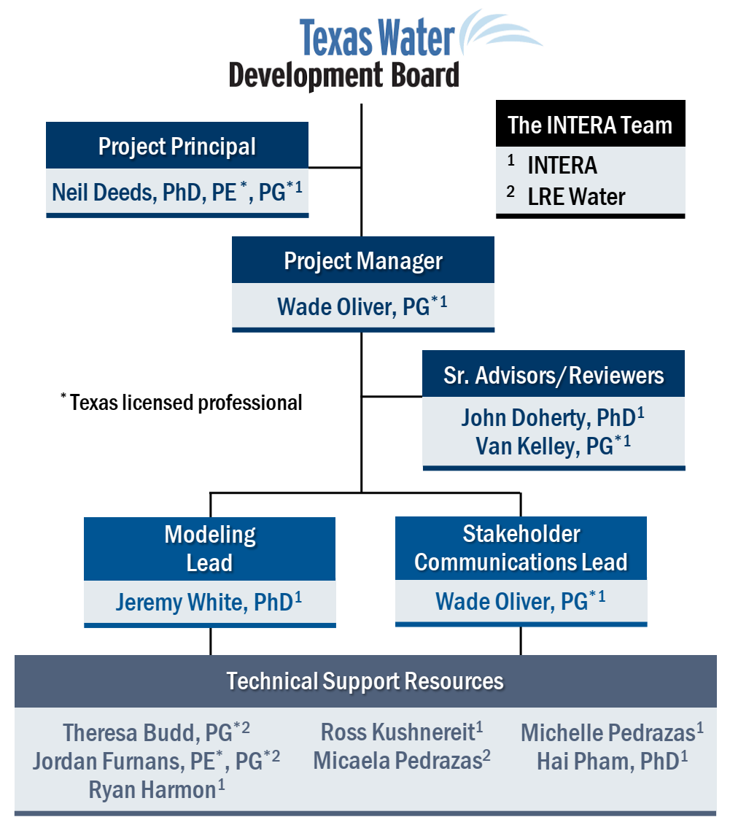
Project Team & Responsibilities
Prime Contractor
Project manager and technical coordination
Technical Lead for model structure, recharge and surface water, calibration, and sensitivity analysis
INTERA Subcontractor
Technical lead on development of pumping dataset

Slide 3
Study Objectives
Improve conceptual understanding of the Cross Timbers Aquifer and its future
Provide tool for assessing desired future condition of the aquifer (DFC)/modeled available groundwater (MAG)
Create a numerical model which can be used for water planning by both public and private entities

Slide 4
Groundwater Modeling Program
Dynamic tools for water planning in Texas
Purpose
Freely Available
To develop tools that can be used to help Groundwater Conservation Districts, Regional Water Planning Groups, and others understand and manage their groundwater resources.
GAM reports are available online and
all models are standardized and well documented
Periodically Updated
Public Process
GAMs are updated when new relevant data becomes available
Transparent development process where model development is recorded in steps

Slide 5
Why Stakeholder Advisory Forums?
Keep stakeholders updated about progress of the modeling project
Inform how the groundwater model can, should, and should not be used
Provide stakeholders with the opportunity to provide input and data to assist with model development

Slide 6
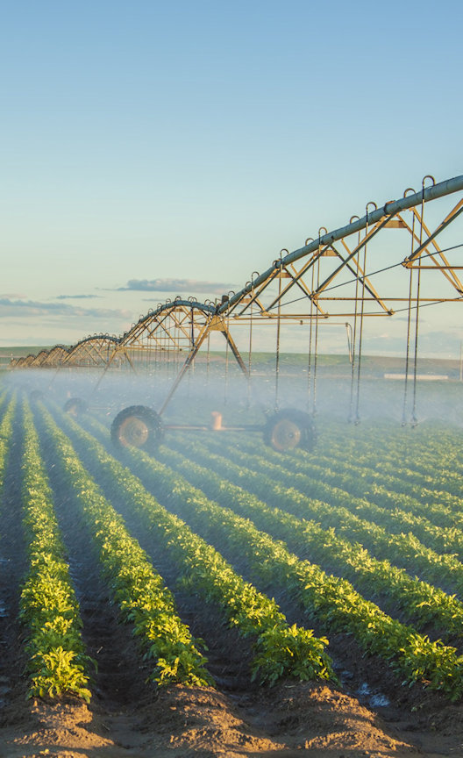
Groundwater Availability:
Where Policy Meets Science
Desired Future Conditions (DFCs)
+
Groundwater Availability Model (GAM)
=
Modeled Available Groundwater (MAG)

Slide 7
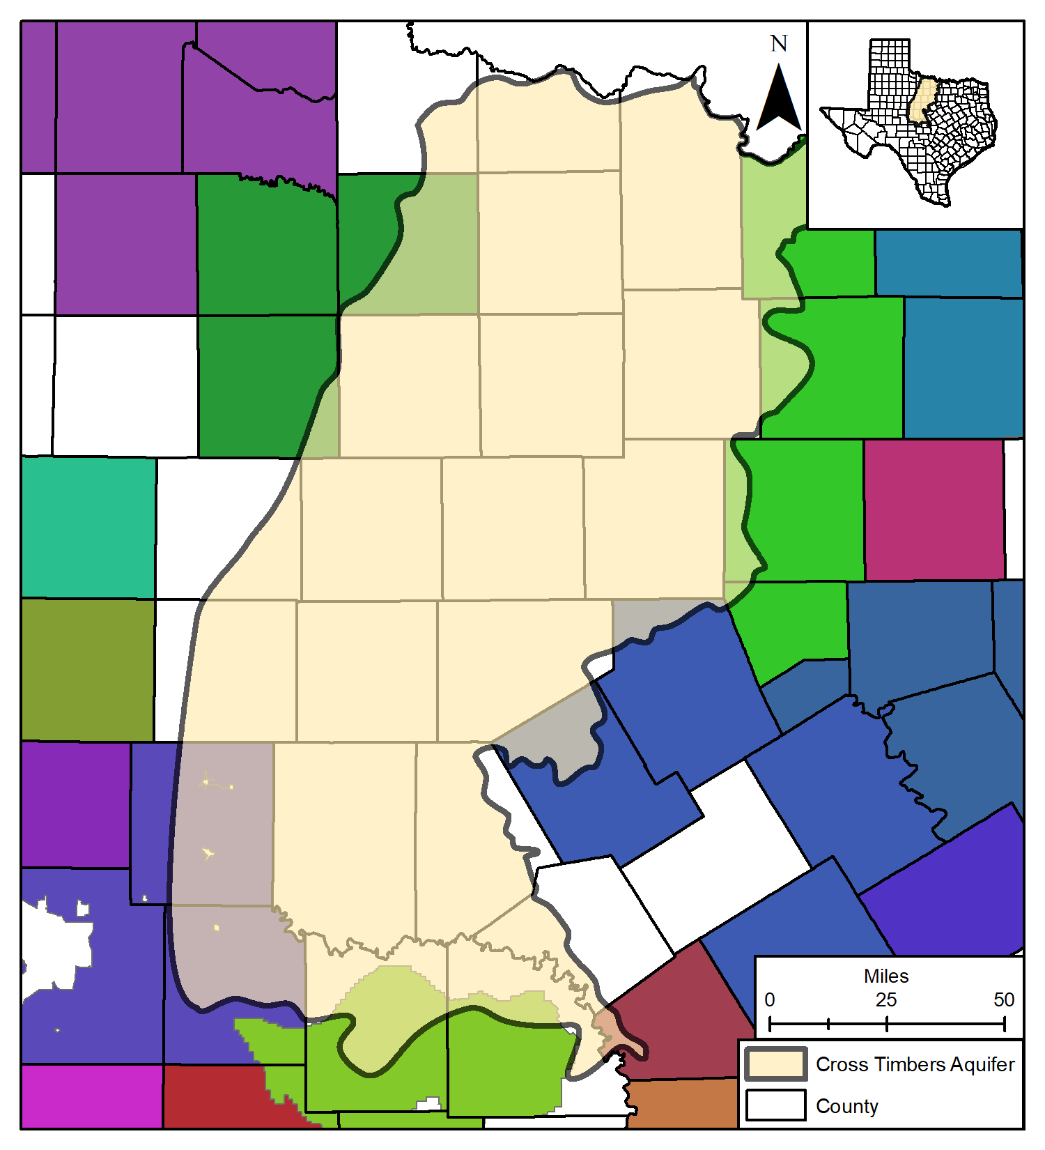
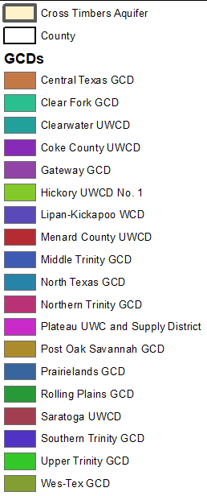
Groundwater Conservation Districts

Slide 8
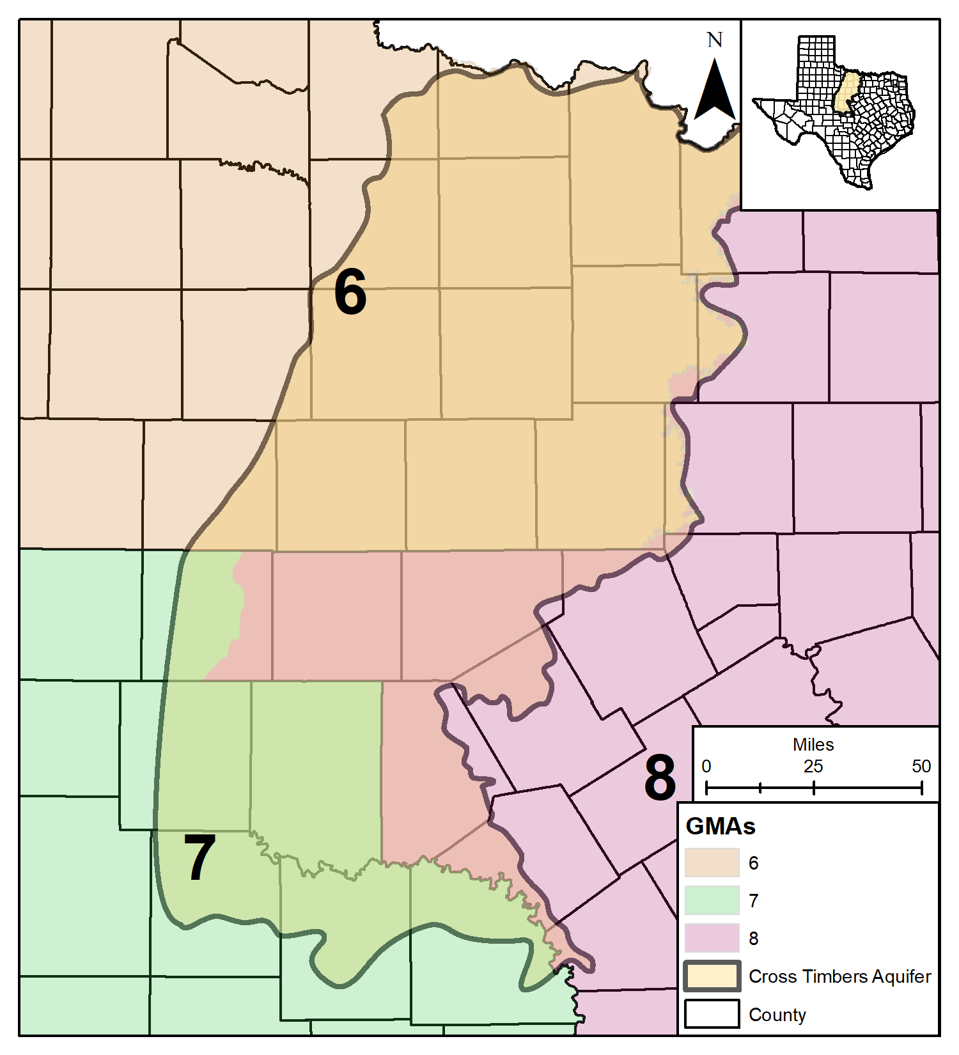
Groundwater Management Agencies

Slide 9
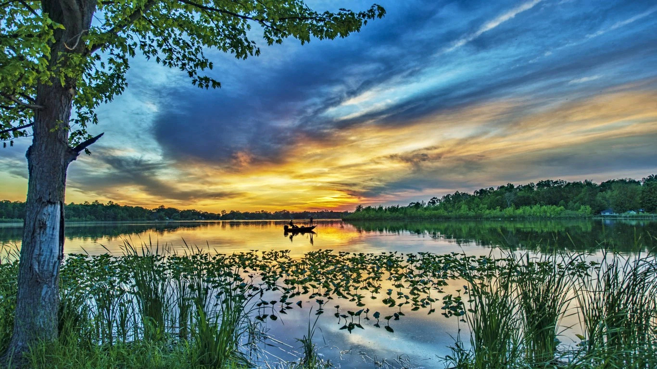
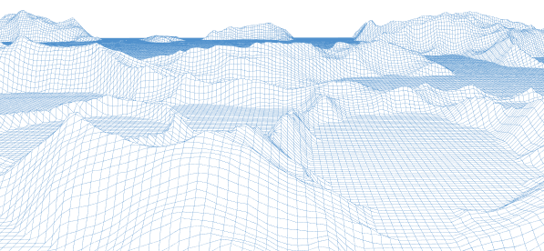
Groundwater Modeling

Slide 10
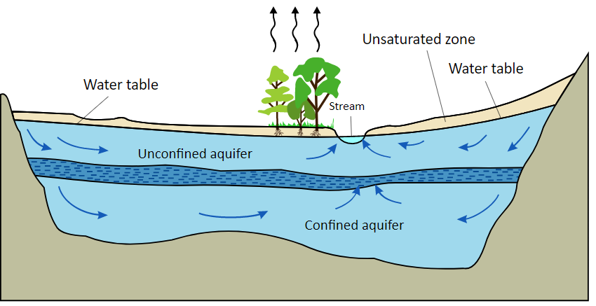
Aquifers and Confining Units
An aquifer is a body of permeable rock which contains or transmits an economically viable quantity of groundwater
Aquifers can be either unconfined (in communication with surface air pressure) or confined (isolated from surface air pressure)
A confining unit is an impermeable rock layer which prevents flow between rock layers
Unsaturated Soils

Slide 11
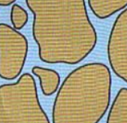
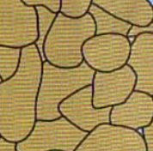
Aquifer Properties
Hydraulic conductivity
the ease with which water is conducted through a porous material
related to permeability and transmissivity
Gravel and Coarse Sand
Finer Sands
Clay and Silt
More Permeable
Higher Conductivity
Less Permeable
Lower Conductivity

Slide 12
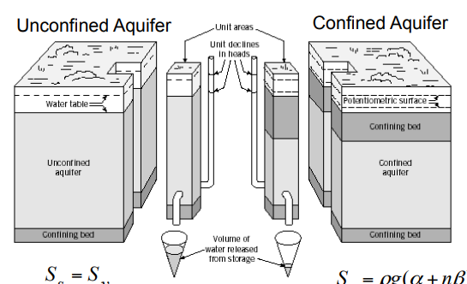
Aquifer Properties
Storativity
The volume of water released from a confined aquifer per unit area of the aquifer and per unit reduction in hydraulic head
Specific Yield
The volume of water released from an unconfined aquifer per unit area of the aquifer and per unit reduction in water table elevation
Heath (1983)

Slide 13
Why Groundwater Flow Models?
Groundwater is more difficult to observe and measure than surface water
Aquifers are complex, and predicting groundwater behavior depends on their physical properties
Groundwater models are tools which aim to integrate dozens of variables dictating the flow within the aquifer(s) of interest
The aim is to provide a comprehensive and accurate estimate of groundwater behavior through time

Slide 14
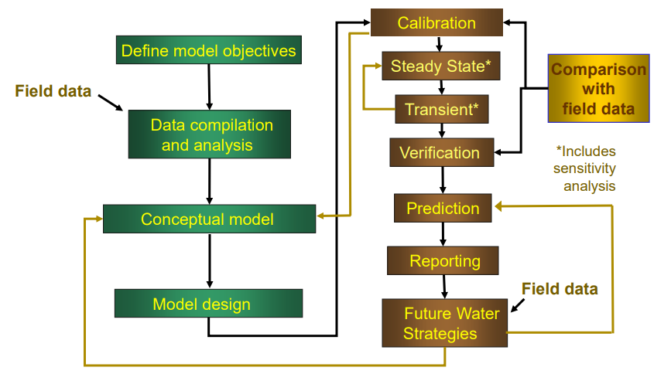
Modeling Protocol

Slide 15
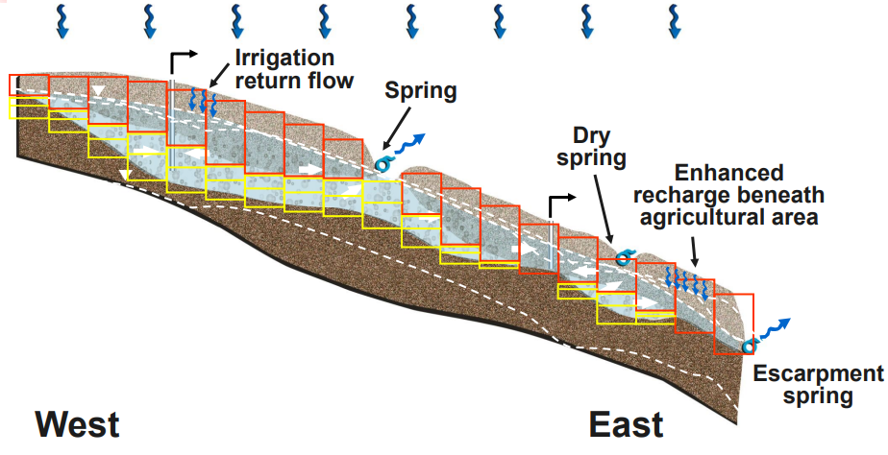
Start with Conceptual Model, Divide into Cells

Slide 16
Technical Approach

Slide 17
Efficient Workflows
Reproducibility and transparency through scripting
Iterative and incremental model building approach
Parameter estimation and uncertainty analysis using PESTPP-IES
MODFLOW 6 will be the basis for the Numerical Model

Slide 18
Efficient Workflows
Open source
utilities
flopy mfsetupgis
Set up MODFLOW 6 model structure, properties, and boundary conditions
Modeling Process
Where science happens
Decisions and assumptions made and tested
Open-source tools
Scripting-driven approach
Rapid, reproducible, and robust
Self-documenting
Incremental complexity
Objectively evaluate
Computational layering design
Spatial resolution
Temporal resolution
Boundary condition
How do these model elements influence simulated future water levels and groundwater fluxes?
Setup PEST interface around the model: parameterization of model properties and boundary conditions; monitor outputs of interest
flopy pyemu
pyemu
Define prior parameter ensemble and likelihood/objective function
PEST++-IES pyemu
History matching using prior parameter ensemble and likelihood function
Matplotlib pyemu
Process results
Science: think critically about results, define hypothesis to test related to all steps above. Repeat as necessary

Slide 19
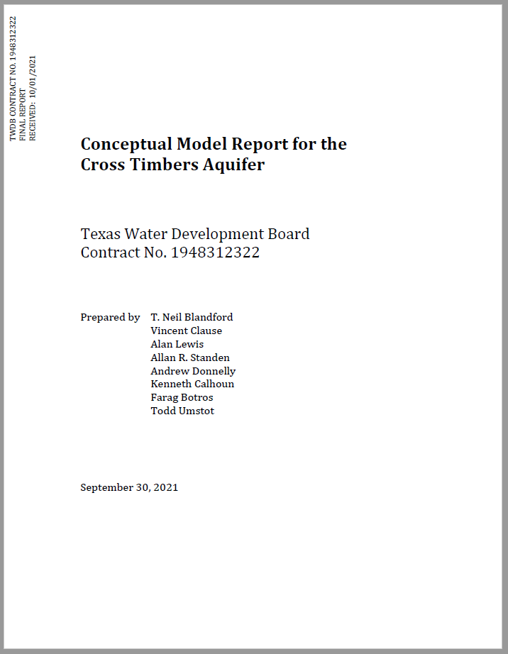
Concept to model
Gridding and Layering:
Testing various grid resolutions and associated uncertainty related to cell sizes
Translating hydrostratigraphic layers to model layers
Boundary condition assignments
Recharge, surface water and groundwater interaction, pumping (LRE), evapotranspiration
Subjective, introduces uncertainty
Simulation periods
Calibration period: TBD–2022
Generic predictive period: 2022–TBD
“business as usual”

Slide 20
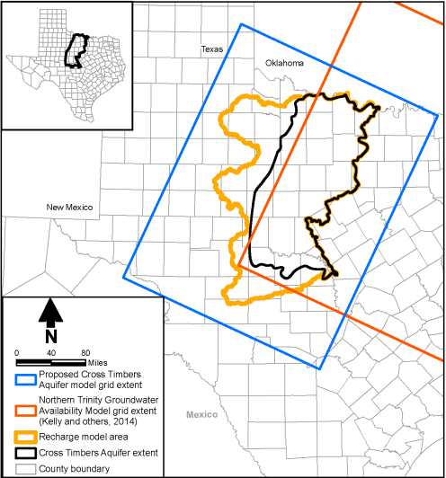
Model Grid
The model grid will cover the active extent of the study area
Grid resolution will balance computational burden with grid resolution
One-mile grid cells with refinement seems most likely
Will be oriented on the same angle as the Northern Trinity Woodbine GAM
Conceptual Model Report for the Cross Timbers Aquifer (TWDB)

Slide 21
Model Layering
Conceptual Model Report for the Cross Timbers Aquifer (TWDB)
10-layer model
There will be a constant-thickness layer between Layers 1A,B and 2 representing the shallow, fresher portion the aquifer where most of the wells are completed
The lower layers are mostly brackish and have little calibration data

Slide 22
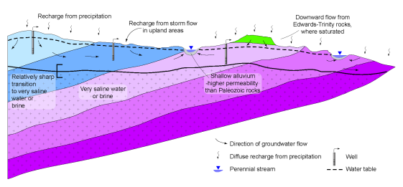
Surface-Groundwater Interaction
Layer 1 will represent any of the shallow sediments overlying the Cross Timbers Aquifer
These shallow alluvium sediments will be incorporated as a water-bearing unit
Grid-refinement around surface water features
Conceptual Model Report for the Cross Timbers Aquifer (TWDB)

Slide 23
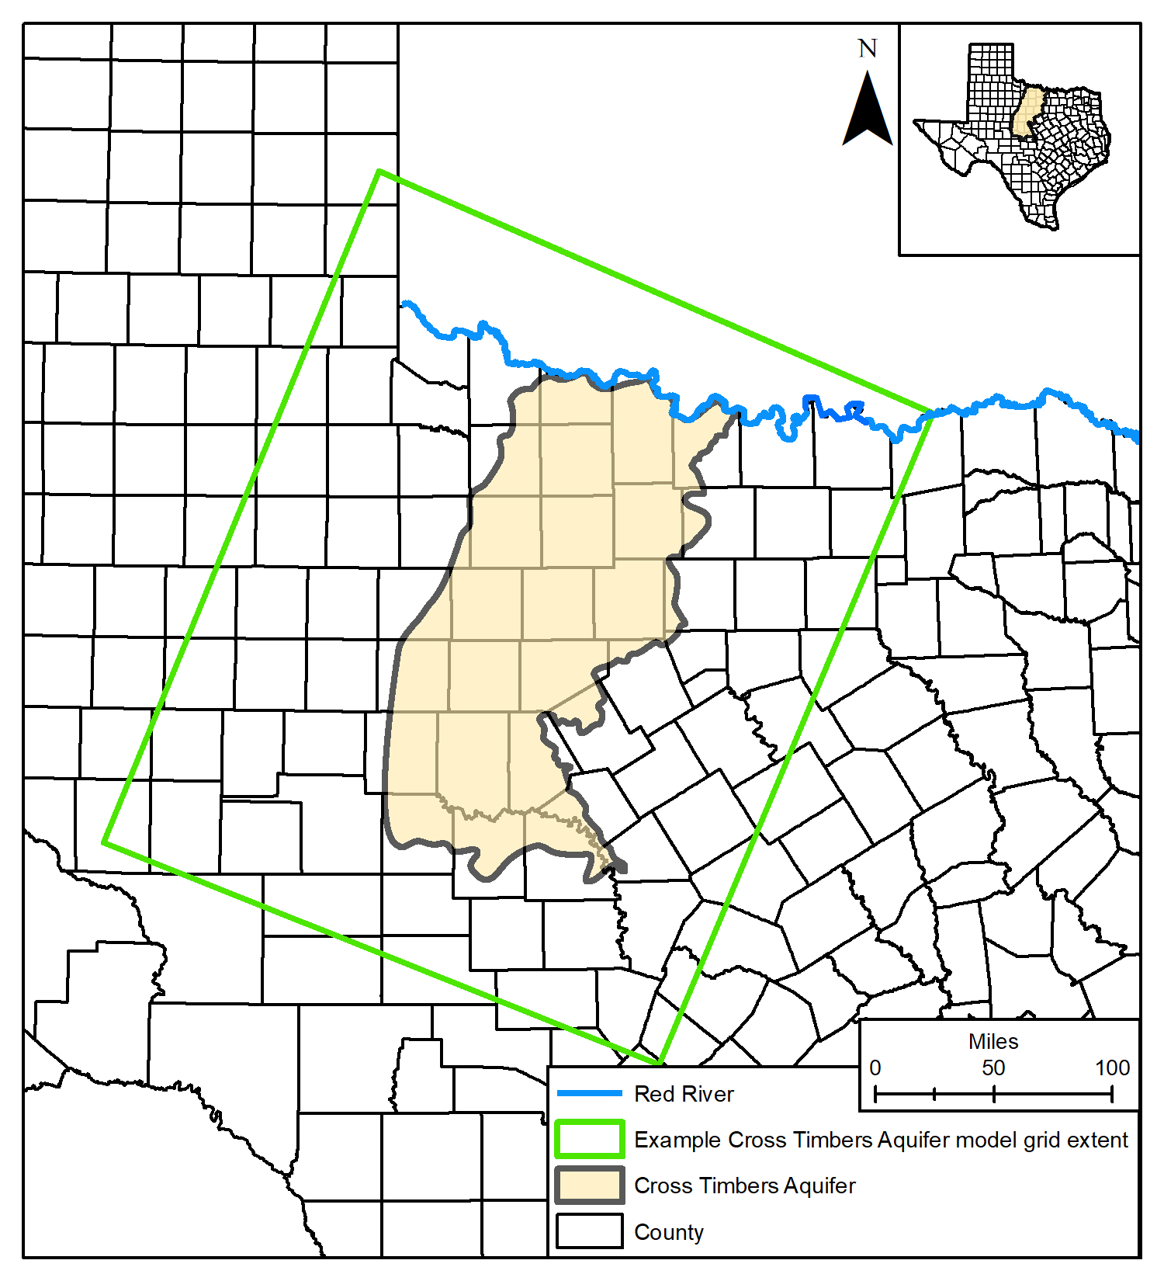
Model Extent and Boundaries
Western boundary:
The aquifer boundary, with a larger western region considered to determine recharge
No-flow
Northern boundary:
Red River
Head boundary in Layer 1, no-flow boundaries in deeper layers
Eastern boundary:
Will closely follow the outcropping edge of the Northern Trinity Aquifer
General Head Boundary
Southern boundary:
No-flow boundary

Slide 24
Hydrogeologic Parameters
Initial hydraulic properties will be based on Section 4 of the Conceptual Model report (based on Specific Capacity Tests from driller reports)
Hydraulic conductivities, and their relationships to anisotropy, will be calibrated
Hydraulic conductivities of the major fault zones in the study area will also be calibrated

Slide 25
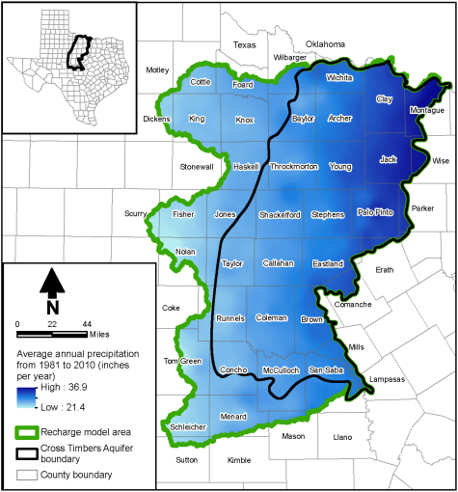
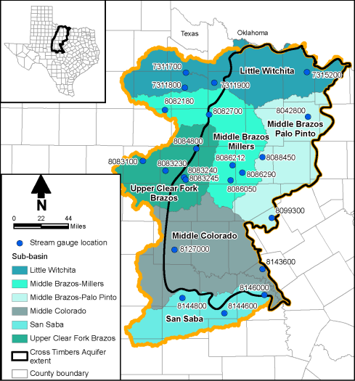
Recharge
Conceptual Model used a Distributed Parameter Watershed Model (DPWM) which will be used as an initial estimate
DPWM cells were ¼-mile by ¼-mile
Recharge is cross-formational
Conceptual Model Report for the Cross Timbers Aquifer (TWDB)

Slide 26
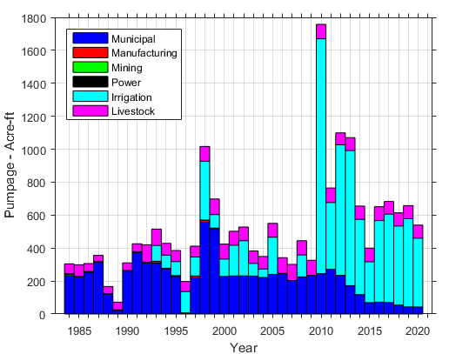
Pumpage Assessment
TWDB Water Usage Survey
Improving Estimates
Assigning Pumpage to Cross-Timbers
Not “Other” or “Unknown”
County by County Analysis
Backward – Analysis from 1984 to 1900
Spatial distribution
Across County
Create MODFLOW WEL Package

Slide 27
Model Calibration
The process of assimilating and integrating information stored as historic state observations
We will primarily use water levels and estimates of baseflow to streams
This information is transferred to the parameters, which are incrementally changed so that the model results more closely match the observations
We will use an ensemble-based calibration process

Slide 28
Model Calibration (cont.)
Observations and Weighting
Weighting – assigning an importance factor to different aspects of the historical observation dataset
Parameters and the Prior
Prior – A distribution which represents the model’s best guess and the uncertainty of the model inputs (the parameters)
We will use the Prior variance to generate an ensemble of uncalibrated hydraulic property fields which will span the range of uncertainty that exists in the properties before calibration

Slide 29
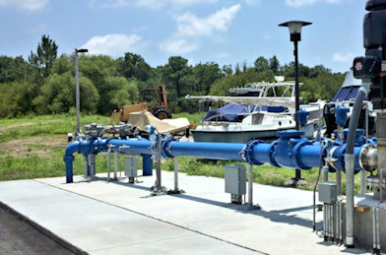
Data Request
Any un-published data to support the model
Geophysical logs
Pump Tests
Water Levels
Interpreted Properties
Structural Picks
Production Information

Slide 30
Project Timeline
 | Jan-23 | Feb-23 | Mar-23 | Apr-23 | May-23 | Jun-23 | Jul-23 | Aug-23 | Sep-23 | Oct-23 | Nov-23 | Dec-23 | Jan-24 | Feb-24 | Mar-24 | Apr-24 | May-24
Task 1: Experiment with model setup and test parameters
Task 2: Evaluate model ensembles, critical thinking/review
Task 3: Predictive simulations
Task 4: Documentation, knowledge transfer/training
Task 5: Meetings with preparation and travel

Slide 31
Contact Information
Wade Oliver, P.G.
Project Manager
832-535-5763
woliver@intera.com
Daryn Hardwick, Ph.D.
Manager of Groundwater Modeling Department
512-475-0470
daryn.hardwick@twdb.texas.gov
Web information:
http://www.twdb.texas.gov/groundwater/models/gam/cstb/cstb.asp

Slide 32
Questions?

