Slide 1
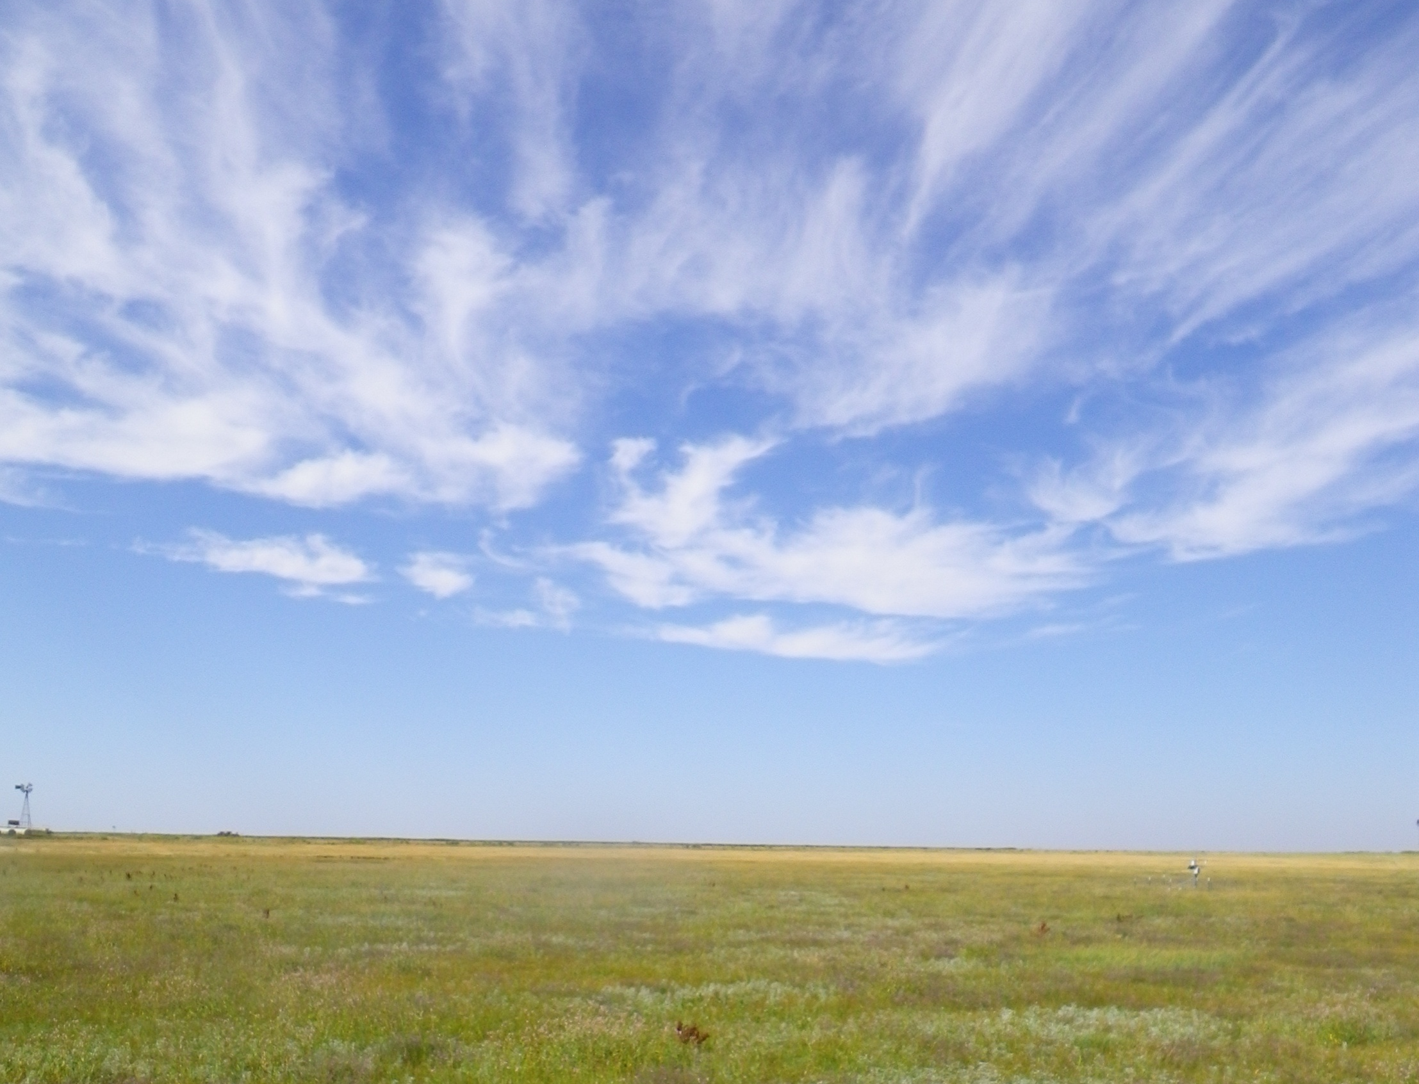
A Thousand Points of Recharge:
Can alternative management strategies increase recharge from the playa lakes of the Southern High Plains to the Ogallala Aquifer?
Preliminary results
Texas Water Development Board
USDA Agricultural Research Service
Texas Tech University
Notes:
This presentation summarizes some of the early results of the playa monitoring program being conducted by the Texas Water Development Board, in conjunction with The USDA and Texas Tech University. The current project was kicked off in 2009, with the first field site instrumented in April 2011, just as drought conditions developed across the State.

Slide 2
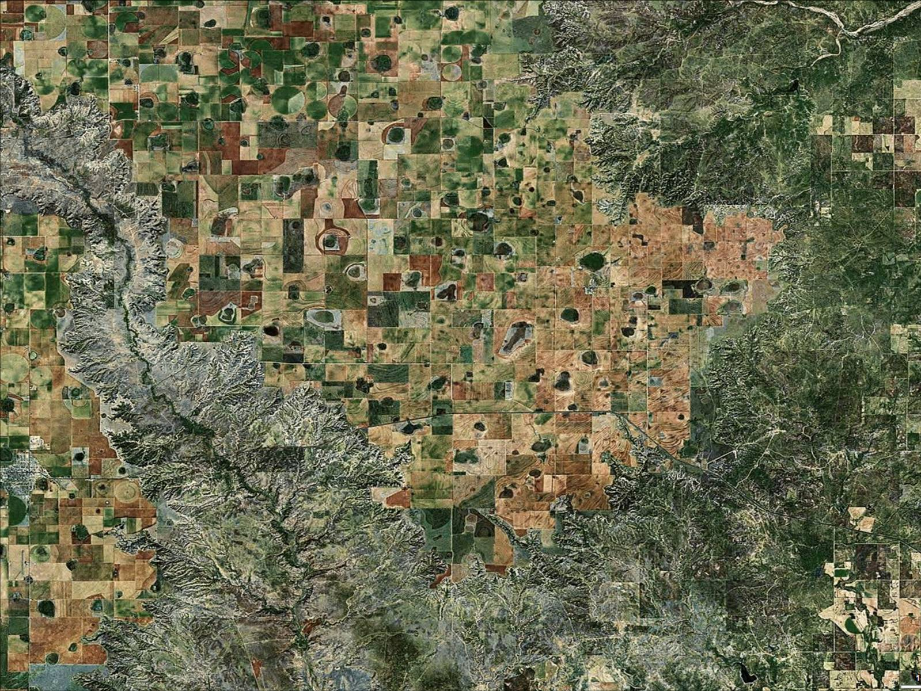
Outline
Playa geography
TWDB playa research program
Monitoring strategy
Preliminary 2012 results
Water balance issues
Conclusions
Plans for continued research
Notes:
Summary of topics to be covered in this presentation.

Slide 3
Scope of TWDB Playa Program
Research goal: develop and test alternative playa management strategies to increase recharge to the Ogallala Aquifer
  Phase 1: Monitor playas to determine overall volume of water collected and current recharge rates
  Phase 2: Modify selected playas, assess cost and performance issues
Notes:
There has been substantial drawdown of the Ogallala Aquifer in the 60 years since large-scale irrigation got started on the High Plains. Enhanced recharge isn’t going to reverse the trend regionally, but it can help prolong the useful life-span of the aquifer and may prove to be a useful water resource at the local scale. But before we start modifying any playas, we need more information on how much water they collect, how long it remains ponded, how much evaporates, and how much contributes to groundwater recharge. Likewise, we need information on the effectiveness of various modification alternatives so that we can evaluate which is best suited for particular locations, land uses, and soil types.

Slide 4
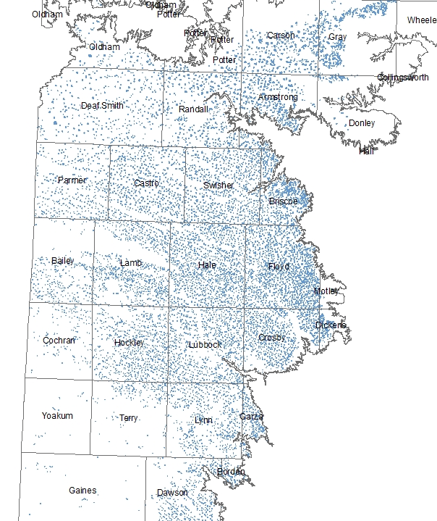
What’s a playa?
Small, internally drained wetlands
Collect runoff from 80% of High Plains land area
Over 19,000 mapped playas in Texas High Plains
Resource for migratory waterfowl
Source of recharge to Ogallala
Notes:
Playas areas are mapped primarily on the basis of the characteristic Vertic soil type present in the playa bottoms. Vertic soils have high montmorillonite clay content and strong shrink-swell response to wetting and drying cycles. Playas range in size from less than an acre to several hundred acres, but typical flood depths are less than three feet deep.

Slide 5
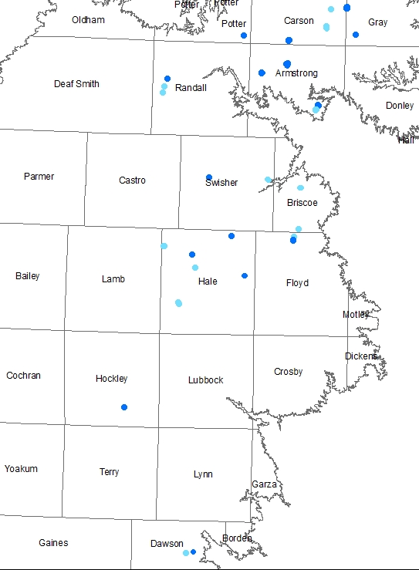
TWDB playa monitoring
17 sites with weather stations and soil moisture monitoring
16 sites with water level monitoring only
LEGEND
Met station
Water level only
Notes:
The locations of TWDB monitoring sites have been determined largely as a function of landowner interest and willingness to participate in the program. The TWDB program is active in 11 counties. The playas we are monitoring range in size from 8 to 200 acres. They average about 44 acres in size, as compared to an average of about 20 acres for all mapped playas in Texas; the smallest playas don’t hold much water and dry out quickly, making them less attractive targets for recharge modifications.
The first monitoring station was installed in April 2011, and installation continues as additional landowners sign up.
The project covers and area of about 14,000 square miles, which makes for a lot of driving!

Slide 6
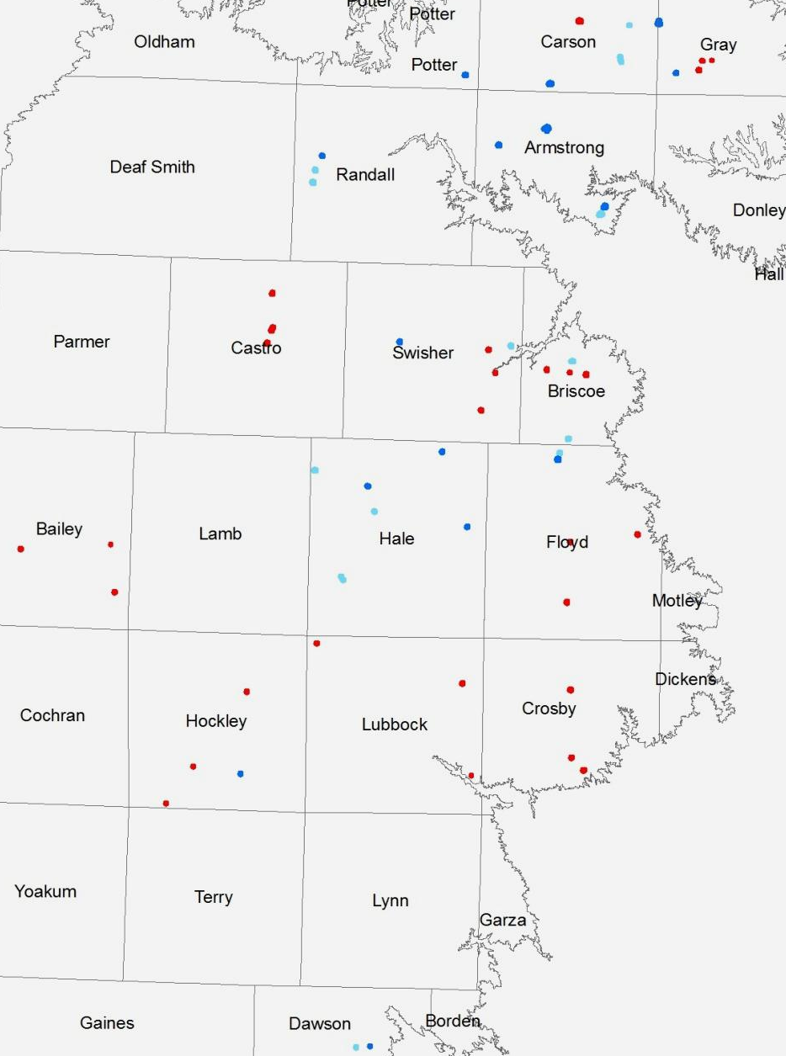
TWDB playa monitoring
17 sites with weather stations and soil moisture monitoring
16 sites with water level monitoring only
30 additional sites monitored by USDA-ARS and Texas Tech University playa project
2012 flooding in approximately one half of monitored sites
LEGEND
Met Station
Water level only
ARS-TTU site
Notes:
The ARS-TTU project design includes one playa each in crop, range, and CRP settings in ten counties.
ARS-TTU playas have been monitored since 2007.
Circles indicate areas where flooding occurred during May and June 2012.

Slide 7
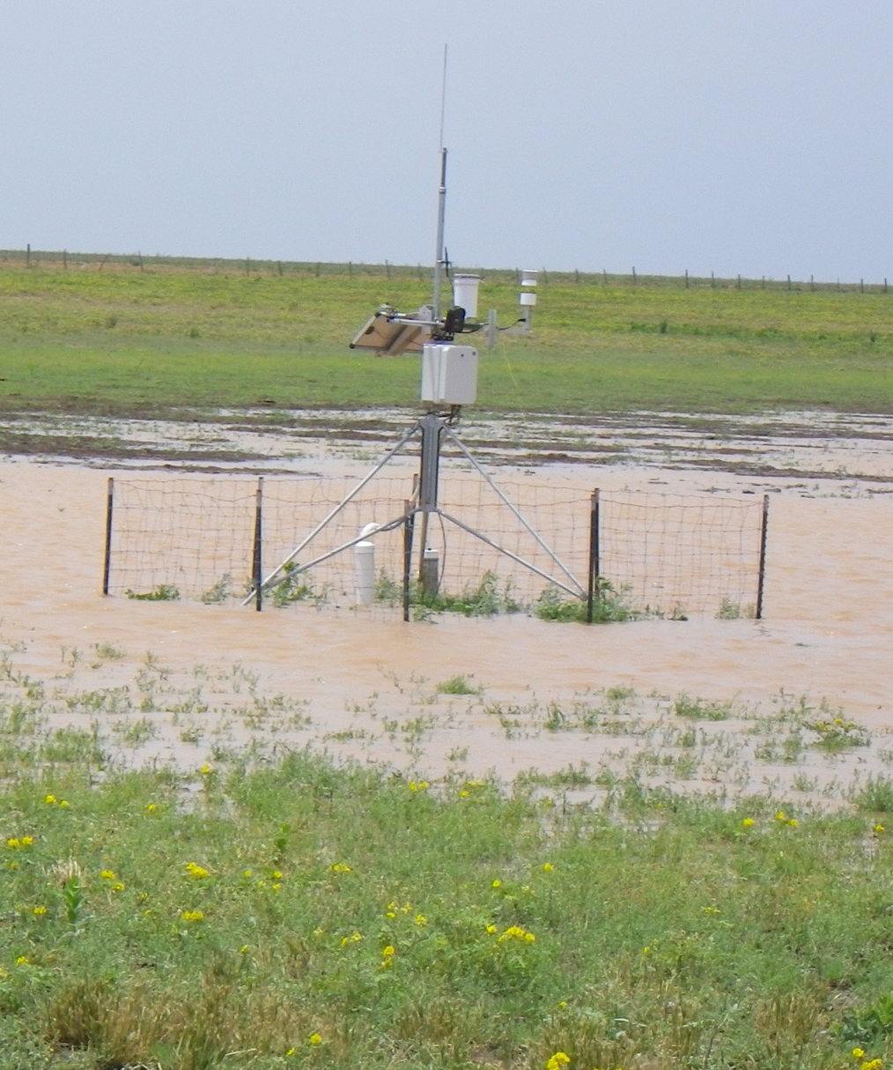
Site instrumentation
Met Station:
  temperature , wind speed, wind direction, RH, Precipitation, Solar radiation, water level, temperature, and conductivity, Subsurface soil moisture tension, Time-lapse imagery
Soil descriptions and moisture content to 20 ft +
Soil resistivity profiles at selected sites
Groundwater monitor wells at select sites
Notes:
High resolution topographic surveys also have been completed at all playas where we have adequate access.
ARS-TTU playas are monitored for generally similar parameters, but have limited capacity to measure subsurface moisture.
The monitoring strategy is to use meteorological data to calculate evaporation rates; the infiltration rate is then calculated as the difference between the observed water level drop and the evaporation rate. Changes in soil moisture content can be used to cross-check the calculated infiltration rate at the TWDB playas.

Slide 8
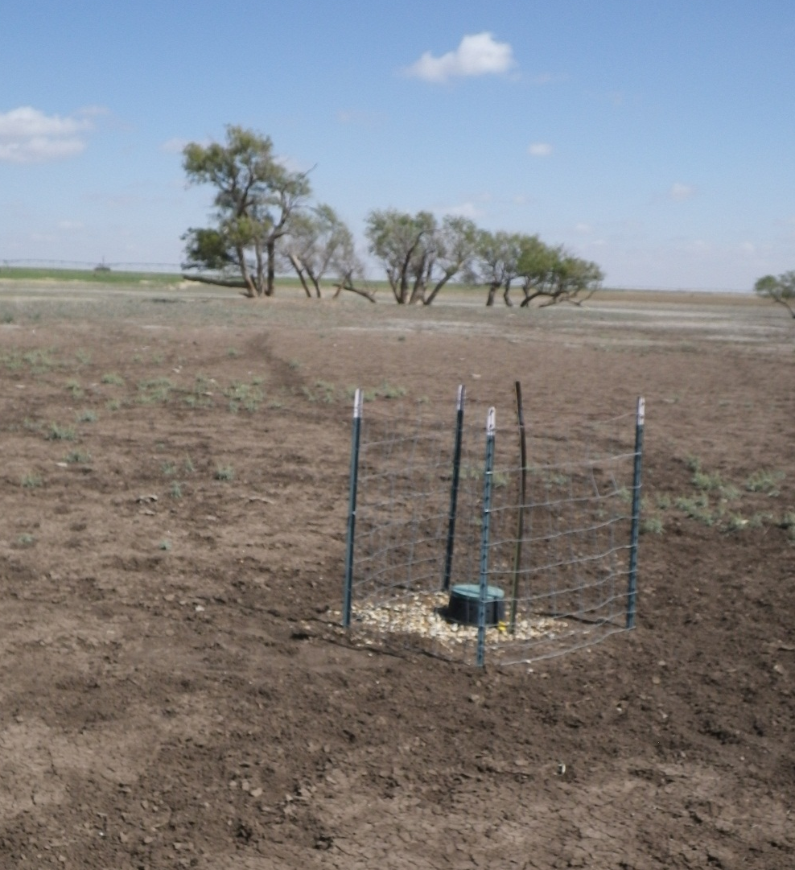
Site instrumentation
Water level only sites:
  Unvented pressure transducer/data logger
  Barometric compensation from nearest weather station
Notes:
The data from these stilling wells also shows the drop in saturation depth after surface water disappears. Additional stilling wells are planned at greater depths to track the subsurface movement of the saturation front in selected playas.

Slide 9
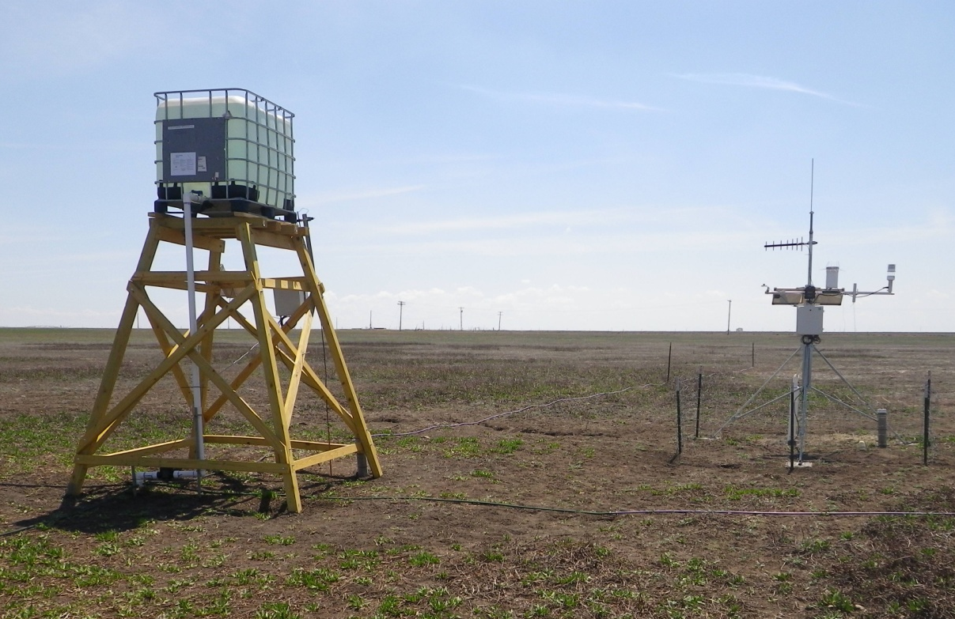
Tracer site
Calcium bromide tracer
Remote alert when water level reaches target depth
Solution diluted and dispersed through 500’ of drip hose
Surface water and lysimeter samples to detect tracer migration
Playa remains dry
Notes:
The bromide tracer test is designed to give us another way to measure water movement from the playa surface down through the soil profile and into the aquifer. The target concentration of bromide in the flood water is 20 to 30 ppm; not enough to be an issue for cattle grazing in the playa, but plenty to be detected in the lab.
Three nests of pressure-vacuum lysimeters are installed to collect soil-water samples at 5, 10, 15, and 20 feet below ground surface, and two wells are located just outside the playa to the east and west.
Surface water and lysimeter samples will be analyzed by ion chromotography on a monthly basis after the playa floods and the tracer is released.

Slide 10
Evapotranspiration data quality
Notes:
Infiltration and recharge estimates depend on accurate data for evapotranspiration, which is calculated from meteorological observations.
Left hand graphic shows 2011 ARS-Lubbock pan evaporation data and ET values calculated from a co-located met station using the Penman-Montieth equations.
The right hand graphic compares calculated ET for the ARS-Lubbock site and the calculated ET for the M. Harrell playa, near Plainview. Differences in environmental settings (urban vs. rural, open ground vs. depression, etc.) probably account for most of the differences. Instrumental error may also contribute.

Slide 11
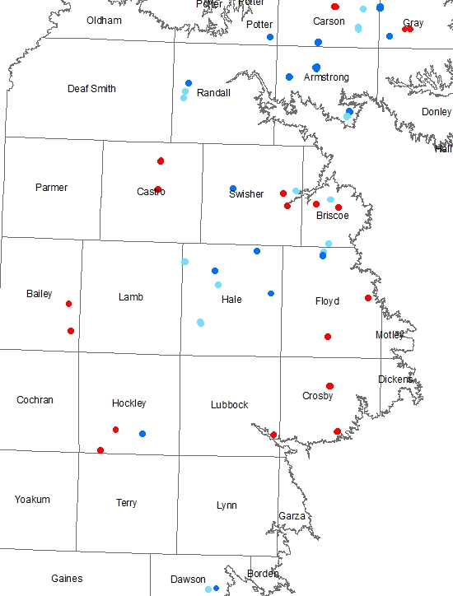
2012 Monitoring
Areas of flooding
Hockley CO
Hale CO
Hale County
Hockley County
LEGEND
Met Station
Water level only
ARS-TTU site
Notes:
During the 2011 drought, virtually all the playas were dry. 2012 was also drier than normal, but playas in Randall, Armstrong, Hale, Hockley, and Dawson Counties were flooded by early summer storms. The following slides provide a quick tour of the results from two of these areas, including geographic setting, basin topography, water level and evaporation, and soil moisture data.

Slide 12
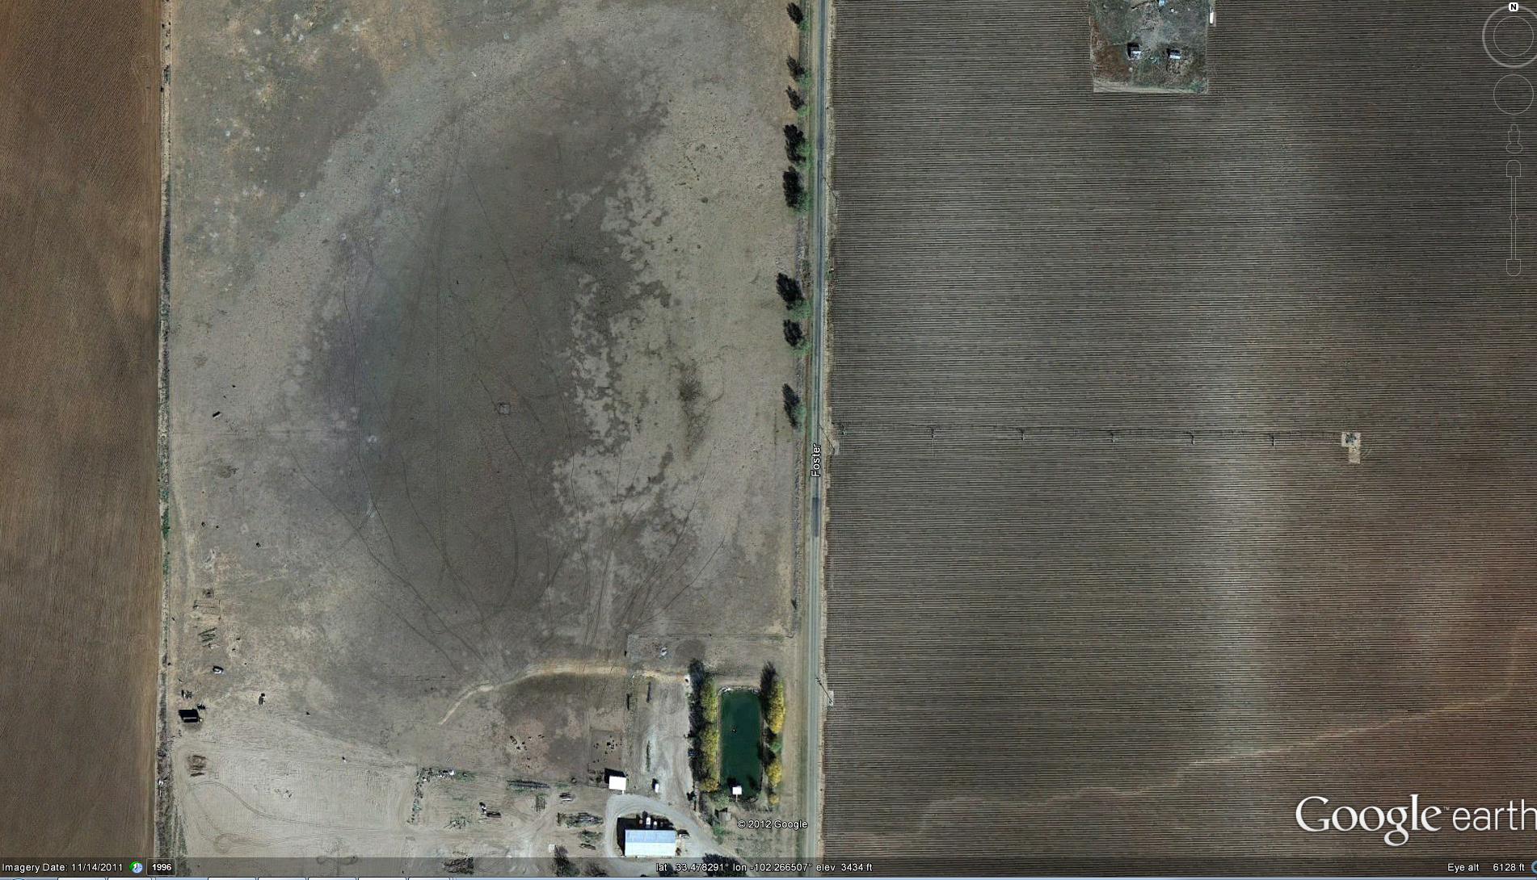
2012 monitoring data
Hockley County, Myatt playa
Notes:
This is a 26 acre playa in central Hockley County, about 30 miles SW of Lubbock.
It is lightly-grazed range-land, with irrigated crops in the watershed.
The yellow star marks the location of the monitoring station.

Slide 13
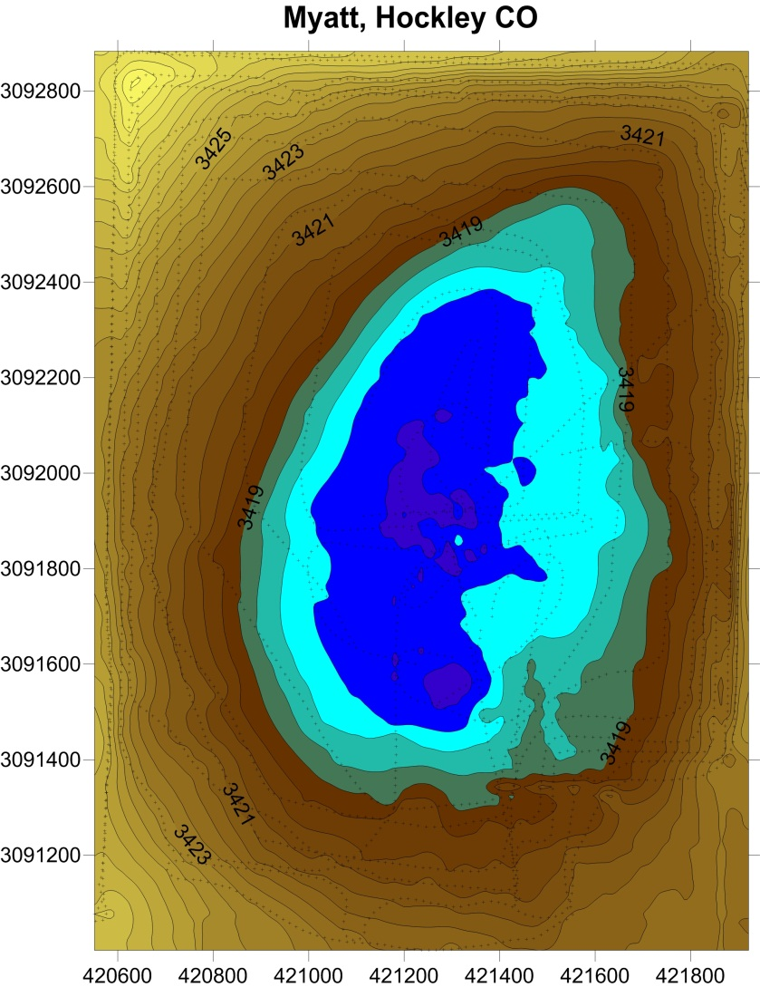
2012 monitoring data
Hockley County, Myatt playa
Notes:
Water flows into this playa from the road bounding the playa to the east. Sediment transported by the floodwaters has built up a delta structure on much of the eastern side of the playa.

Slide 14
2012 monitoring data
Hockley County, Myatt playa
 | WL drop, mm/day | Evaporation, mm/day | Infiltration, mm/day
Initial | 28.95 | 12.36 | 16.59
Late May | 15.20 | 12.95 | 2.15
June - July | 15.44 | 10.13 | 5.31
Notes:
This graphic compares measured water levels (in blue) and calculated water levels if evaporation were the only route of water loss. Infiltration is represented by the vertical distance between the two lines.
Several storm events maintained flooded conditions in the Myatt playa for three months through the summer of 2012.
The initial storm dropped over 40 mm of rain, with 35.8 mm in one hour.
During the first week of inundation in May the infiltration averaged nearly 17 mm/day, but declined to just over 5 mm/day in July.
The red arrows along the date axis correspond to the three time periods shown in the data table.

Slide 15
2012 monitoring data
Hockley County, Myatt playa
Notes:
The soil moisture potential gradient helps explain the changing infiltration rates observed in the Myatt playa. Infiltration can only occur when there is a downward gradient in moisture potential, i.e. when the blue line showing moisture potential at the 4 foot depth is above the red line showing moisture potential at the 8 foot depth. The soil moisture sensor at 4 feet depth initially saturates as the playa floodwater enters open cracks in the clay soil. The cracks quickly swell shut, limiting further infiltration, so that the moisture at the 4-foot depth re-equilibrates with the dry soil around the cracks and goes back below the moisture potential at 8 feet depth for a period of about 2 months. Around June 23 the bulk soil wetting front reaches the 4 foot depth and by early July the moisture potential at 4 feet moves above the moisture potential at 8 feet, and re-establishing a downward gradient of soil moisture tension and allowing soil moisture to move through the profile again.

Slide 16
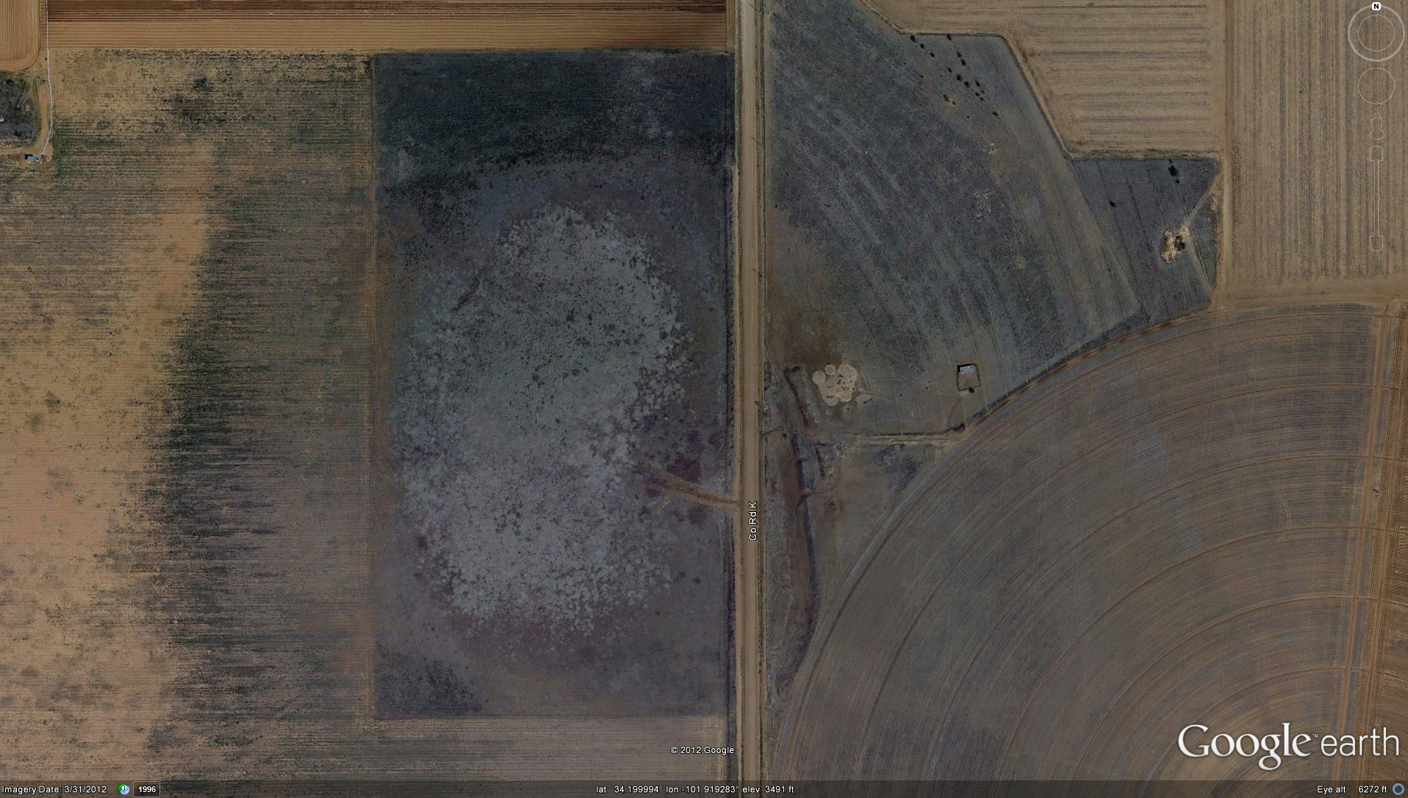
2012 monitoring data
Hale County, M. Harrell playa
Notes:
The M. Harrell site is a 20 acre playa with lightly grazed native vegetation in the playa bottom and irrigated crop land in the watershed.
The yellow star indicates the monitoring station location.

Slide 17
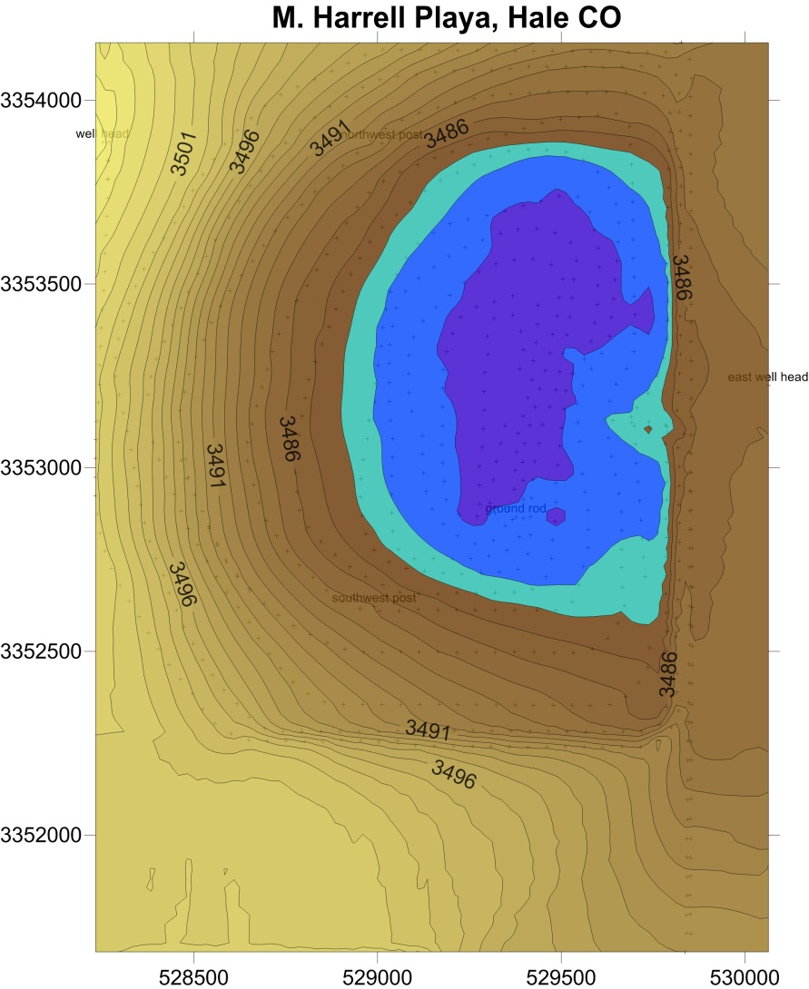
2012 monitoring data
Hale County, M. Harrell playa
Notes:
The approximate extent of the 2012 flooding is shown in dark blue.

Slide 18
2012 monitoring data
Hale County playas
 | WL drop, mm/day | Evaporation, mm/day | Infiltration, mm/day
M. Harrell | 12.48 | 11.62 | 0.80
Reiff 1 | 11.56 | 11.62 | -0.06
Reiff 2 | 12.11 | 11.62 | 0.49
B. Harrell | 36.88 | 11.62 | 25.26
Notes:
This graphic shows water levels for several Hale County playas together with evaporation calculated for the M. Harrell site. Over 90 percent of the ponded water in the M. Harrell playa was lost to evaporation. The estimated evaporation rate at the M. Harrell location slightly exceeded the measured water level decline at the two Rieff playas, about 30 miles SW of the M. Harrell playa. The only Hale County playa with a substantial infiltration rate is the B. Harrell playa, which had an average estimated infiltration rate of over 25 mm/day, with much higher rates during the first few days after flooding. The B. Harrell playa lies on a wet-weather drainage of interconnected playas, and may be underlain by sandier materials than the other Hale County playas, which are not connected to other wetland areas.

Slide 19
2012 monitoring data
Hale County, M. Harrell playa
Water balance and soil moisture changes
Post-flood core samples at 0 to 8 ft depth average 11.25% moisture gain by weight
Represents over 60 cm of water held in near-surface soil
But estimated infiltration is less than 10% of this amount
What gives?
Preceding rainfall/runoff that does not produce ponding?
Rapid initial infiltration?
clay
v. fine sand
silty clay
silty sand
Soil Type
Notes:
Soil core samples were collected at three times in the M. Harrell playa. Pre-flooding samples, shown in red and blue, match fairly closely except for the progressive drying of the shallowest soils during the 2011 drought. Post flood (green) soil moisture gains are equivalent to the entire two foot flood depth recorded at the M. Harrell playa, however the evaporation rate estimates suggests that over 90 percent of the ponded water evaporated.
Rainfall records and soil moisture sensors indicate little or no runoff into playa in the months between July 2011 and the June 2012 flooding.
Rapid infiltration by initial stormwater runoff, before flooding occurs, appears to be the best explanation for the discrepancy in the measured water budget.

Slide 20
Flood sequence details
2012 monitoring data
Hale County, M. Harrell playa
Notes:
The detailed records for rainfall, water level, and soil moisture during the June 2012 flood event show that the soil moisture at a 3 foot depth starts to increase within minutes in response to heavy rainfall (dashed line). The 3 foot soil moisture increases to saturation within 2 hours, before surface water begins to pond. The surface water level increases more slowly, stabilizing after about 8 hours. The soil moisture at a 6 foot depth starts to increase slowly within hours of the storm event, and then increase more rapidly about the same time that the surface water depth reaches it maximum.
It appears that a large volume of water is taken up by the near-surface soil as storm runoff flows into the dry playa basin. This water volume is not measured by the water level sensor and is not reflected in the water balance estimates used to determine infiltration and recharge, but may represent a significant fraction of the overall water budget.

Slide 21
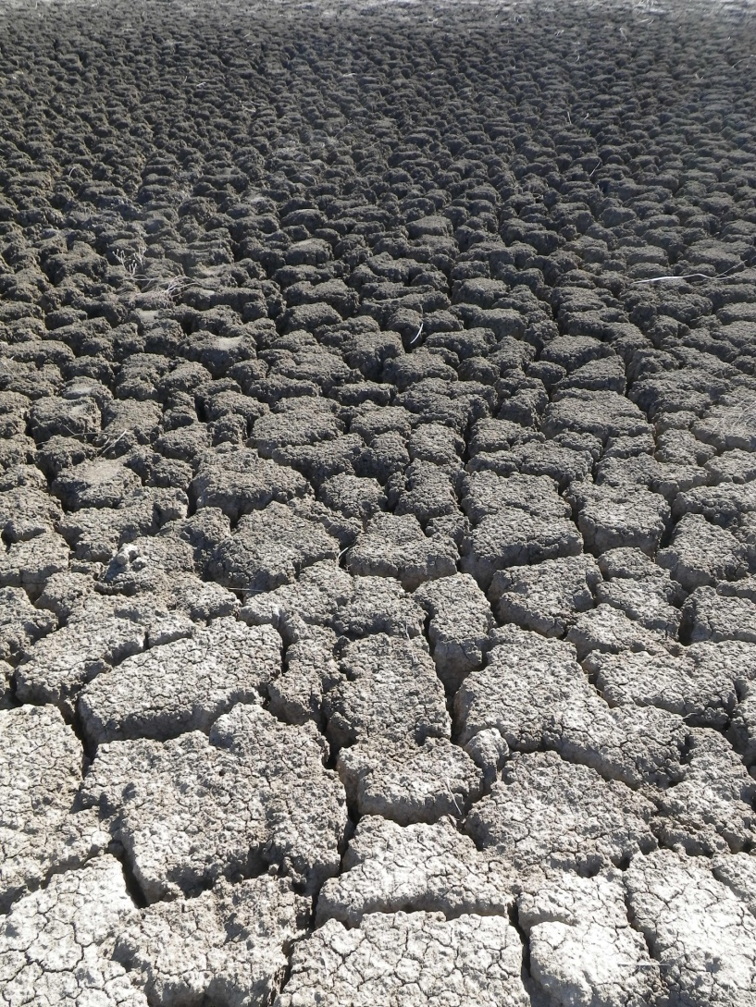
Summary of 2012 findings
Most ponded water evaporates
Rapid initial infiltration in a few playas
Large volumes of water infiltrate prior to ponding, complicating water balance
Notes:
The large, deep desiccation cracks shown in the photo illustrate how large amounts of water can rapidly enter the soil profile. Ponding does not occur until the cracks are filled. New monitoring techniques are needed to reliably measure this part of the water budget. Because there are not well defined drainages entering most playas it is not practical to measure runoff volume directly. Soil moisture sensors typically respond to a very small volume of soil, so that readings are biased depending on how close the sensor is to open cracks in the soil.

Slide 22
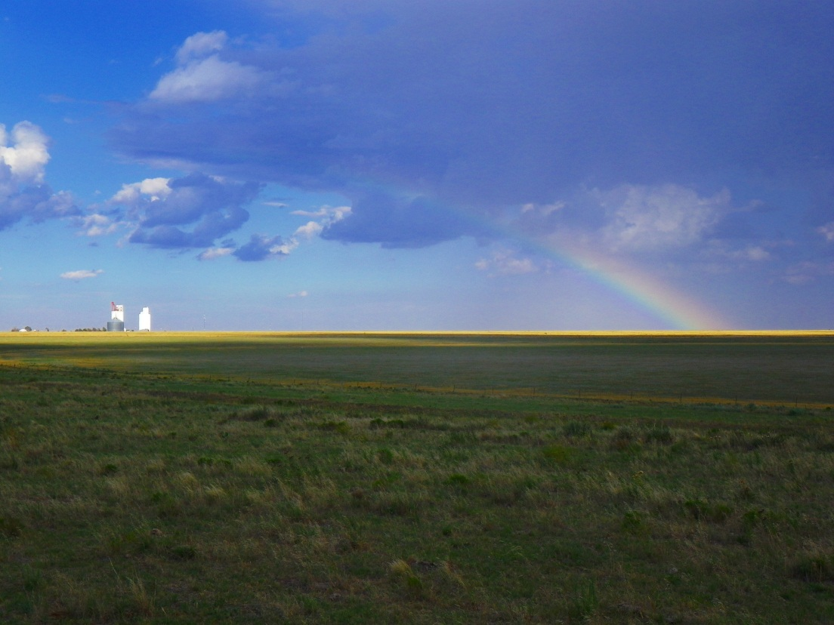
Coming attractions…
Continued monitoring
Modeling
Additional soil moisture sensors?
Tracer study?
Playa behavior in wetter years?
Implications for playa modification?
Notes:
Continued monitoring will help put 2012 results in context with the regions’ climatic variability – in wetter years the volume of water going into initially wetting playa soils will be relatively smaller.
More data on soil moisture is clearly needed. Getting quantitative results at appropriate temporal and spatial scales is going to be a challenge. Unsaturated zone models will help resolve some of these issues.
And the tracer study is set up and waiting on the rains…
We are starting to screen ideas for playa modifications that could be tested with models and in the field.

Slide 23
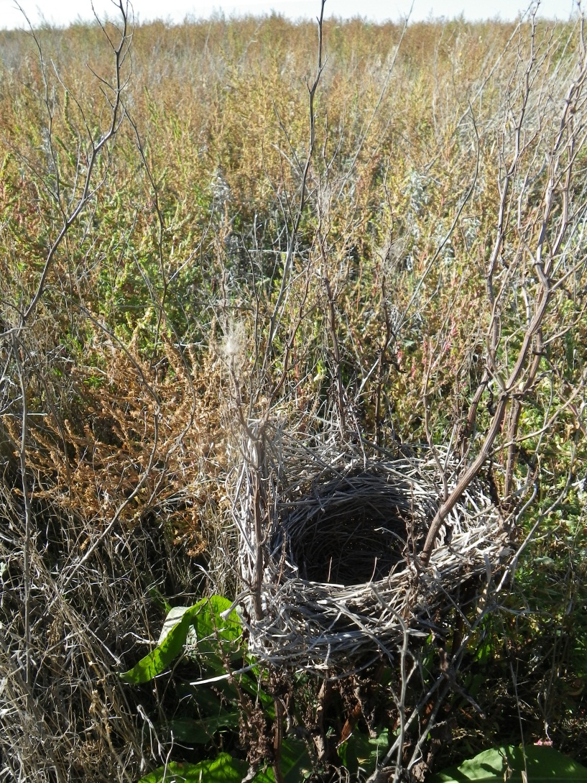
Questions?
Contacts:
Andrew Weinberg
Texas Water Development Board
Andrew.weinberg@twdb.texas.gov
512-463-3210
Dennis Gitz
USDA/ARS – Lubbock
dennis.gitz@ars.usda.gov
806-723 5232
Ken Rainwater
Texas Tech University/ Water Resources Center
ken.rainwater@ttu.edu
806-742-3490

