Slide 1
Water conservation PLAN
A How-to Guide for submitting a

Slide 2
WHO IS REQUIRED TO SUBMIT?
Entities required to submit a Water Conservation Plan are:
Those with financial assistance of more than $500,000 from the Texas Water Development Board.
Those with 3,300 or more retail service connections.
Those with a non-irrigation surface water right of 1,000 ac/ft or more from the Texas Commission on Environmental Quality.
Those with an irrigation surface water right of 10,000 ac/ft or more from the Texas Commission on Environmental Quality.

Slide 3
What are you required to submit?
A Water Conservation Plan (WCP)
A Utility Profile (UP)
A Drought Contingency Plan (DCP)
A Water Conservation Plan Annual Report (AR)

Slide 4
Water conservation plan (WCP)
Is a strategy for:
Reducing the consumption of water
Reducing the loss of water
Improving the efficiency of the use of water
Increasing the reuse of water
Contains Best Management Practices (BMPs) to meet identified targets and goals.
Be as detailed as possible about implemented BMPs.
Should be reviewed and updated every 5 years.

Slide 5
Utility profile (UP)
The UP is the first step in developing your WCP.
It ensures important information and data is considered when preparing your plan.
Helps you evaluate your water and wastewater system to identify potential targets and goals for water conservation.
Should be reviewed and updated every 5 years when you update your WCP.

Slide 6
Drought contingency plan (DCP)
Is a strategy for responding to temporary water supply shortages.
Must include quantified and specific targets for water reduction during a water shortage.
Should be reviewed and updated every 5 years.
Can be part of your WCP.

Slide 7
Annual report (AR)
Details progress in the implementation of the minimum requirements of your WCP.
Is submitted annually by May 1st.
To access the online reporting program, visit the Texas Water Development Board Water Conservation Plan Annual Report Web site.

Slide 8
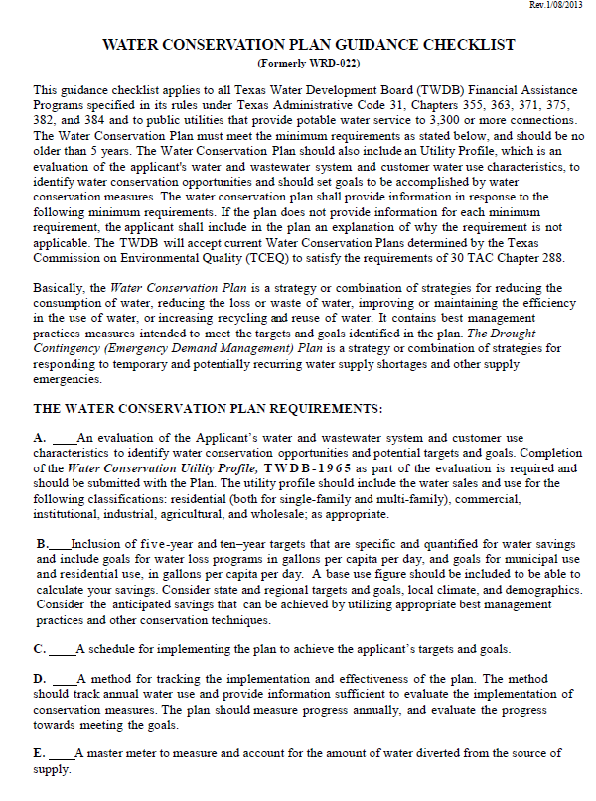
Water conservation plan checklist
Use the checklist as a guide for making sure all required elements are included in your Water Conservation Plan.
Access the checklist at www.twdb.texas.gov/conservation/municipal/plans/doc/WCPChecklist.pdf.
The first Water Conservation Plan requirement is to complete a Utility Profile.

Slide 9
Utility profile
The Utility Profile should be submitted in the Water Loss, Use, and Conservation (LUC) online reporting program.
The online program will help streamline the process by auto-populating pertinent historic data we may have on file.

Slide 10
Utility profile continued
Section IA asks for population and service area data.

Slide 11
Utility profile continued
Section IB asks for system input data.
Many of the cells in this document have auto-calculating fields which aides the user with data input.

Slide 12
Utility profile continued
Section II (A-H) asks for system data.
This includes previous five years’ data on connection counts, gallons of retail water sold by customer category, GPCD, gallons of retail water sold by month, & water loss.
If we have previous reports on file, some of this data may be auto-populated.

Slide 13
Utility profile continued
Section III should be filled out by entities who provide wastewater.
If you do not provide wastewater then you are finished with the Utility Profile.

Slide 14
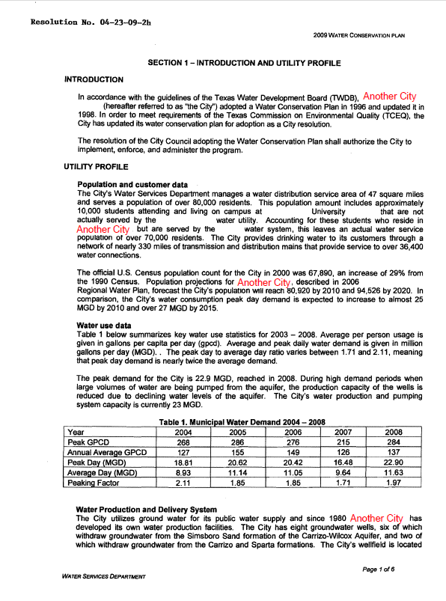
Water conservation plan requirements
Not only do you need to submit a Utility Profile, you should also provide a summary of the Utility Profile within the body of your Water Conservation Plan .
Utility Profile Summary

Slide 15
Water conservation plan checklist
The second requirement is the inclusion of 5- and 10-year targets and goals for total GPCD, residential GPCD (if applicable), and water loss.

Slide 16
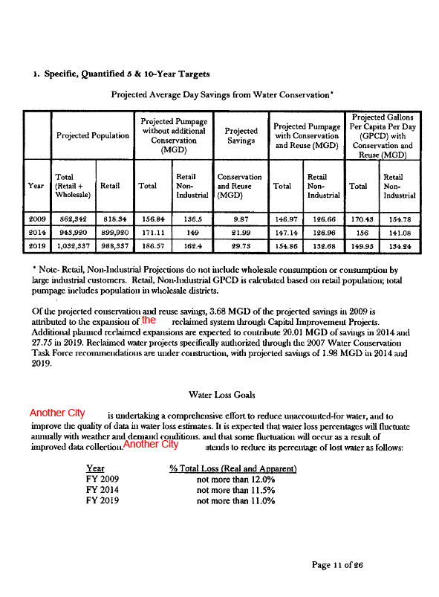
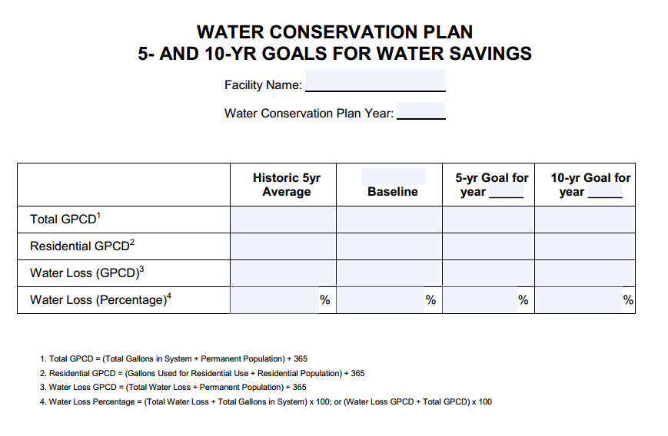
5- and 10-year targets and goals
Targets and goals can be shown in many ways as in the example provided on the right or by using the table below. You can access the Goals Table here.

Slide 17
Water conservation plan checklist
The third requirement is the inclusion of a schedule for implementing your WCP.

Slide 18
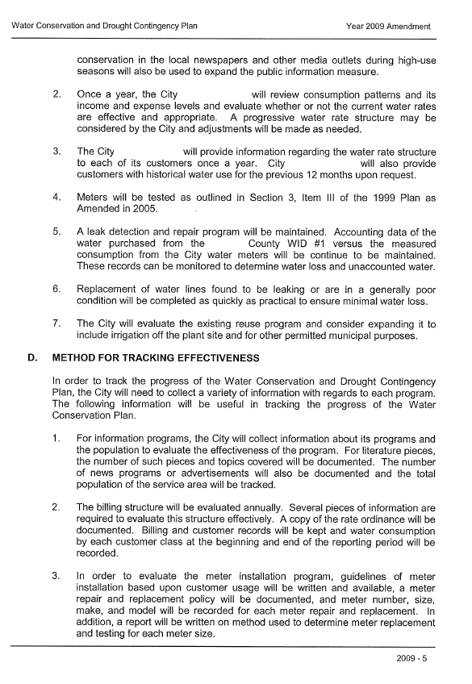
Implementation schedule
The implementation schedule can be in phases based on your activities or BMPs.
Implementation schedule

Slide 19
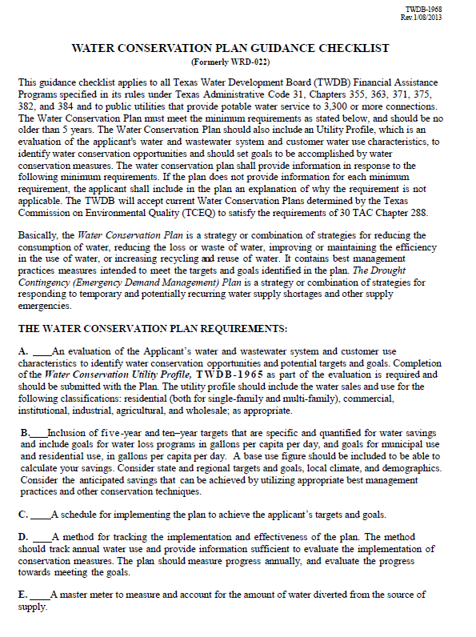
Water conservation plan checklist
The fourth requirement is a method for tracking the effectiveness of your WCP.

Slide 20
Method for tracking effectiveness
This method should relate to the conservation activities of the established targets and goals.
Tracking method

Slide 21
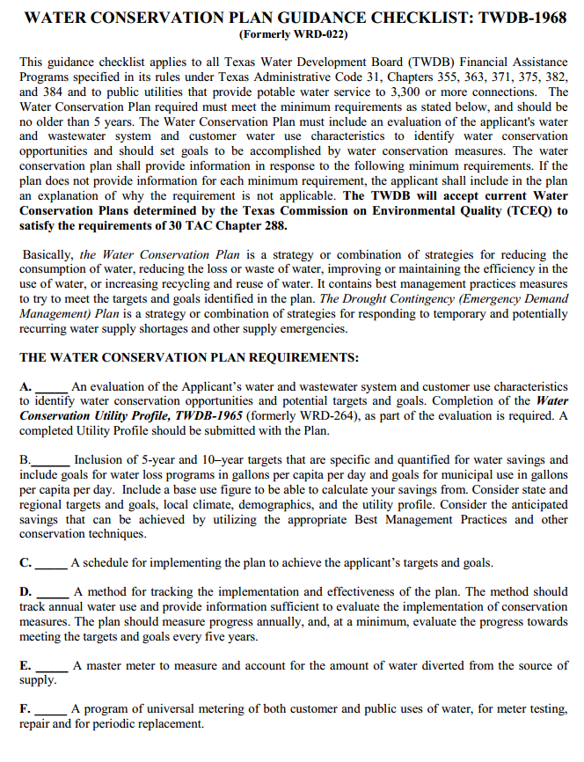
Water conservation plan checklist
The fifth requirement is to describe the master meter and account for water diverted from the source of supply.

Slide 22
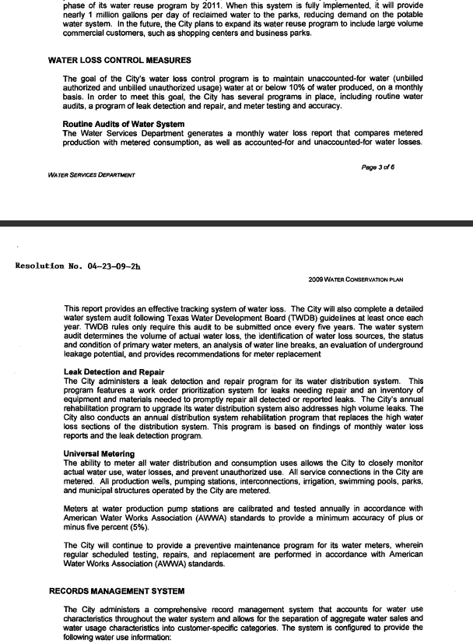
Master meter
Description of how water diverted from source supply is tracked using a master metering system.

Slide 23
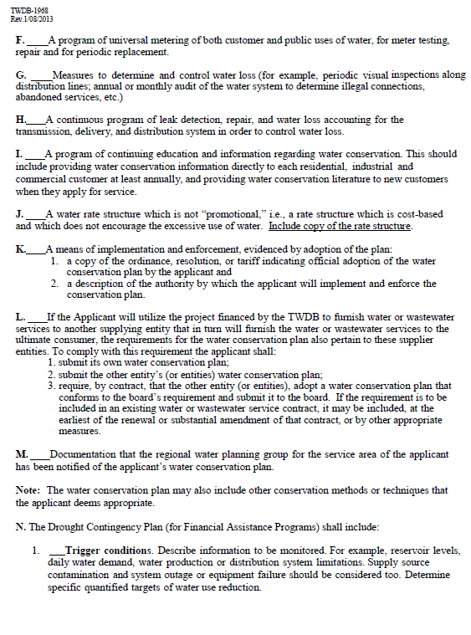
Water conservation plan checklist
The sixth requirement is to describe the universal metering system.

Slide 24
Universal metering system
Description of universal metering system

Slide 25
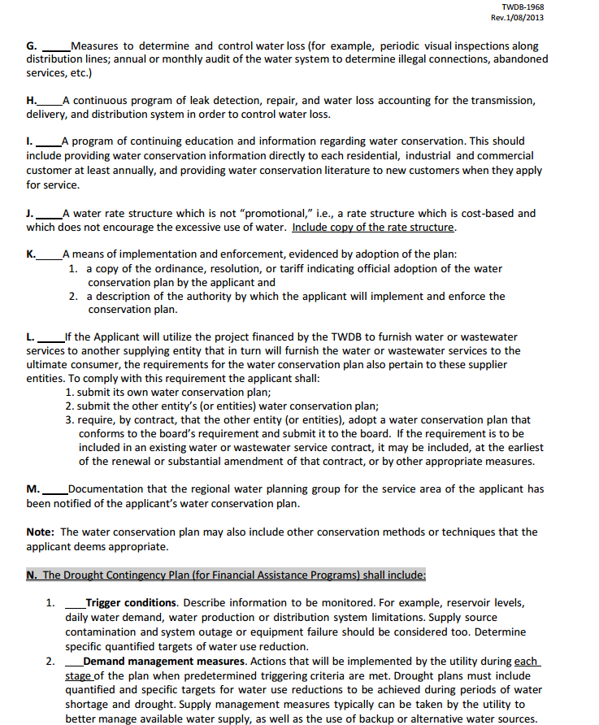
Water conservation plan checklist
The seventh requirement is to describe the measures used to control water loss.

Slide 26
Water loss control measures
Description of measures to control water loss

Slide 27
Water conservation plan checklist
The eighth requirement is the inclusion of a leak detection program to control water loss.

Slide 28
Leak detection program
Description of a leak detection and repair program

Slide 29
Water conservation plan checklist
The ninth requirement is the inclusion of a continuing education program on water conservation.
Public (and school) education is the easiest and most cost-effective way of addressing water conservation.

Slide 30
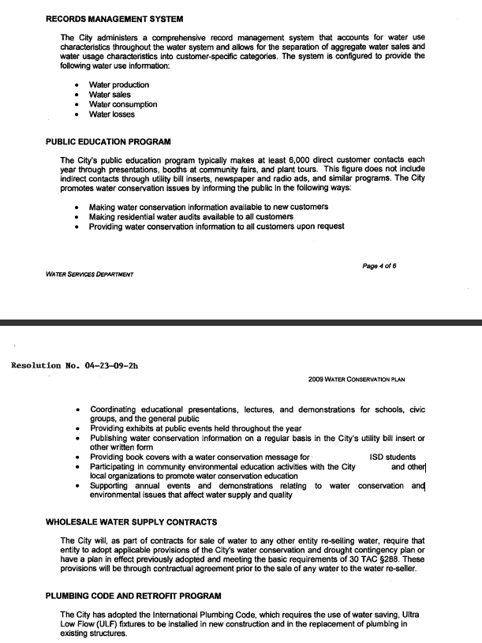
Education program
Description of water conservation education program. Many educational programs include outreach, public information, and school programs.

Slide 31
Water conservation plan checklist
The tenth requirement is the inclusion of a rate structure that is not promotional.
An example of this is the use of an inclining block rate, so when the customer uses more water they are charged more money.
A copy of your current rate structure should be included with your Plan.

Slide 32
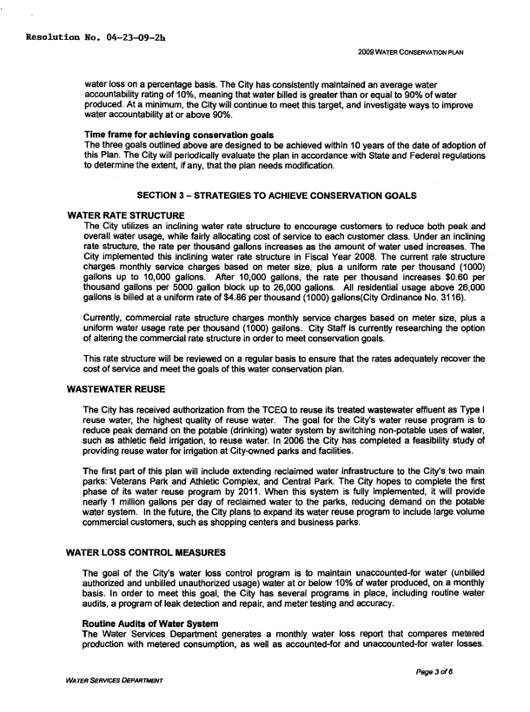
RATE STRUCTURE
Water rate structure

Slide 33
Water conservation plan checklist
The eleventh requirement is to describe the means of implementation and enforcement of your Plan by official adoption, along with the description of the authority implementing and enforcing your Plan.
This may be shown with an attachment of an ordinance, resolution, or tariff in your Plan.

Slide 34
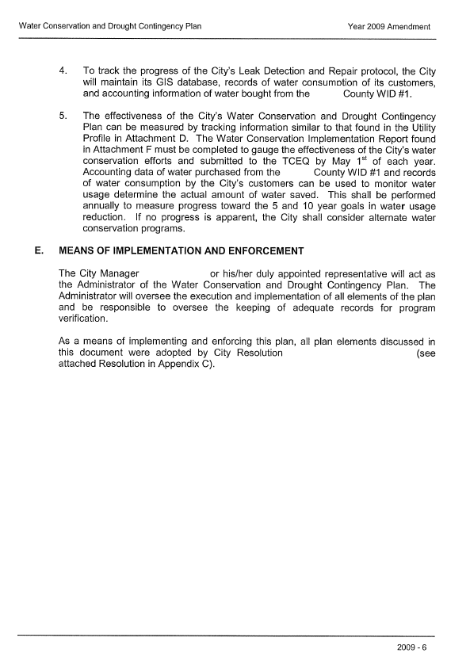
Means of implementation and enforcement
Means of implementation and enforcement

Slide 35
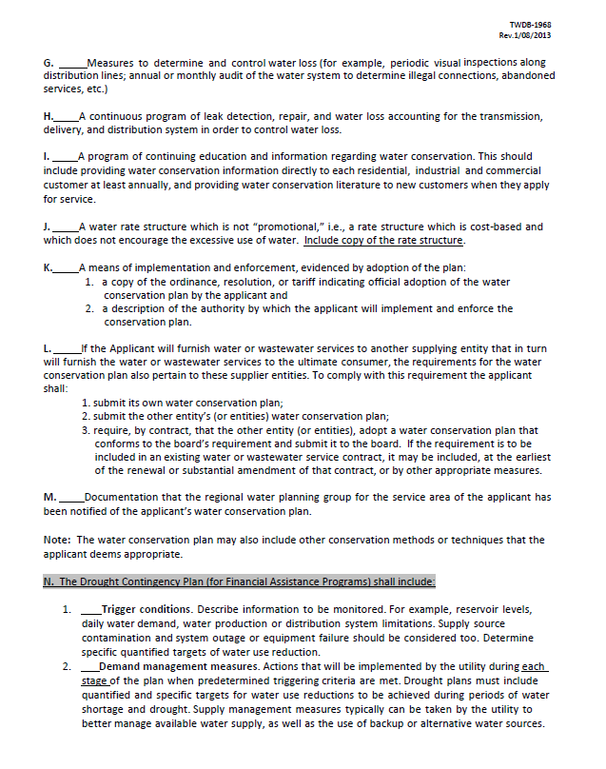
Water conservation plan checklist
The twelfth requirement is for entities who supply water to other retail providers via a wholesale contract.
Water Conservation Plan requirements also apply to the supplier entities.

Slide 36
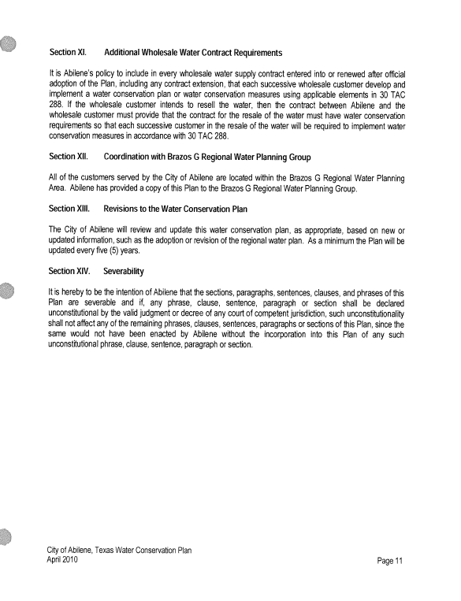
WHOLESALE CONTRACTS
Each successive wholesale customer must develop and implement a WCP or utilize water conservation measures.
If the wholesale entity receives financial assistance from TWDB, they must also submit their wholesale customers’ WCPs to TWDB.
Wholesale contracts

Slide 37
Water conservation plan checklist
The thirteenth requirement is the inclusion of notification to the Regional Water Planning Group.

Slide 38
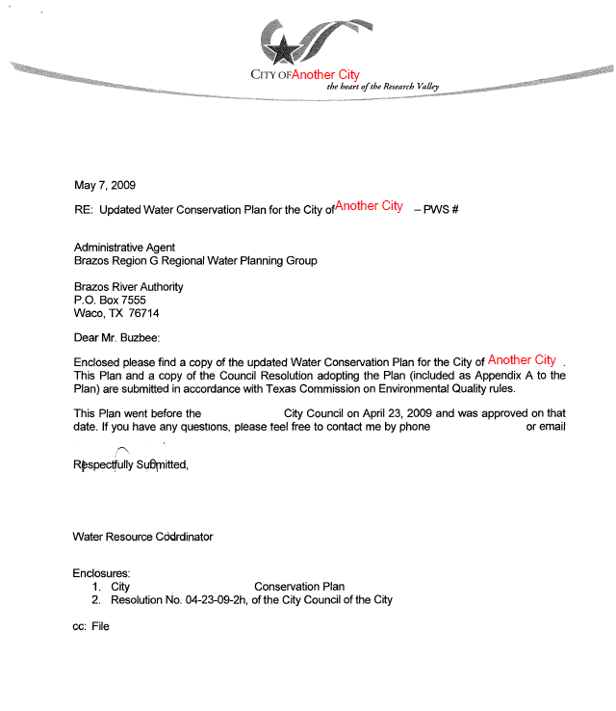
Regional water planning group notification
A copy of the letter notifying your Regional Planning Group (RPG) of adoption of your Plan should be included.

Slide 39
Water conservation plan checklist
The fourteenth requirement is the inclusion of your Drought Contingency Plan if you receive financial assistance from TWDB.
The DCP must include the following:

Slide 40
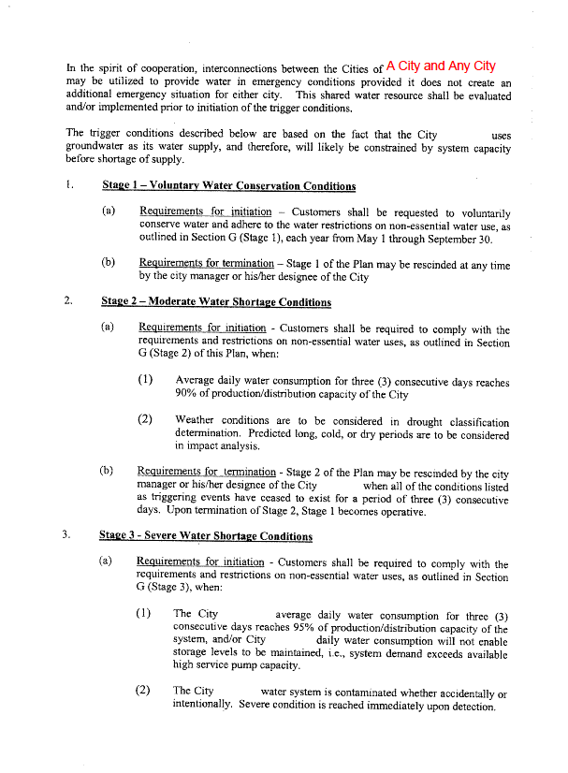
Drought contingency plan (DCP)
Trigger conditions that outline what will cause the DCP to be activated. Some examples are supply source contamination, system outages, and low reservoir levels.

Slide 41
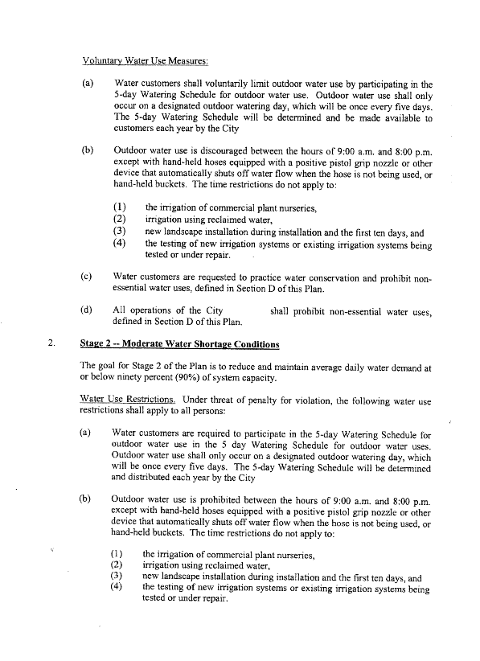
Drought contingency plan (DCP)
Demand management measures that refer to actions to be taken at each stage of the DCP that include quantified and specific targets for water use reduction.

Slide 42
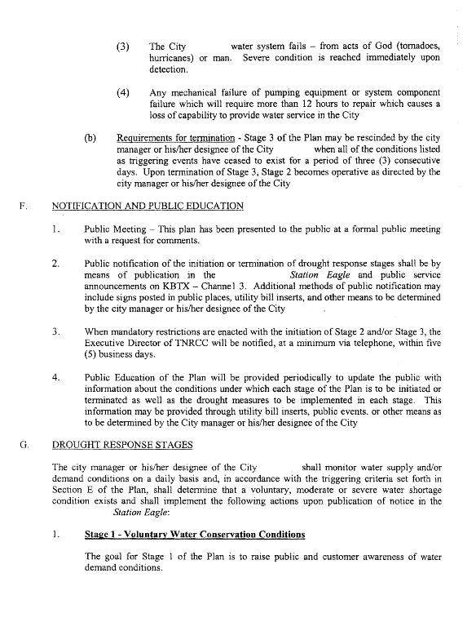
Drought contingency plan (DCP)
Initiation and termination procedures of each stage, including public notification.

Slide 43
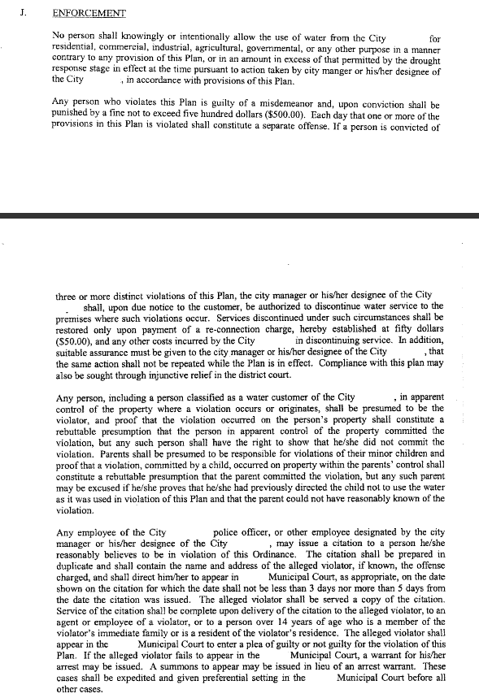
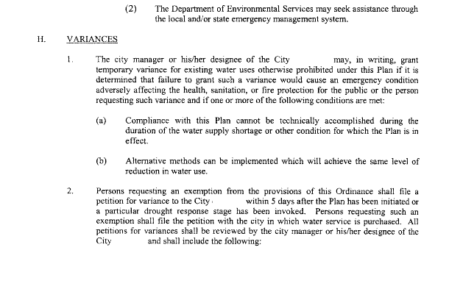
Drought contingency plan (DCP)
Specific variances and enforcement in the DCP.

Slide 44
Drought contingency plan (DCP)
Measures to inform and educate the public on the preparation of the DCP.

Slide 45
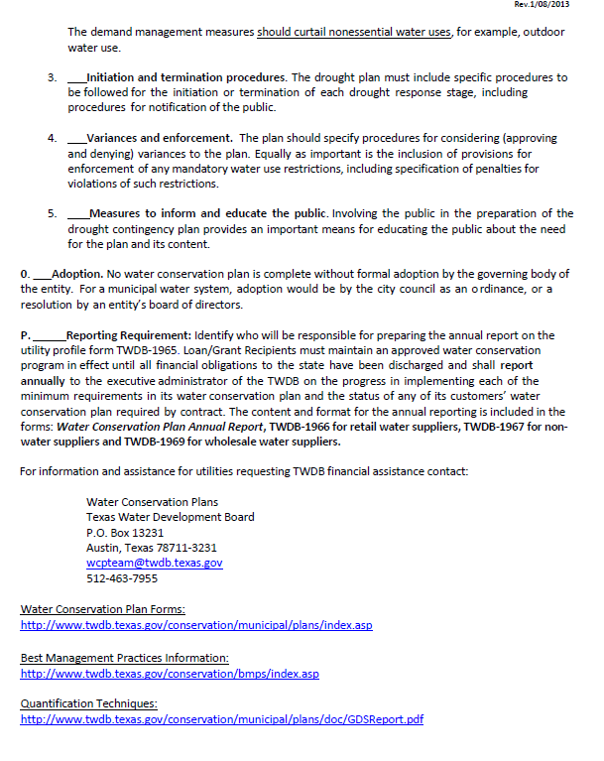
Water conservation plan checklist
The fifteenth requirement is the inclusion of an official adoption of your Plan.

Slide 46
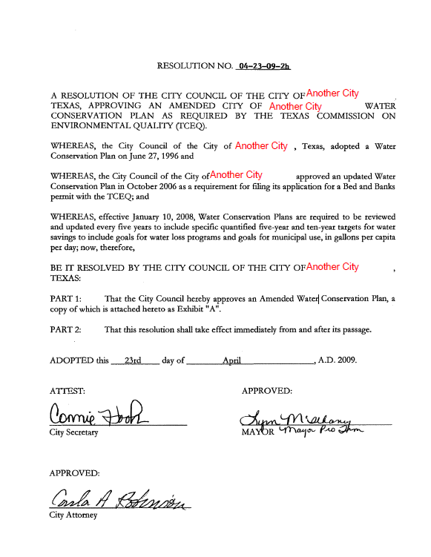
Plan Adoption
Your Plan is not complete unless a signed copy of the official adoption is included.

Slide 47
Water conservation plan checklist
The final requirement is to report annually on the effectiveness of your Plan by submitting a Water Conservation Plan Annual Report every year.

Slide 48
ANNUAL REPORT
The Annual Report (AR) is due May 1st of every year.
The AR should be submitted using the online reporting program.
You can access the system by visiting the Water Conservation Plan Annual Reports webpage.

Slide 49
Water conservation plan
Once your Plan is submitted, TWDB staff will review your Plan for completeness.
Additional comments or questions should be directed to wcpteam@twdb.texas.gov.

Slide 50
TWDB Municipal: 512-463-7955
For additional help, contact:

