Slide 1


Estimating Agricultural Irrigation
Agricultural Water Conservation Department
Texas Water Development Board
December 2025
The following presentation is within the scope of the Texas Water Development Board’s statutory responsibilities and priorities but, unless specifically noted, does not necessarily reflect official Board positions or decisions.

Slide 2
What we’ll talk about
Introduction
Review history
Summary of recent estimates
Methodology
Upcoming changes

Slide 3
Introduction
The Texas Water Development Board (TWDB) is responsible for planning and financially assisting the development and management of water resources in Texas
The state water plan includes future water demand and supply projections for irrigation and livestock water use sectors
TWDB staff estimate agricultural irrigation water use for every county annually
TWDB does not have authority to require producers to report actual water use, instead multiple data sources are collated

Slide 4
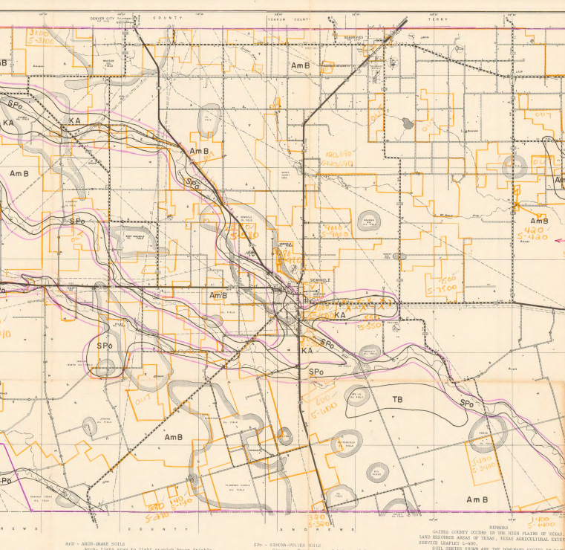
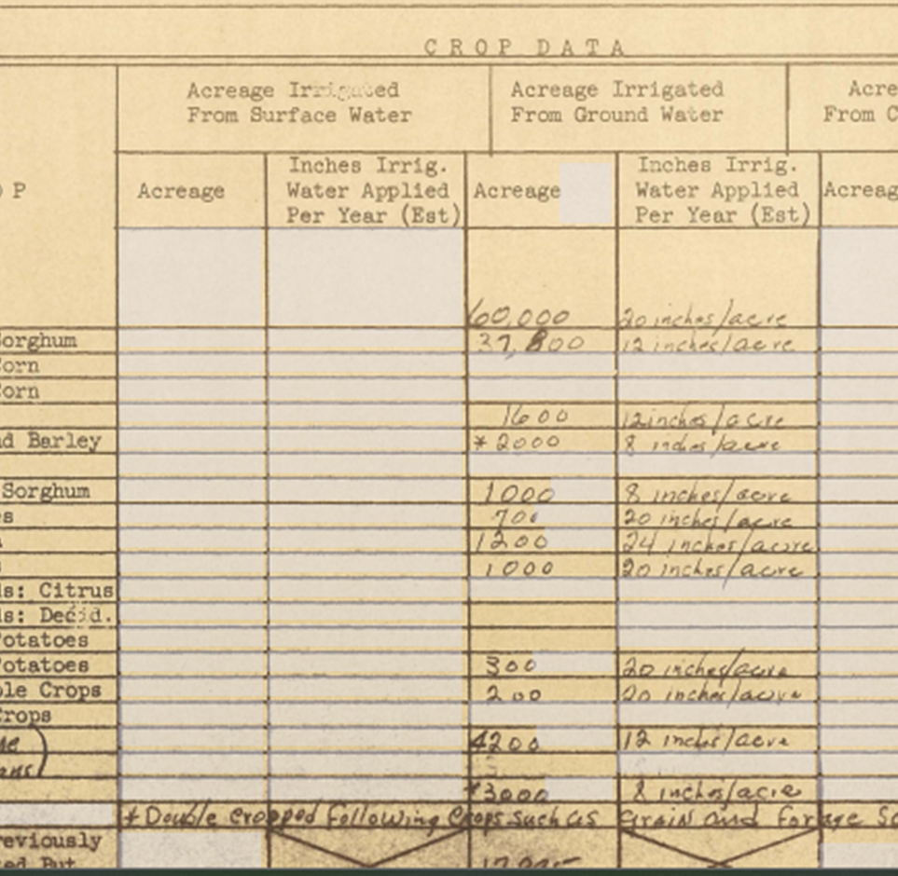
History 1958-2000
Irrigation surveys
Produced every 5 years
Joint effort between Natural Resources Conservation Service (NRCS) & TWDB
Farm-specific data collected
  Irrigated acres
  Application rates
Images from historic irrigation surveys

Slide 5
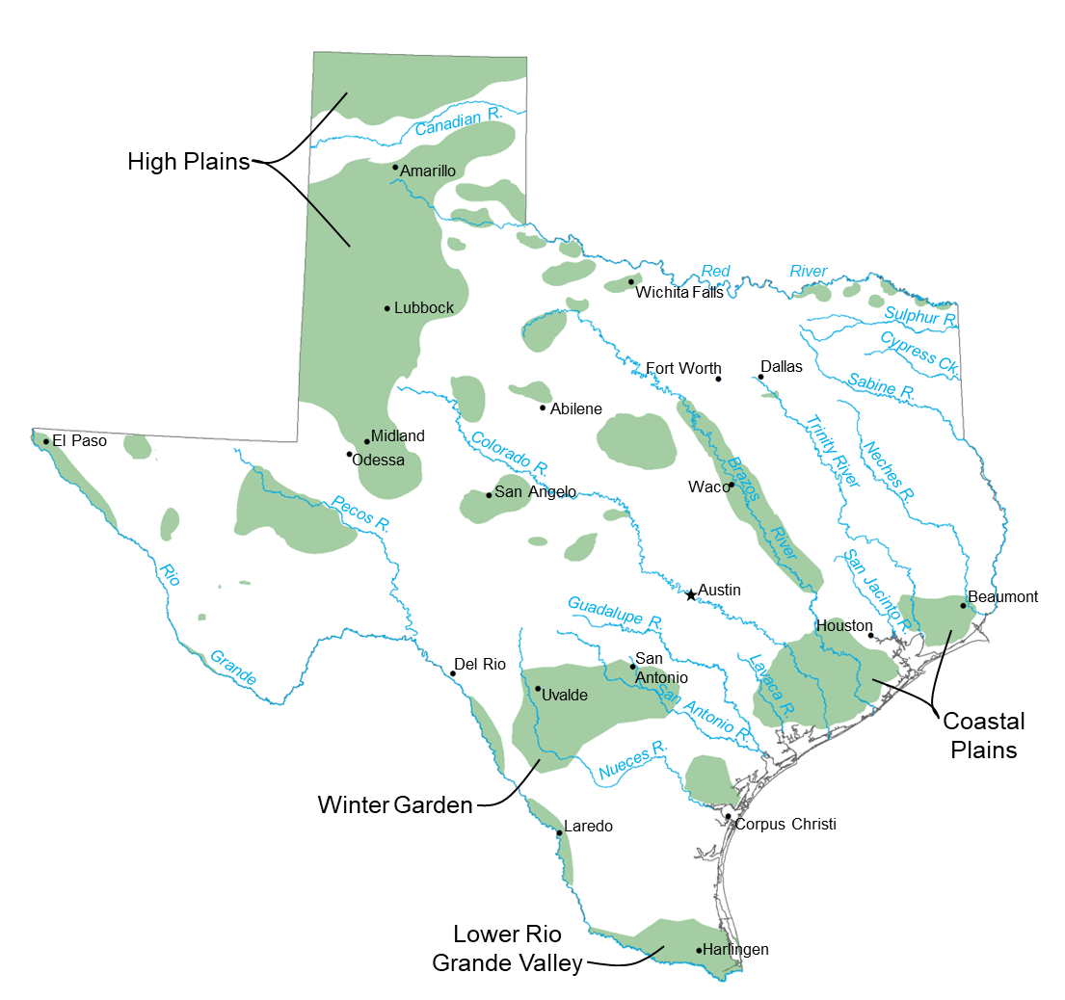
History 1985-2000
Annual estimates of on-farm irrigation water use
Crop specific per-acre irrigation rates from NRCS survey
Irrigated acreage data from the Texas Agricultural Statistics Service (TASS)
  Data gaps filled using most recent 5-year NRCS survey
Image created by Antonio Delgado

Slide 6

Early 2000s
TWDB staff added “ingredients” to the estimates
  Accounting for conveyance loss
  Golf course irrigation
  Surface water rights
  Use of GIS for weather data
  ET in select regions where data was available
Image via Instagram

Slide 7
Historical estimates data
Historical Irrigation Water Use Total Estimates and Acreage by Crop Type, 1985 and later
  Annual irrigation water use summary including surface water, groundwater and reuse and acreage for crop types by county, 1985 and later.
Historical Water Use Estimates and TWDB Water Demand Projections
  The data in this interactive dashboard displays historical water use estimates and water demand projections for 16 Regional Water Planning Groups and 254 counties in Texas. The TWDB considers six broad categories of water demand, which include: irrigation, livestock, manufacturing, mining, municipal, and steam-electric power.
Livestock Inventory and Water Use Estimates
  This dashboard displays annual livestock inventory and water use estimates. Inventory estimates are based on U.S. Department of Agriculture National Agricultural Statistics Service data, as well as supplemental data sources. Inventory data is used to estimate water use

Slide 8
Snapshot of recent estimates
 | 2023 | 2022 | Five-Year Average
Total Acre-Feet | 7,390,643 | 7,309,734 | 7,475,167
Total Acres | 6,370,640 | 6,026,890 | 5,853,373
% GW | 83.5 | 78.3 | 74.8
% SW | 15.9 | 21.1 | 24.4
% WW | 0.6 | 0.6 | 0.8

Slide 9
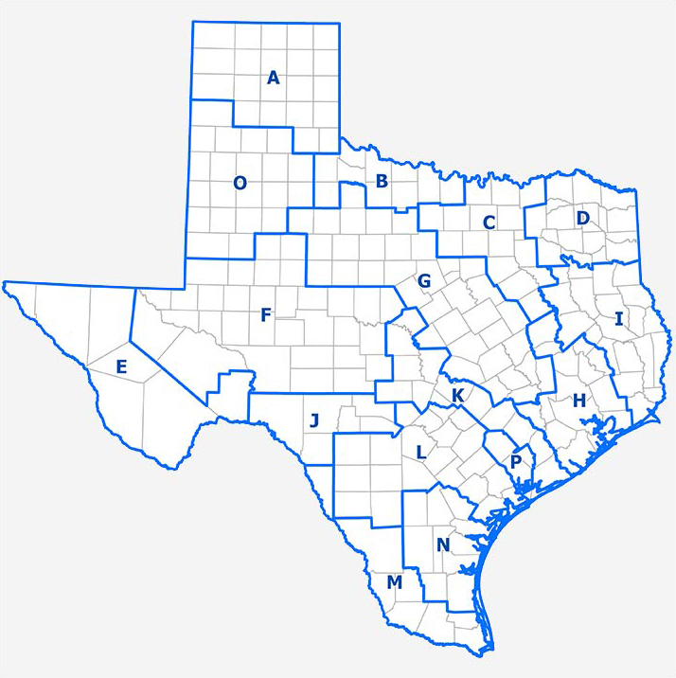
2023 Irrigation by Region

Slide 10
2023 Crop acreage and water use

Slide 11
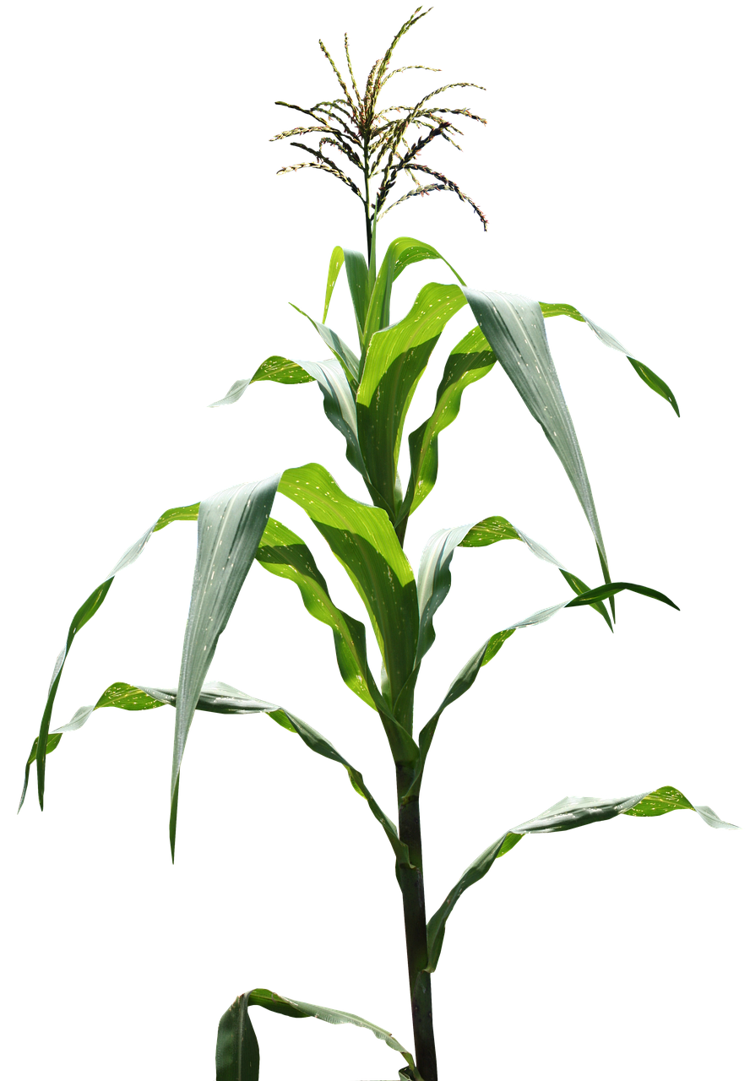
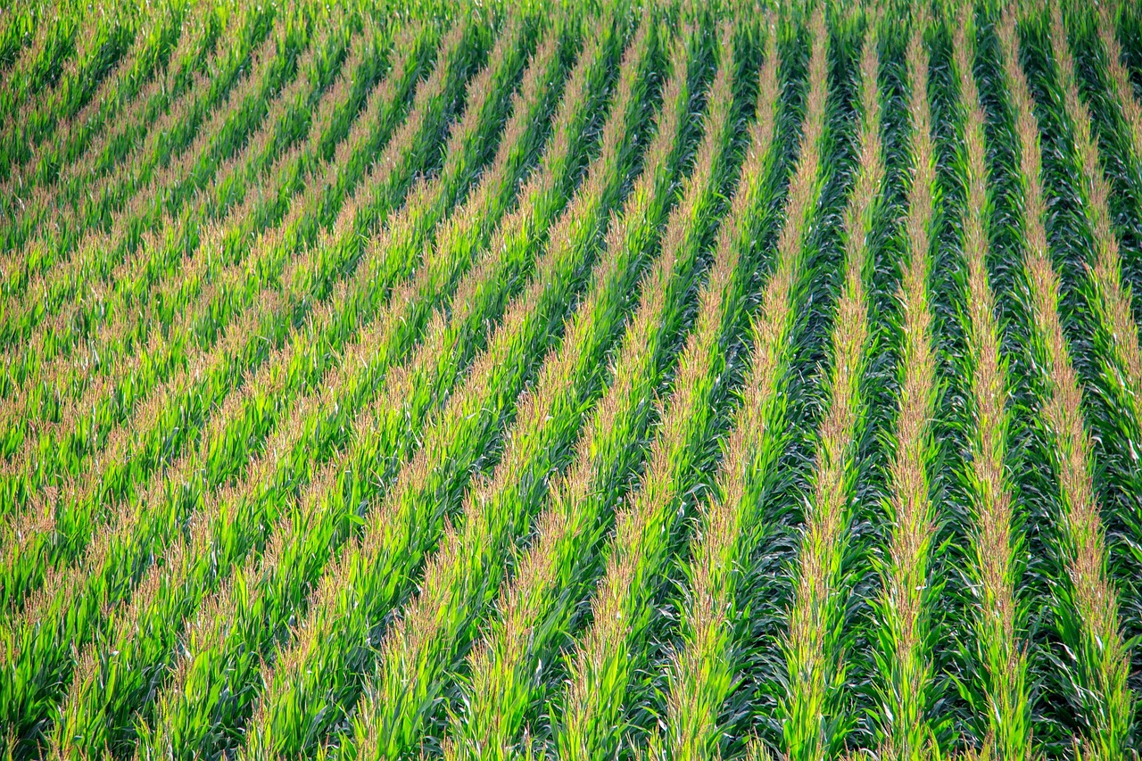
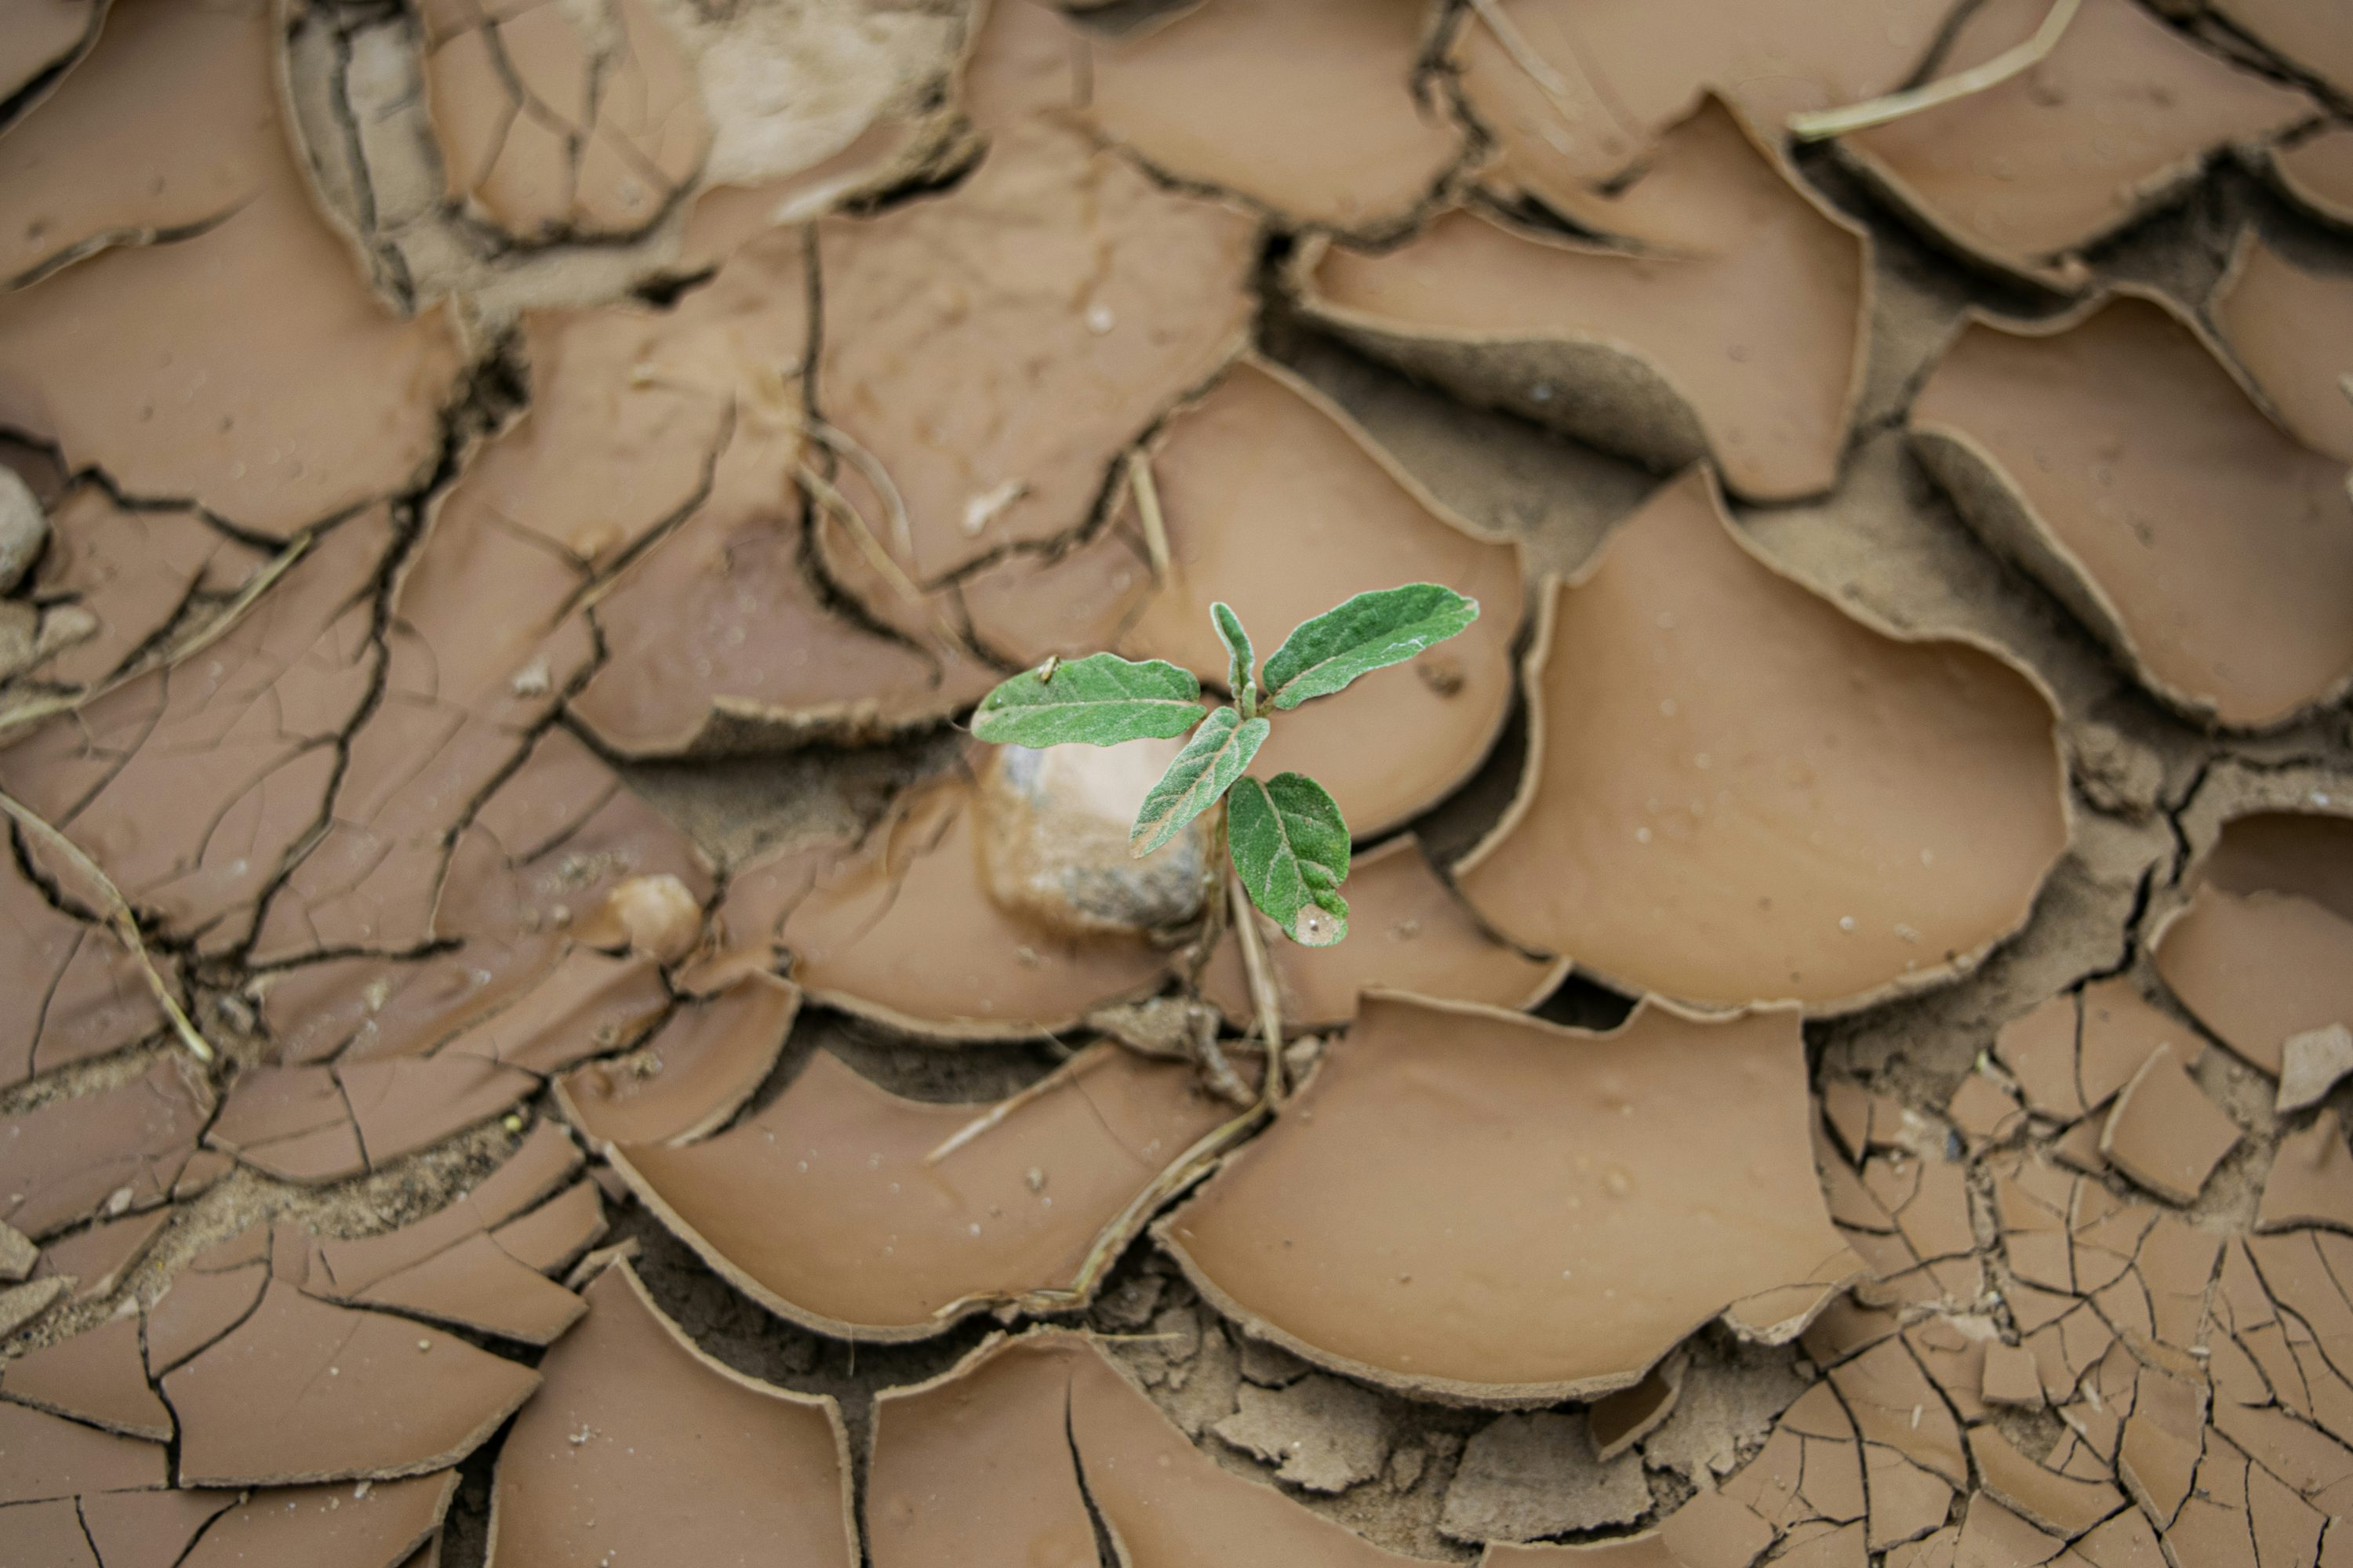
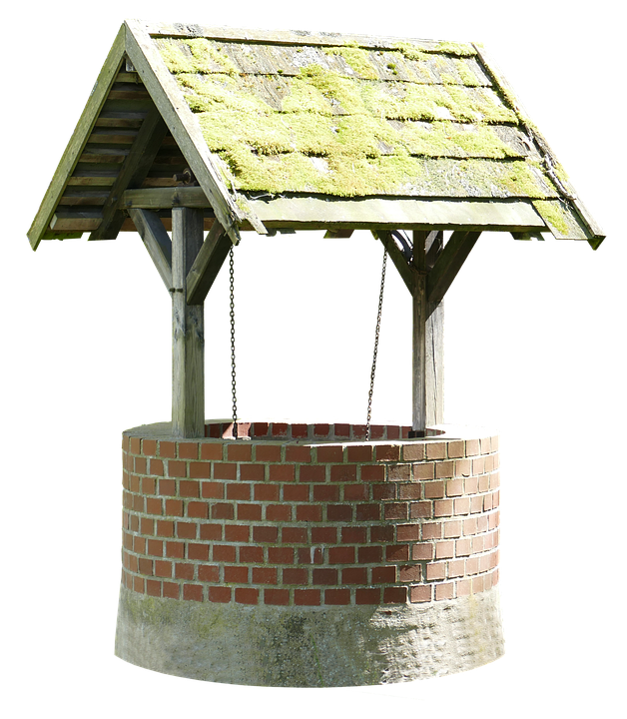
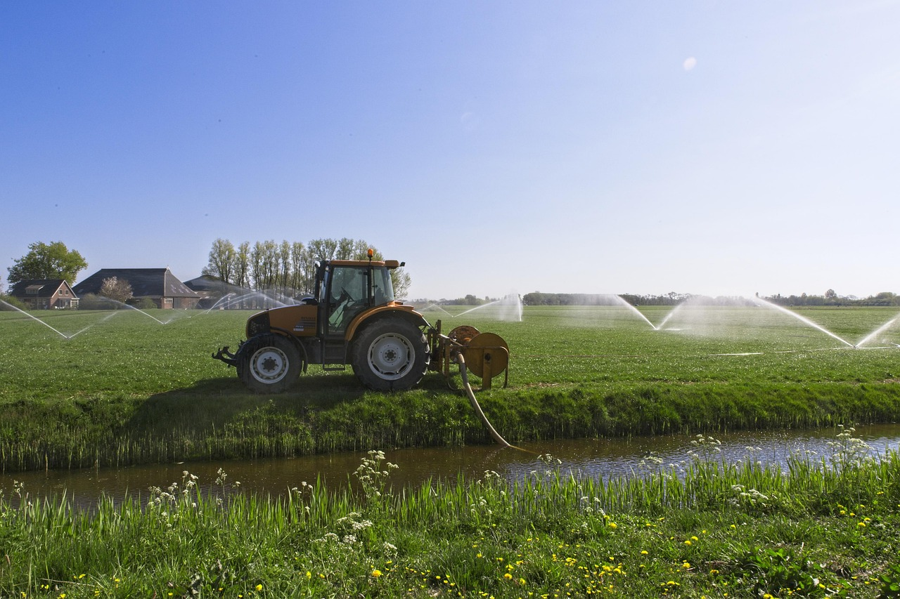

Images representing the components of the irrigation estimates
Crop-specific irrigation rate
Acres of that crop
Climatological adjustments
Revise based on local feedback
Surface water rights and reuse
Groundwater estimates
Royalty free photos from unsplash.com

Slide 12
Estimating Irrigation Process
Establish
Establish irrigated acres
Account
Account for effective precipitation and evapotranspiration
Aggregate
Aggregate surface water rights
Estimate
Estimate groundwater withdrawals
Solicit
Solicit GCDs for review of draft estimates
Adjust
Adjust as needed

Slide 13
Establish irrigated acres
Download Farm Service Agency (FSA) acreage data for year
Filter out other states, non-irrigated crops
Group major crops together (ex: red winter wheat → wheat)
Less common crops aggregated in “Other” category, make up ~1%
End with 17 categories of major crops, including Other and Failed
Organize by crop by county
Compare to historic acres
Confirm major changes with satellite imagery or contact local district

Slide 14


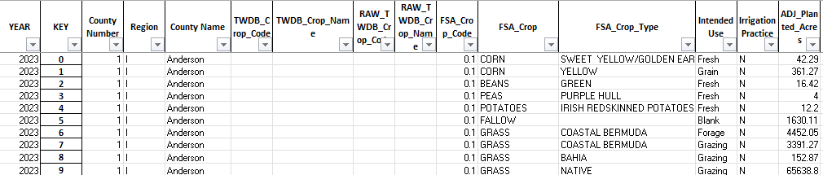
Data processing
Farm Service Agency data, over a million records
After initial processing, down to ~16,000 records

Slide 15
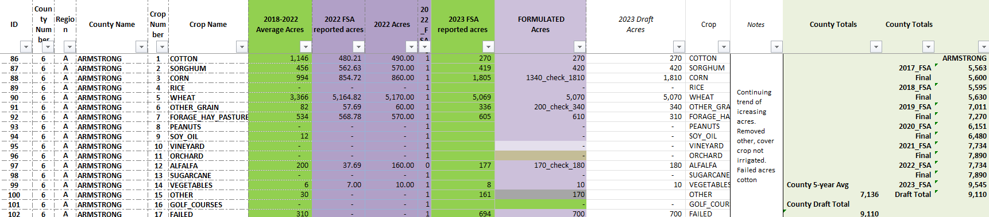
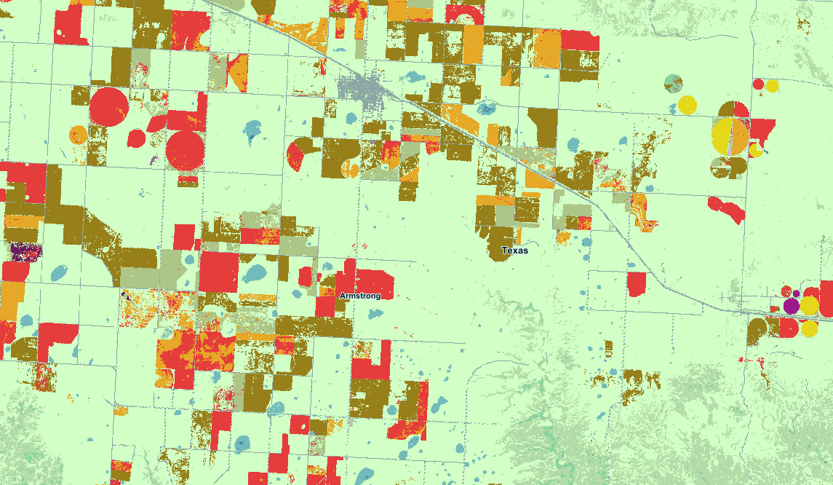
Aggregate each crop category per county, compare to historic values, verify changes
From over a million records to 4,318 rows (254 counties x 17 crop categories, null values included)
Image from the National Agricultural Statistics Service CropScape Data Layer

Slide 16
Account for precipitation and evapotranspiration
Water balance approach
Net irrigation water requirement (NIWR)
Potential Evapotranspiration (PET)
Effective rainfall (ERAIN)
NIWR = PET – ERAIN
If observed rainfall > 75 mm/month, ERAIN = 0.8 * observed rainfall - 25
If observed rainfall < 75 mm/month, ERAIN = 0.6 * observed rainfall - 10

Slide 17
Calculating NIWR per county
Compare year of interest's NIWR to previous 5-year average NIWR
Use resulting percentage as a multiplication factor and apply to historic irrigation rate
Example:
5-year NIWR = 1500 millimeters for X county
Year of interest NIWR = 1950 millimeters for the same county
(1950 / 1500) * 100 = 1.3 (or 130%)
5-year irrigation rate for Y crop in X county = 20 inches per acre
20 * 1.3= 26 inches per acre

Slide 18
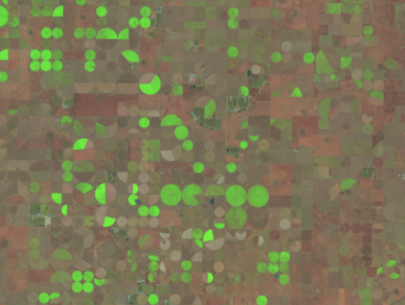
Data sources & references
Historically, PET data taken from MODIS
  Interest in Sentinel, Landsat 8, 9 and OpenET
Observed rainfall from NOAA gridded precipitation data
Allen, Richard & Pereira, L. & Raes, Dirk & Smith, M.. (1998). Crop evapotranspiration guidelines for computing crop requirements. FAO Irrig. Drain. Report modeling and application. J. Hydrol.. 285. 19-40.
Image from USGS EarthExplorer using Landsat 4-9 Data. Portion of Gray County, Texas in 2024.

Slide 19
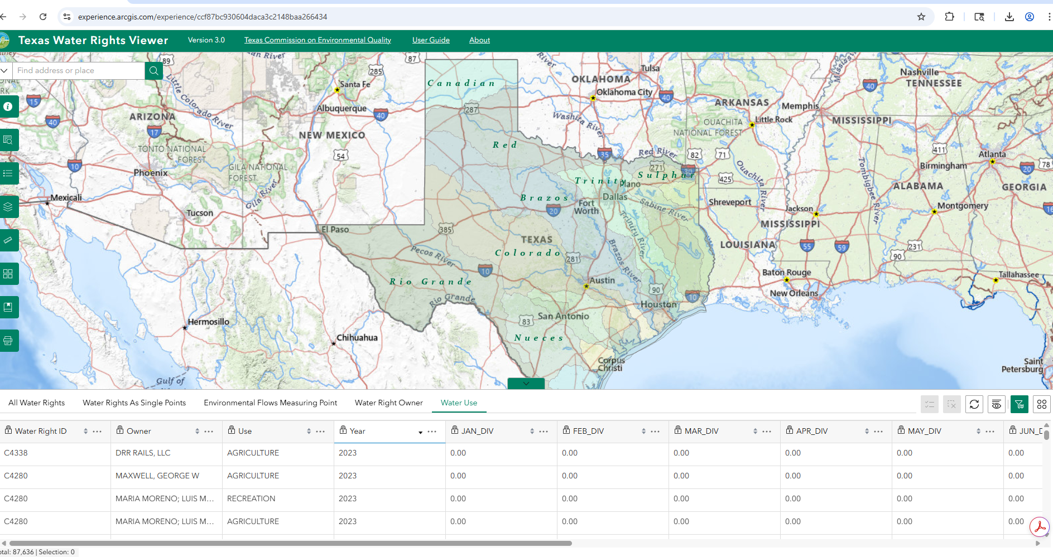
Surface water rights
The Texas Commission on Water Quality (TCEQ) administers surface water rights
Image from TCEQ Water Rights Viewer

Slide 20
Surface water data processing
Multi-step process to get the information needed
Water right data comes in multiple datasets
  Need to connect their location and reported water use
Multiple diversions / water right owners can be connected to a single water right ID
Water rights can be sold / owner name changes
  Associated use for the water may change
Additional confirmation from river authorities
Incorporate water reuse into surface water per county
  Reuse comes from TWDB Water Use Survey

Slide 21
Estimate groundwater withdrawals
Estimated water use
Account for precipitation
Surface water diversions
Waste water reuse
Assign the remainder as groundwater

Slide 22
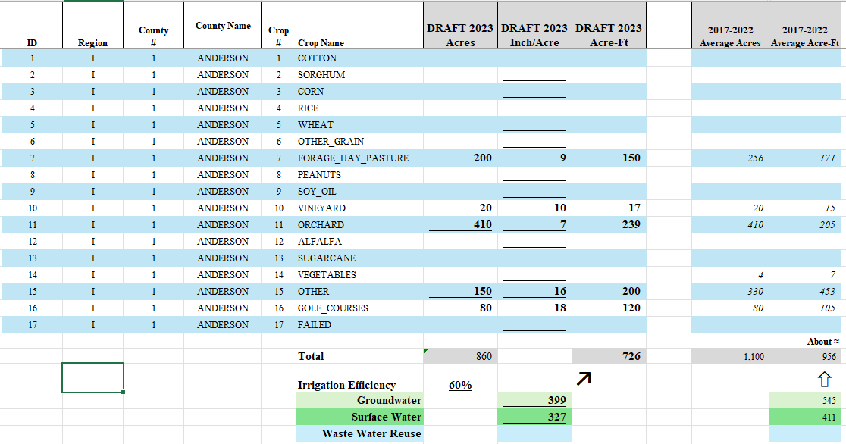
Solicit reviews of draft estimates
Mail out draft estimates to
  Groundwater conservation districts
  Groundwater management areas
  Irrigation districts
  River authorities
  Flood and subsidence districts
  Municipalities in some cases

Slide 23
Adjust as needed
Irrigation rates can vary farm-to-farm, even within a single GCD
  On-farm decisions can change irrigation rates – no two farms are clones
  Depending on weather, rates can vary several inches year to year
Ground truthing and local metering programs can confirm or dismiss trends we identify
Note: where data gaps exist, interpolations round up to account for unreported acres, water lost in transmission, and effectiveness of rainfall.

Slide 24


Changes coming!
Incorporating more remote sensing
  New staff and new project
Utilizing robust models for pixel-level classification
Partnering with the University of Texas at Austin and the University of Oklahoma to develop the Texas Irrigation Watch
Based on Landsat-based Irrigation Dataset (LANID-US)

Slide 25
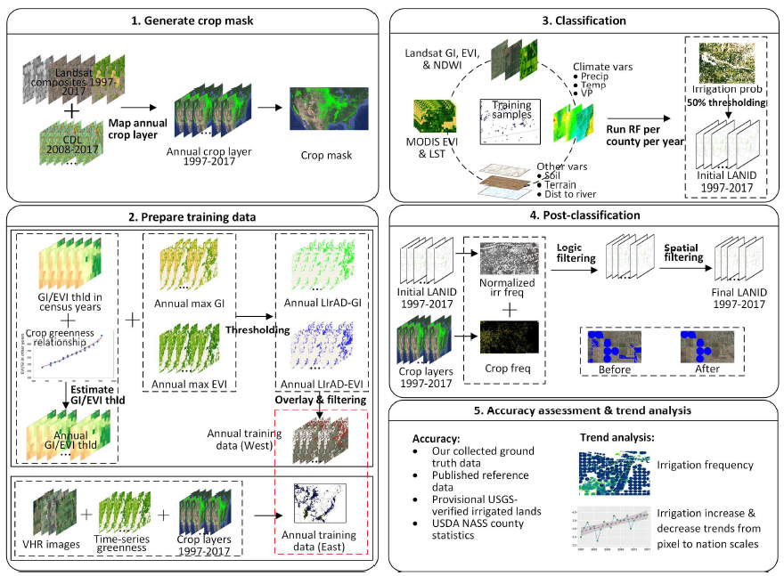
Citation for the paper, “Mapping annual irrigation from Landsat imagery and environmental variables across the conterminous United States.”
Yanhua Xie, Tyler J. Lark,
Mapping annual irrigation from Landsat imagery and environmental variables across the conterminous United States,
Remote Sensing of Environment,
Volume 260,
2021,
112445,
ISSN 0034-4257,
https://doi.org/10.1016/j.rse.2021.112445.

Slide 26

Questions?
Agricultural Water Conservation Department – Estimates Team
Emily Fort, Data Analyst
  Emily.Fort@twdb.texas.gov
Yared Bayissa, GIS Specialist
  Yared.Bayissa@twdb.texas.gov
AgWater@twdb.texas.gov

