Slide 1
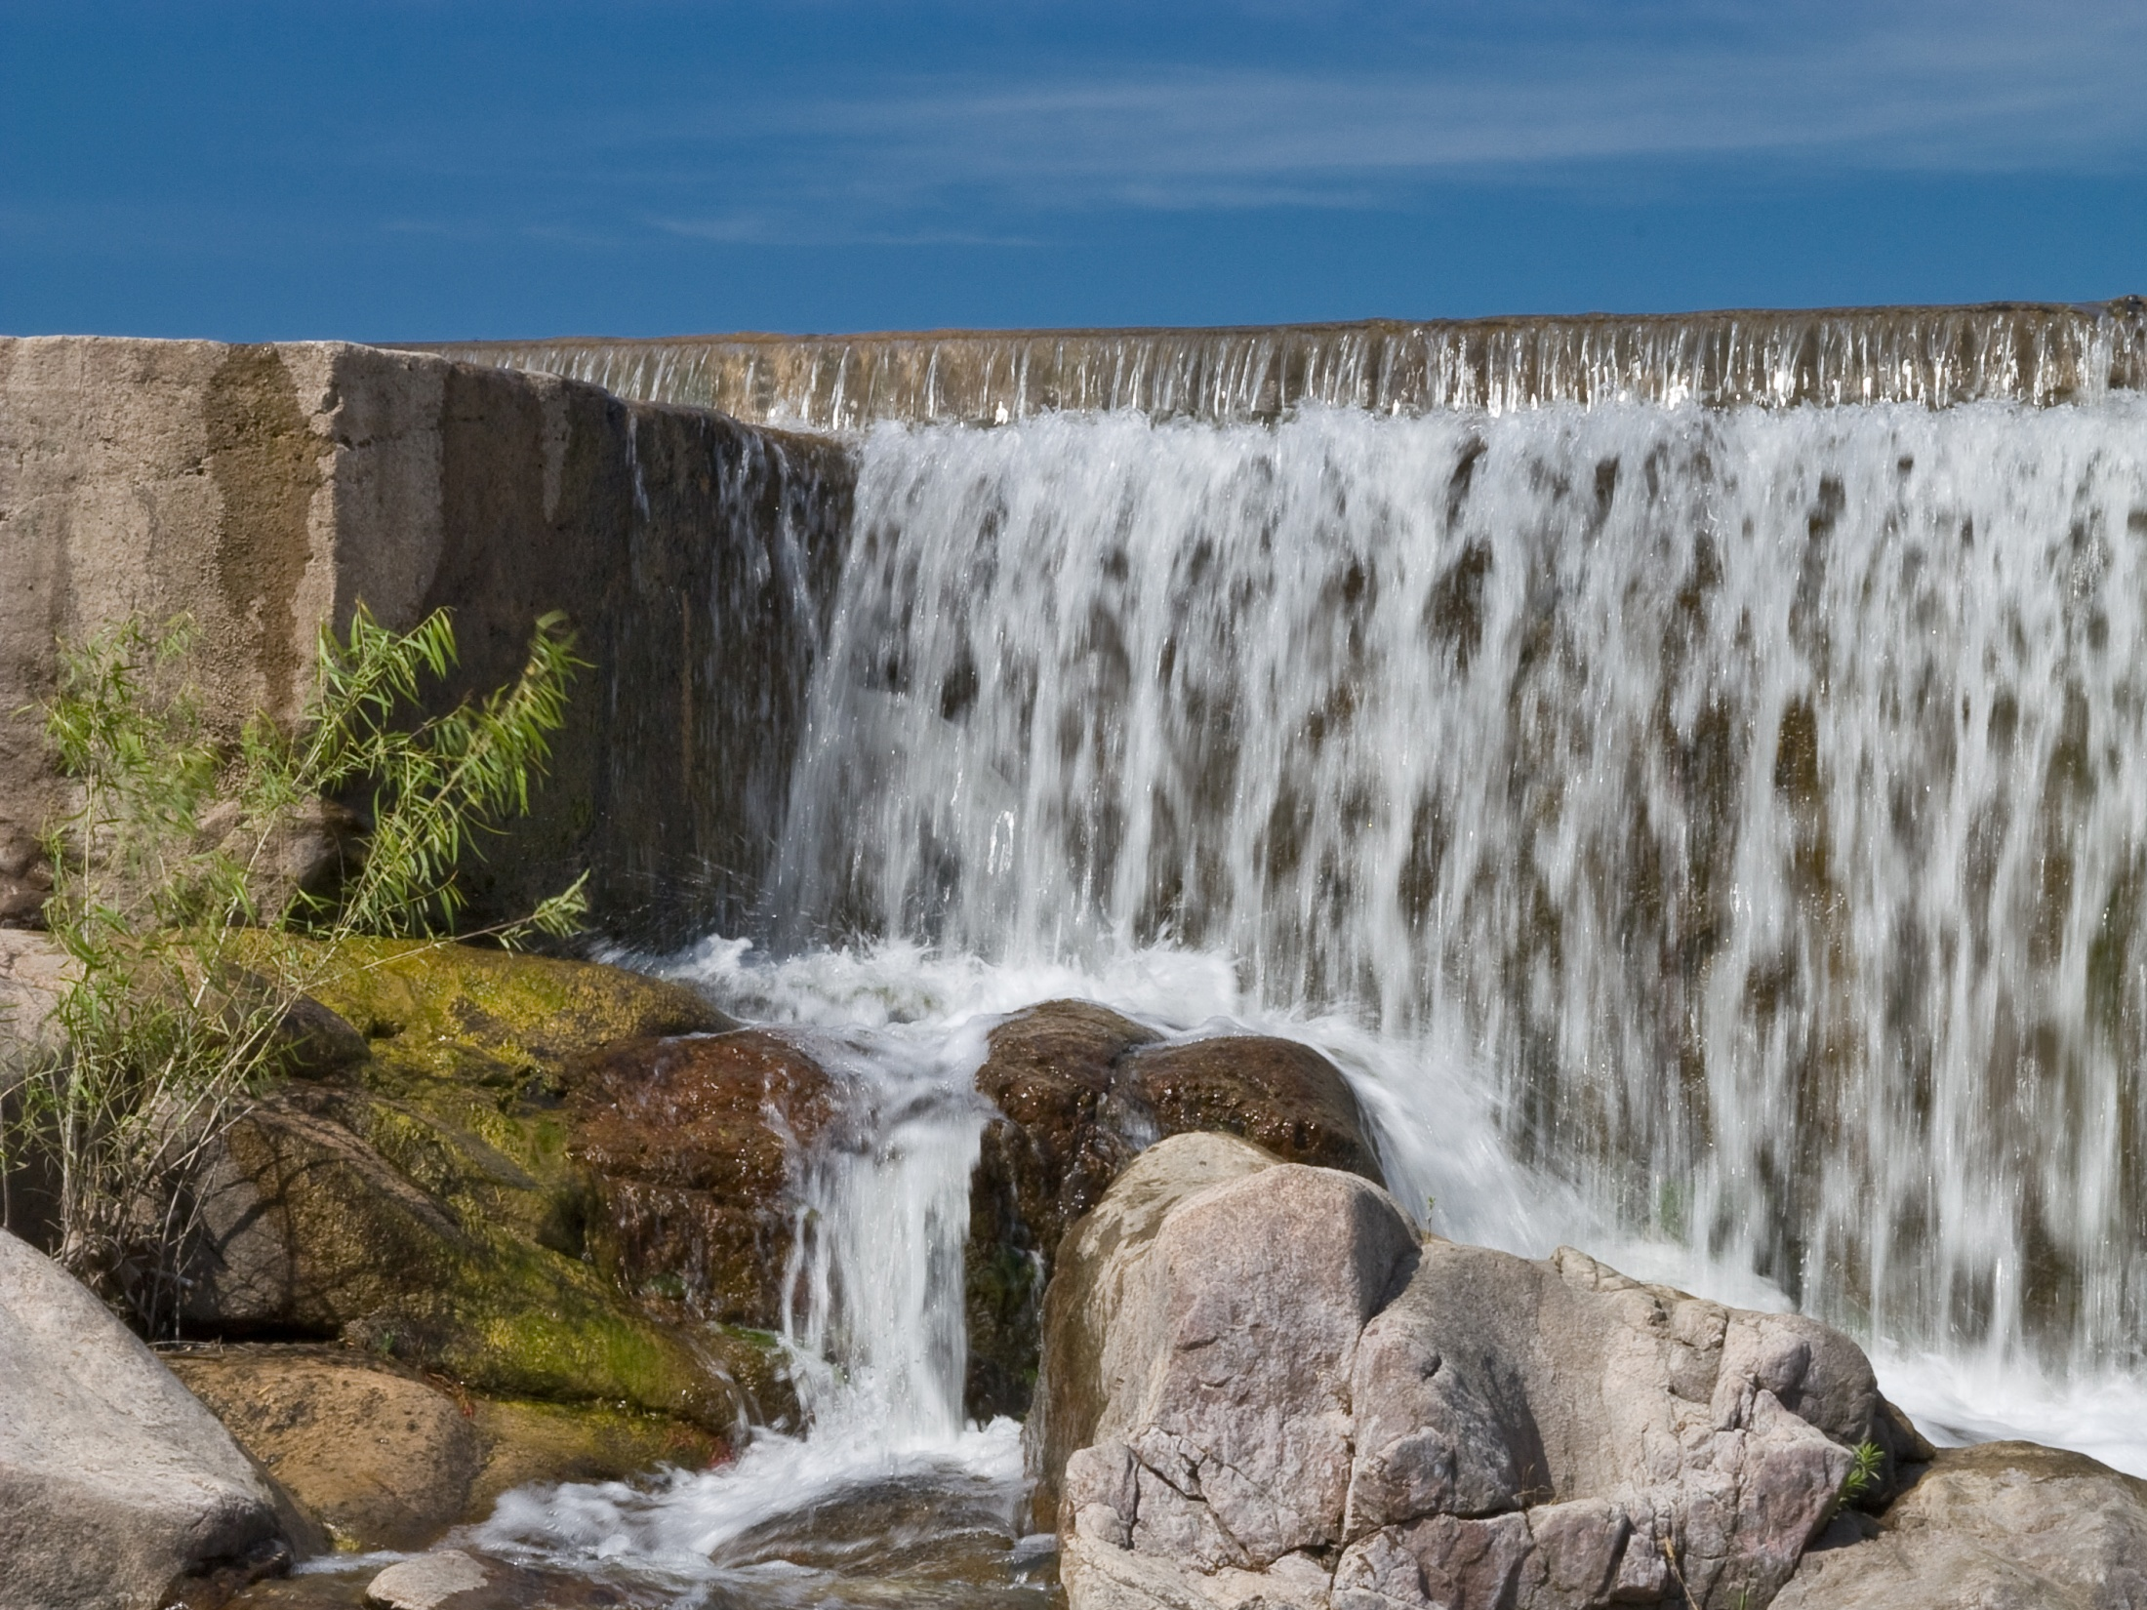
Water for Texas
2012 State Water Plan

Slide 2
Regional Summaries

Slide 3
Panhandle (A) Region
Population in the region is projected to increase 39% to 541,035 from 2010-2060
Water supply needed in 2060: 418,400 acre-feet
Recommended strategy volume 2060: 648,220 acre-feet/year
Capital cost: $739 million

Slide 4
Panhandle (A) Region
Conservation=86% of 2060 strategy volume (mostly irrigation)
Significant groundwater development
Significant unmet irrigation needs in the near-term

Slide 5
Region B
Population in the region is projected to increase 5% to 221,734 from 2010-2060
Water supply needed in 2060: 40,400 acre-feet
Recommended strategy Volume 2060: 77,000 acre-feet/year
Capital cost: $499 million

Slide 6
Region B
Conservation: 19% of 2060 strategy volume
New reservoir: Ringgold
Limited unmet irrigation needs in 2010

Slide 7
Region C
Population in the region is projected to increase 96% to 13,045,592, 2010-2060
Water supply needed in 2060: 1,588,200 acre-feet
Recommended strategy volume 2060: 2,360,300 acre-feet/year
Capital cost: $21.5 billion
Conservation: 12% of 2060 strategy volume

Slide 8
Region C
Reuse: 11% of 2060 strategy volume
New reservoirs: Ralph Hall, Lower Bois d’Arc, Marvin Nichols, Fastrill replacement project
New conveyance projects with significant costs

Slide 9
North East Texas (D) Region
Population in the region is projected to increase 57% to 1,213,095, 2010-2060
Water supply needed in 2060: 96,140 acre-feet
Recommended strategy volume 2060: 98,470 acre-feet
Capital cost: $39 million

Slide 10
North East Texas (D) Region
Recommended surface water contracts for most needs, including water from new Region C project
Opposition to Marvin Nichols Reservoir
Three unique stream segments recommended

Slide 11
Far West Texas (E) Region
Population in the region is projected to increase 79% to 1,542,824, 2010-2060
Water supply needed in 2060: 226,570 acre-feet
Recommended strategy volume 2060: 130,525 acre-feet
Capital cost: $842 million
Conservation: 40% of 2060 strategy volume;
Notes:
2010 population is about 863,000. Strategies include conservation wastewater reuse, desalination of groundwater, treatment of agricultural drain water, and recharge of aquifers with treated surface water.

Slide 12
Far West Texas (E) Region
Desalination: 21% of 2060 strategy volume
Significant unmet irrigation needs
One additional unique stream segment recommended

Slide 13
Region F
Population in the region is projected to increase 17% to 724,094, 2010-2060
Water supply needed in 2060: 220,000 acre-feet
Recommended strategy volume 2060: 235,200 acre-feet
Capital cost: $915 million
Conservation: 35% of 2060 strategy volume
Notes:
Strategies include conservation and reuse; new groundwater development; desalination; and subordination of senior downstream water rights.

Slide 14
Region F
Strategy: downstream water rights are assumed to be subordinated to increase reliable supply
Unmet needs; irrigation and steam-electric power production

Slide 15
Brazos G Region
Population in the region is projected to increase 76% to 3,448,879, 2010-2060
Water supply needed in 2060: 390,730 acre-feet
Recommended strategy volume 2060: 587,100 acre-feet
Capital cost: $3.2 billion
Conservation: 7% of strategy volume 2060

Slide 16
Brazos G Region
New reservoirs: Brushy Creek; Cedar Ridge; Millers Creek Augmentation; Turkey Peak; Coryell County; plus 3 recommended as unique reservoir sites
Conjunctive use 2060: 12% of strategy volume; BRA system operation strategy : 14%
Unmet irrigation/mining needs in all years; a few unmet electric power and municipal needs in 2010

Slide 17
Region H
Population is projected to increase 89% to 11.3 million, 2010-2060
Water supply needed 2060: 1,236,335 acre-feet
Recommended strategy volume 2060: 1,501,180 acre-feet
Capital cost: $12 billion
Conservation: 12% of 2060 strategy volume

Slide 18
Region H
New reservoirs: Allen’s Creek; Cow Off-channel; Gulf Coast Water Authority Off-channel; Brazoria Off-Channel; Fort Bend Off-Channel
Reuse: 19% of 2060 strategy volumes

Slide 19
East Texas (I) Region
Population in the region is projected to increase 36% to 1,482,448, 2010-2060
Water supply needed 2060: 182,145 acre-feet
Recommended strategy volume 2060: 638,075 acre-feet
Capital cost: $885 million

Slide 20
East Texas (I) Region
Conservation: 7% of 2060 2060 strategy volume
New reservoirs: Columbia; Fastrill replacement project
Limited unmet electric power and mining needs

Slide 21
Plateau (J) Region
Population in the region is projected to increase 52% to 205,910, 2010-2060
Water supply needed 2060: 2,390 acre-feet
Recommended strategy volume 2060: 23,010 acre-feet
Capital cost: $55 million
Notes:
Strategies include aquifer storage and recovery; conservation; new groundwater development; surface water acquisition & storage; & water supply contracts.

Slide 22
Plateau (J) Region
Conservation: 3% of 2060 strategy volume
Brush control supply not available during drought-of-record
Aquifer storage and recovery: 21% of 2060 strategy volume

Slide 23
Lower Colorado (K) Region
Population in the region is projected to increase 100% to 2,831,937, 2010-2060
Water supply needed 2060: 367,670 acre-feet
Recommended strategy volume 2060: 646,170 acre-feet
Capital cost $907 million

Slide 24
Lower Colorado (K) Region
Conservation: 37% of 2060 strategy volume
New reservoir: LCRA/SAWS Off-channel
Reuse: 21% of 2060 strategy volume

Slide 25
South Central Texas (L) Region
Population in the region is projected to increase 75% to 4,297,786, 2010-2060
Water supply needed 2060: 436,750 acre-feet
Recommended strategy volume 2060: 765,740 acre-feet
Capital cost: $7.6 billion
Conservation: 11% of 2060 strategy volume

Slide 26
South Central Texas (L) Region
New reservoirs (all off- channel): GBRA; Mid-Basin; Exelon; Lower Basin New Appropriation Projects; LCRA/SAWS; Lavaca
Significant Carrizo-Wilcox Aquifer development
Five unique stream segments recommended
Limited unmet irrigation needs

Slide 27
Rio Grande (M) Region
Population in the region is projected to increase 142% to 3,935,223, 2010-2060
Water supply needed 2060: 609,900 acre-feet
Recommended strategy volume 2060: 673,845 acre-feet
Capital cost: $2.2 billion

Slide 28
Rio Grande (M) Region
Conservation: 43% of 2060 strategy volumes
New reservoirs: Brownsville Weir; Laredo Low Water Weir
Unmet irrigation needs

Slide 29
Coastal Bend (N) Region
Population in the region is projected to increase 44% to 885,665, 2010-2060
Water supply needed 2060: 75,745 acre-feet
Recommended strategy volume 2060: 156,325
Capital cost: $656 million

Slide 30
Coastal Bend (N) Region
Conservation: 5% of 2060 strategy volume
New reservoirs: Lavaca Off-Channel; Nueces Off-Channel
Limited unmet mining needs

Slide 31
Llano Estacado (O) Region
Population in the region is projected to increase 12% to 551,758, 2010-2060
Water supply needed 2060: 2,366,035 acre-feet
Recommended strategy volume 2060:395,960
Capital cost: $1.1 billion

Slide 32
Llano Estacado (O) Region
Conservation: 74% of 2060 strategy volume
New reservoirs: Jim Bertram Lake 07; Post
Significant unmet irrigation and livestock needs

Slide 33
Lavaca (P) Region
Population in the region is projected to increase by less than 1% to 49,663, 2010-2060
Water supply needed 2060: 67,730 acre-feet

Slide 34
Lavaca (P) Region
Recommended strategy volume 2060: 67,740

