Slide 1


Water for Texas
2012 State Water Plan

Slide 2

Water Planning: Legislative Response to Drought
Late 1950s Drought of Record
  1957: Creation of TWDB
  $200 million Water Development Fund
  9 State Water Plans, 1961-2012
Late 1990s: Potential New Drought of Record
  ~$6 billion economic losses in ‘96 (mostly agriculture)
  ~300 entities with threat to water supplies
  1997 & 2001: Implementation of SB 1 & 2 which created & refined regional water planning

Slide 3
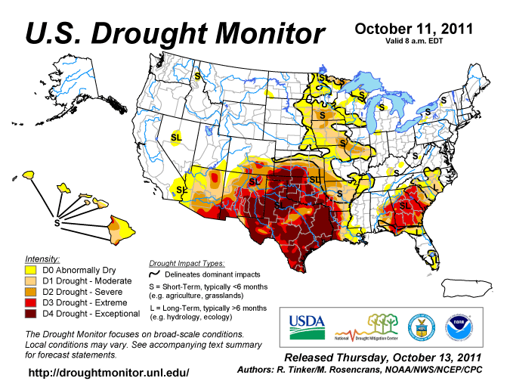

Slide 4
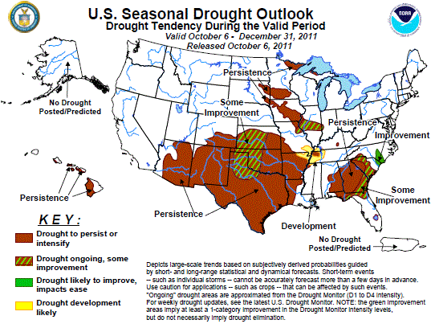

Slide 5
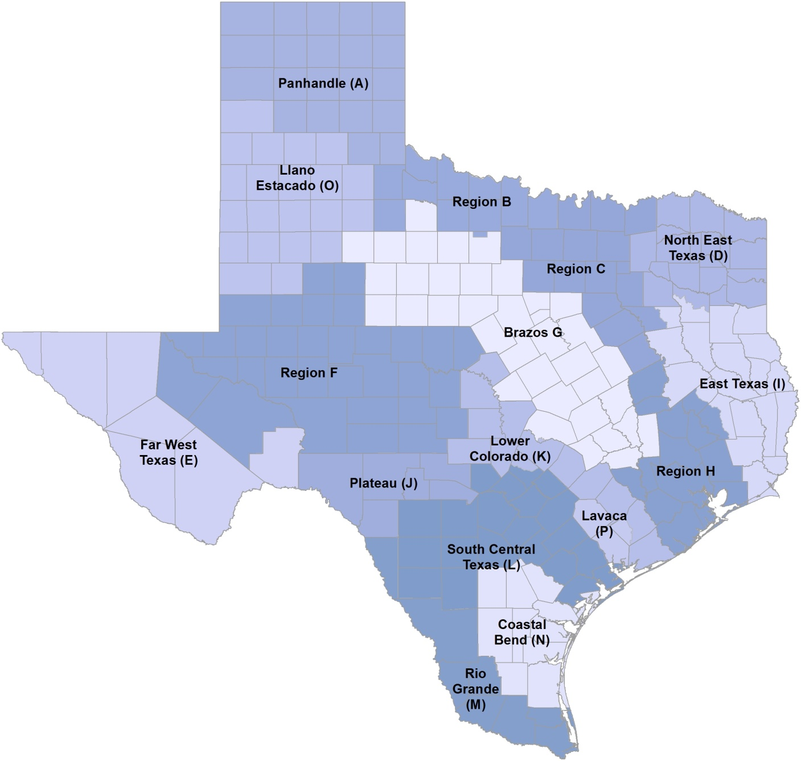
Regional Water Planning
Statutory interests:
Public
Counties
Municipalities
Electric-generating utilities
River authorities
Industries
Agriculture
Environment
Small businesses
Water districts
Water utilities
Groundwater management areas
Notes:
Texas has 16 regional water planning groups, one for each planning area. There are now 12 interests represented on each planning group.
Legislation passed during the 82nd Legislative Session now requires that groundwater conservation districts in each groundwater management area located in the regional water planning area to appoint one representative to serve on the regional water planning group.

Slide 6
Regional Water Planning
Project future population and water demand
Quantify existing and future water supplies
Identify surpluses and needs
Evaluate and recommend water management strategies
Make policy recommendations
Adopt the plan
Existing Water Supplies
Projected Water Demand
Surplus (+) or Need (-)
Notes:
Regional water planning groups compare existing water supplies with current and projected water demands to identify when and where additional water supplies are needed for water user groups and wholesale water providers.
If existing supplies do not meet future demand, they recommend specific water management strategies to meet water supply needs, such as conservation of existing water supplies, new reservoir and groundwater development, conveyance facilities to move available or newly developed water supplies to areas of need, water reuse, and others.
Planning groups identify water user groups that will not have enough water during times of drought, recommend strategies that could be implemented to address shortages, and estimate the costs of these strategies.

Slide 7
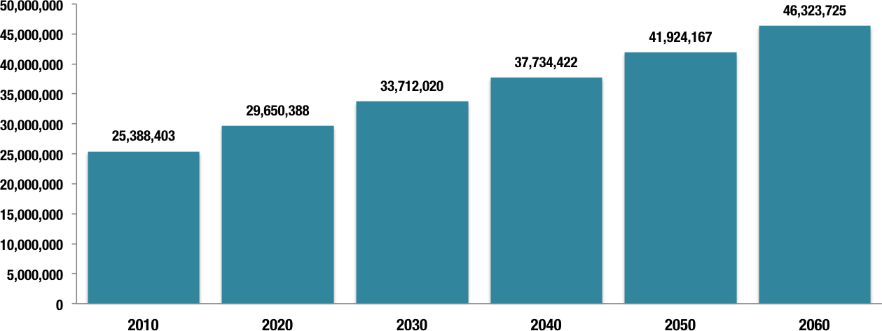
Projected Texas Population

Slide 8
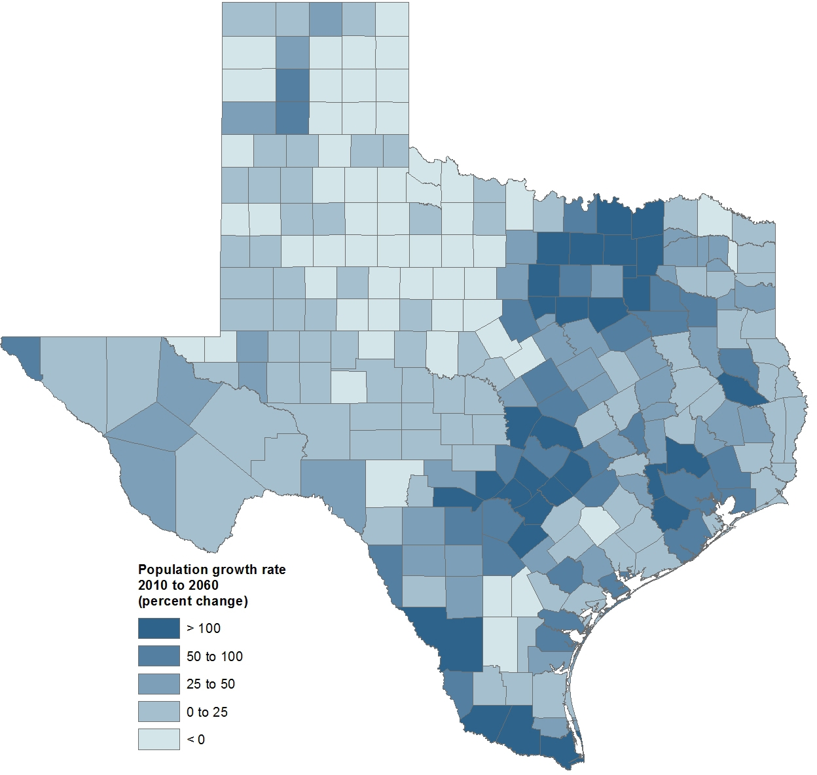
Projected Population Growth in Texas Counties

Slide 9
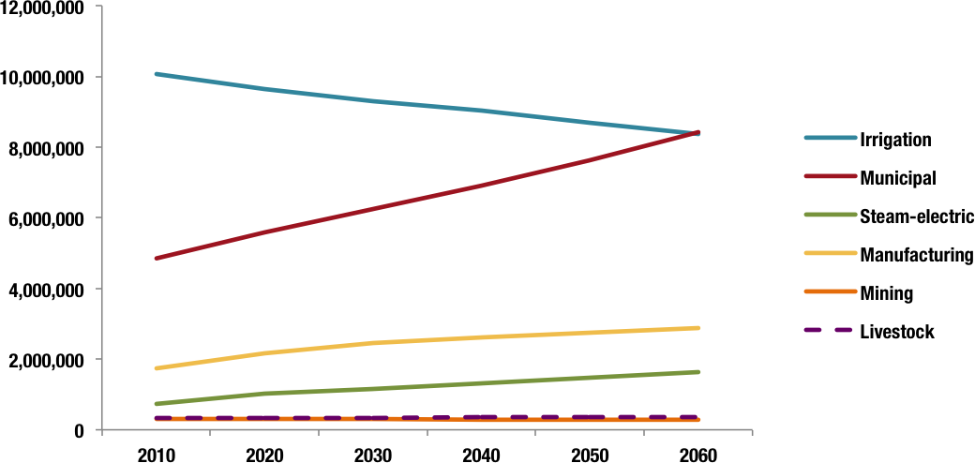
Water Demand Projections by Category

Slide 10
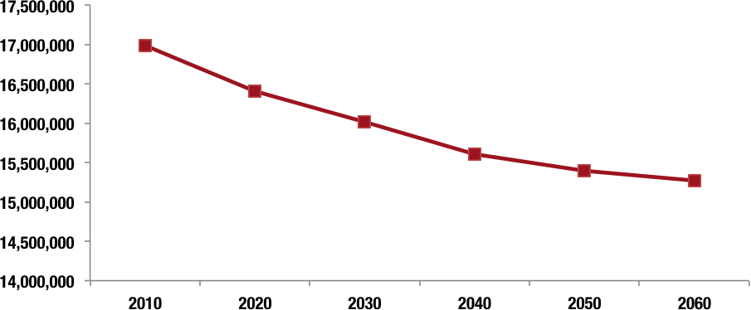
Projected Existing Supplies

Slide 11
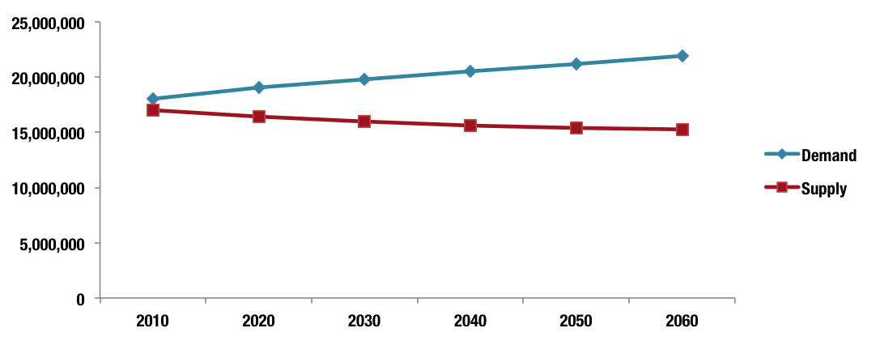
Projected Water Demands and Existing Supplies
Notes:
Water demand is projected to increase by 22 percent.
Existing water supplies—categorized as surface water, groundwater, and reuse water—are projected to decrease about 10 percent.
(Needs are more than the difference between supply and demand because supplies are not always available to all users throughout a region.)

Slide 12
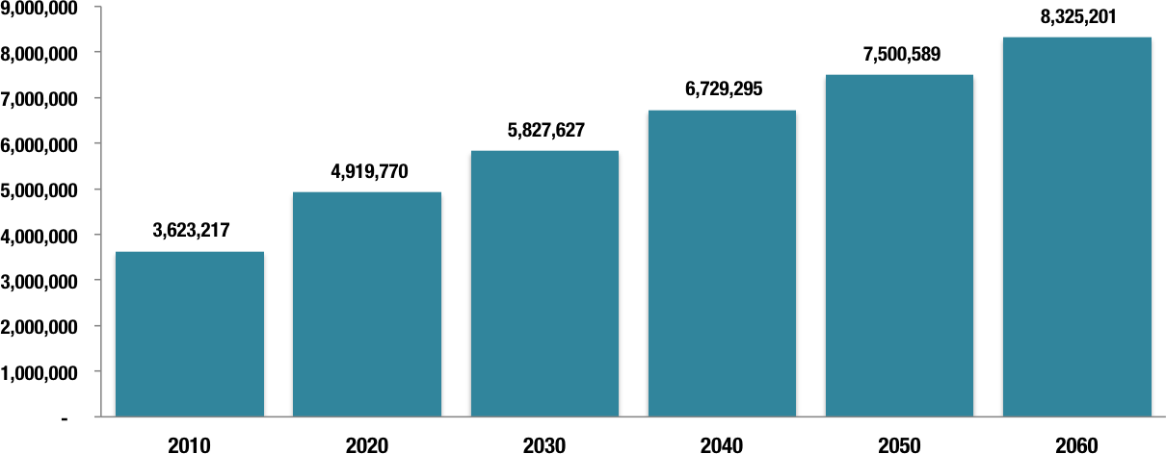
Projected Need for Additional Water in Times of Drought
Notes:
We do not have enough existing water supplies today to meet the demand for water during times of drought.
In the event of severe drought conditions, the state would face an immediate need for additional water supplies of 3.6 million acre‐feet per year with 86 percent of that need in irrigation and about 9 percent associated directly with municipal water users. Total needs are projected to be 8.3 million acre‐feet per year by 2060.
(Needs are more than the difference between supply and demand because supplies are not always available to all users throughout a region.)
The strategies recommended by regional water planning groups would provide, if implemented, 9.0 million acre‐feet per year in additional water supplies by 2060.
These strategies included 562 unique water supply projects.
Twelve planning groups were unable to meet all water supply needs for each water user group in their planning areas. Approximately 2.2 million acre-feet of water supply needs are unmet in 2010, increasing to approximately 2.5 million acre-feet in 2060. Irrigation represents the vast majority (98-99 percent) of unmet needs in all decades. The major reason for not meeting a water user group’s water supply need is that the planning group did not identify an economically feasible water management strategy to meet the water supply need.

Slide 13
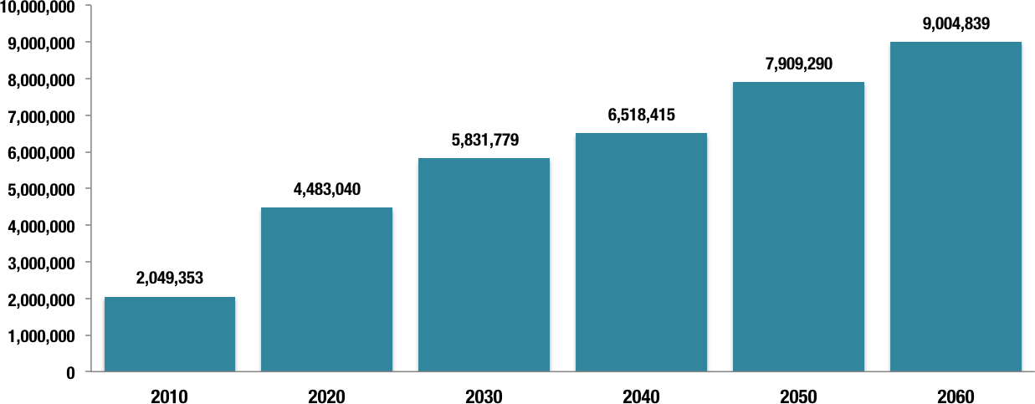
Water Supplies from Water Management Strategies

Slide 14
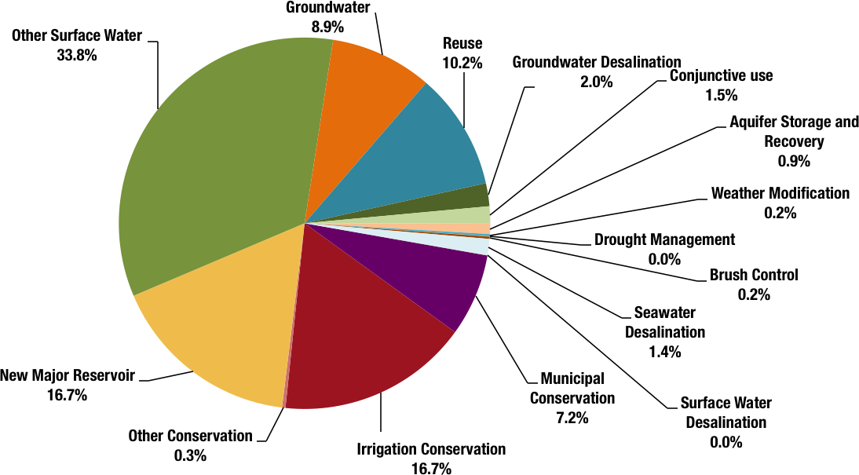
Relative Volumes of Recommended Strategies (2060)
< 1%
< 1%

Slide 15
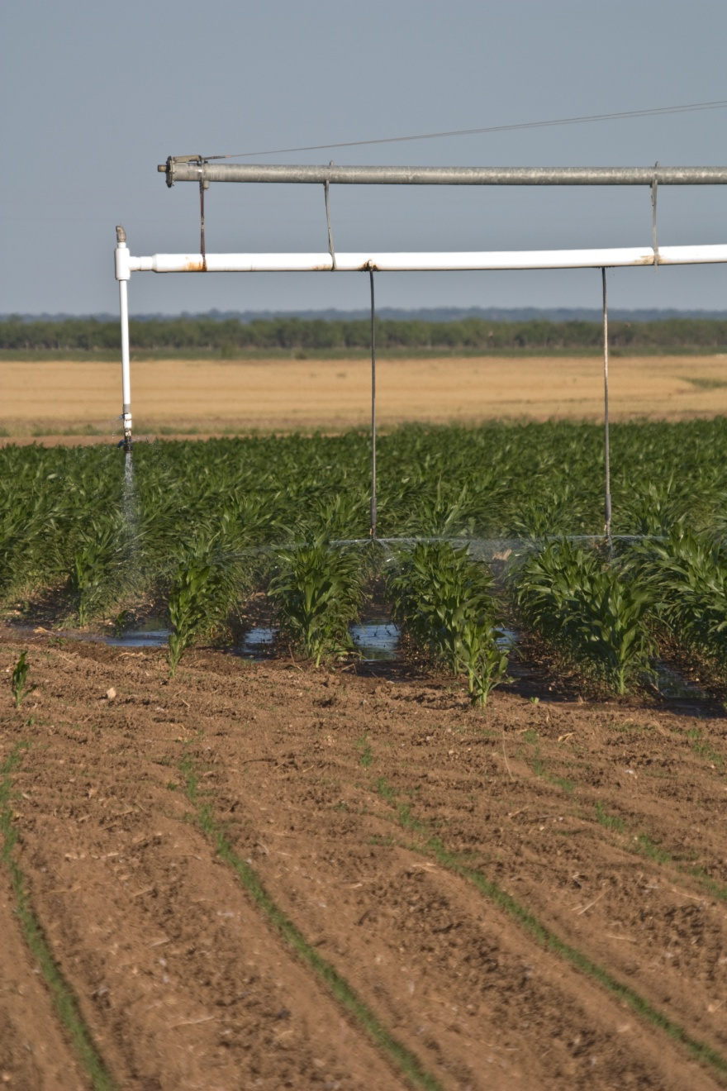
Conservation
Focuses on efficiency of use/reduction of demands on existing supplies
Recommended 2010 strategies produce 767,000 acre-feet (municipal, irrigation; other)
Recommended 2060 strategies produce 2.2 million acre-feet (all types)

Slide 16
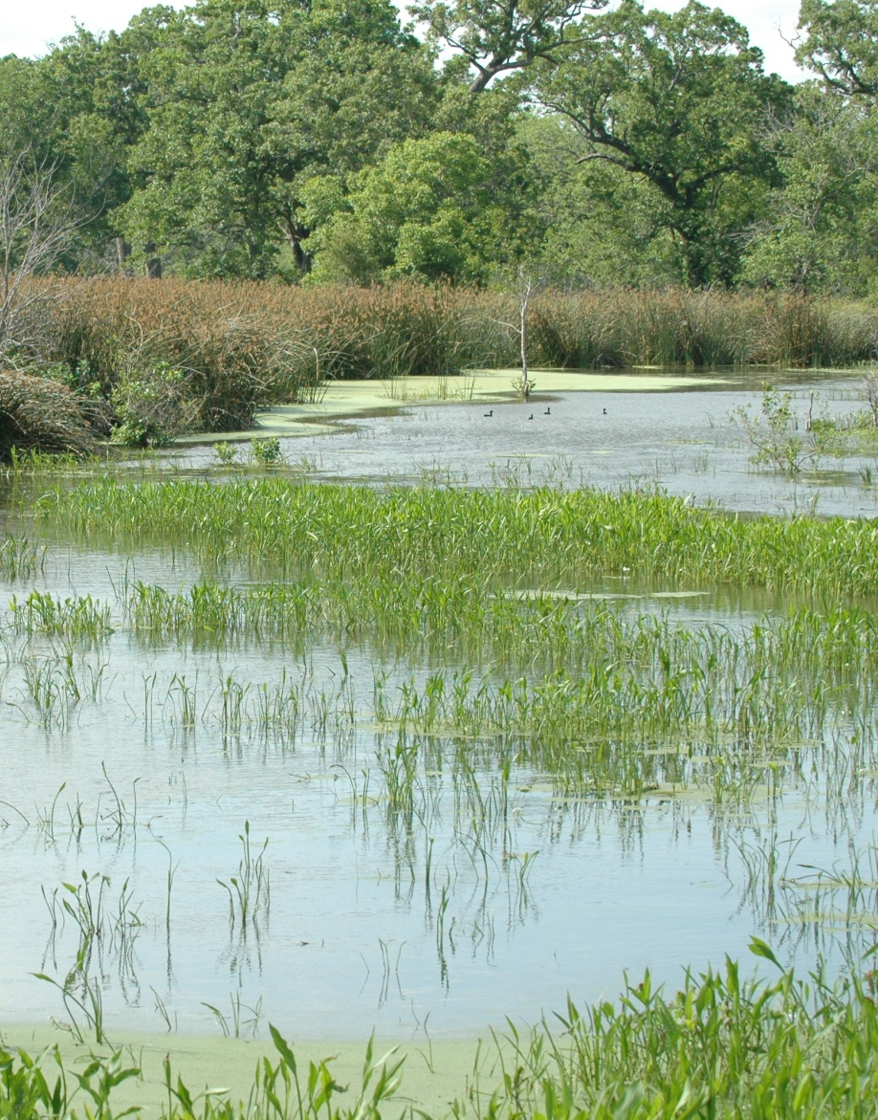
Reuse
Volume from reuse in
2010: 100,600 acre-feet
Volume from reuse in 2060: 915,600 acre-feet
Nearly 350,000 acre feet of reuse projects implemented since 2007

Slide 17
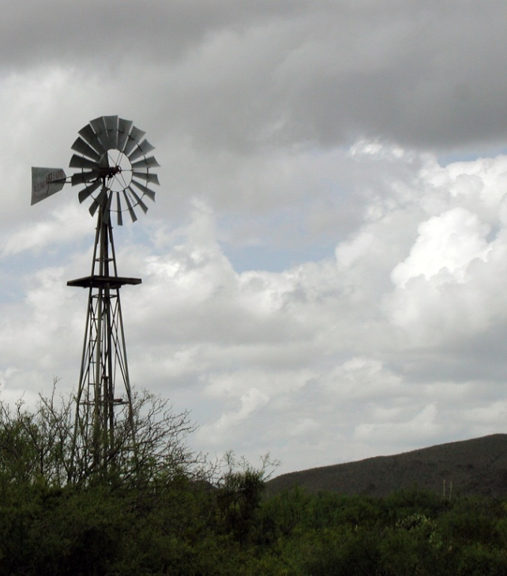
New Groundwater Supplies
New groundwater in 2010: 254,000 acre-feet
New groundwater in 2060: 800,800 acre-feet
2010 groundwater desalination: 56,550 acre-feet
2060 groundwater desalination:181,570 acre-feet

Slide 18
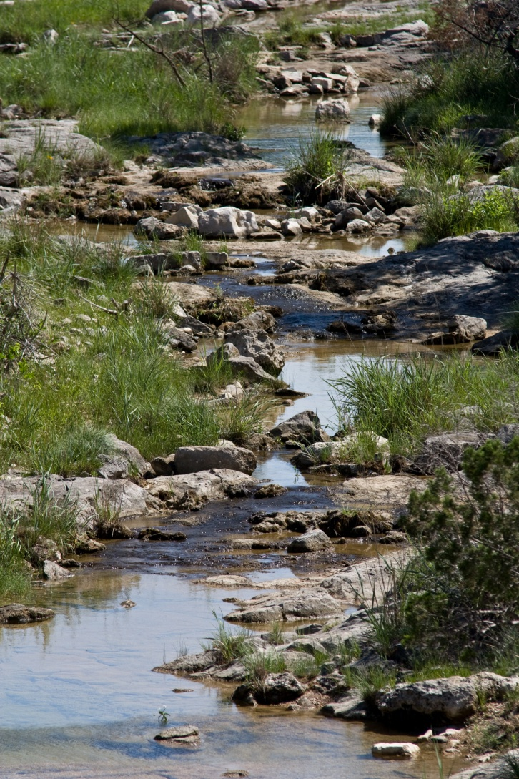
Surface Water
Includes stream diversions, new reservoirs, new/increased water supply contracts, connection of developed supplies to infrastructure, operational changes, and other strategies
Volume in 2010: 762,100 acre-feet
Volume in 2060: 4,550,000 acre-feet
Notes:
By 2060, new surface water strategies produce 5 times the volume produced by new groundwater strategies.
Operational changes: operation of reservoirs as a system to increase yield; reallocation of reservoir storage from flood control or hydro-electric power generation to water supply
“Other” surface water strategies: existing water that is not legally or physically available

Slide 19
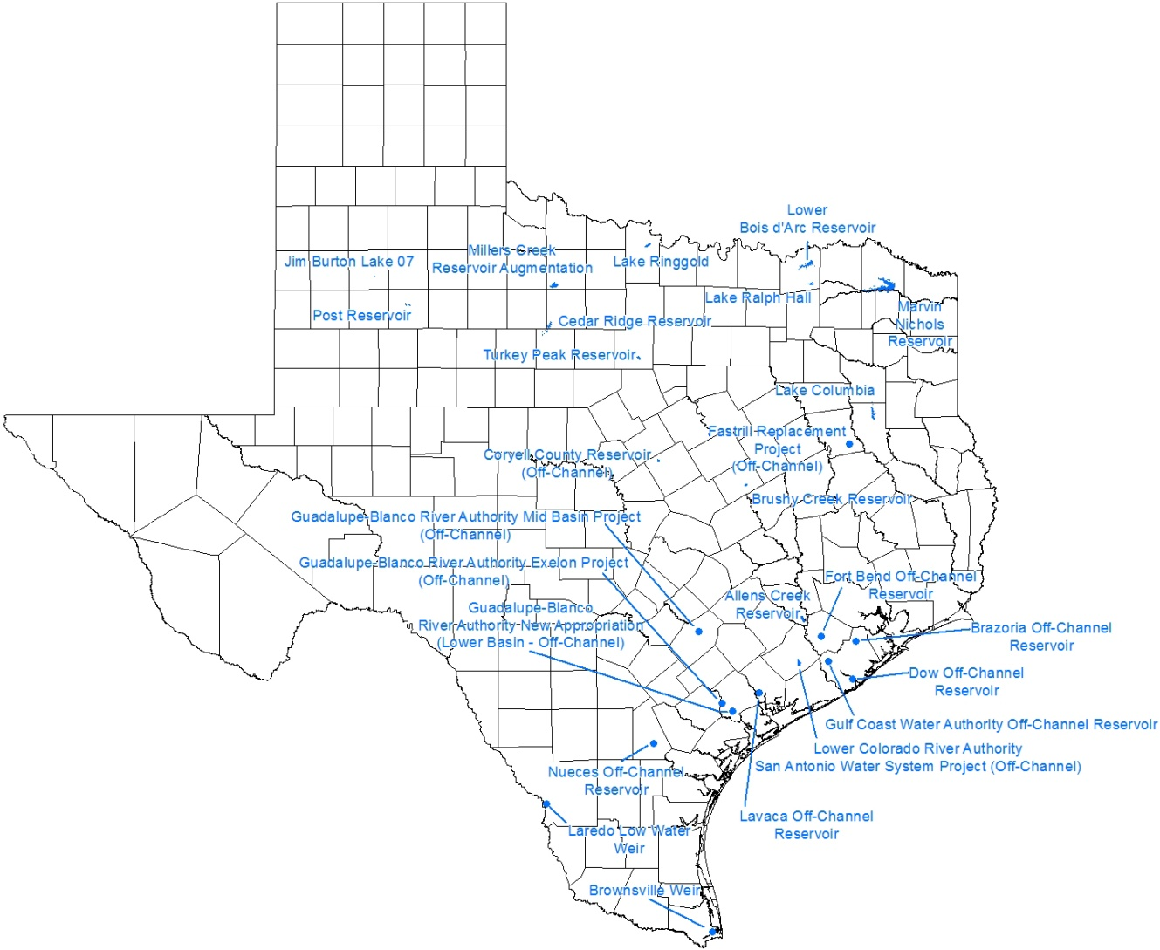
Recommended New Major Reservoirs
Notes:
Volume in 2010: 19,672 acre-feet
Volume in 2060: 1,499,671 acre-feet

Slide 20
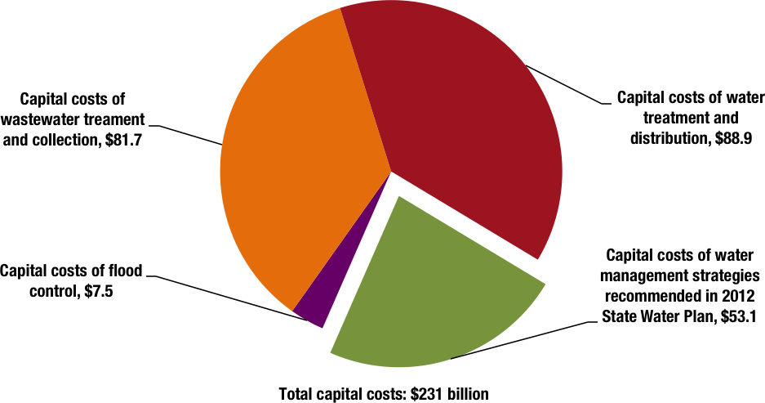
Total Water Supply
Capital Costs: $53 Billion
Notes:
Water providers surveyed during the planning process reported an anticipated need of $26.9 billion in state financial assistance to implement municipal water management strategies in their planning areas. This amount represents about 58 percent of the total capital costs for water supply management strategies recommended for municipal water user groups in the 2011 regional water plans.

Slide 21
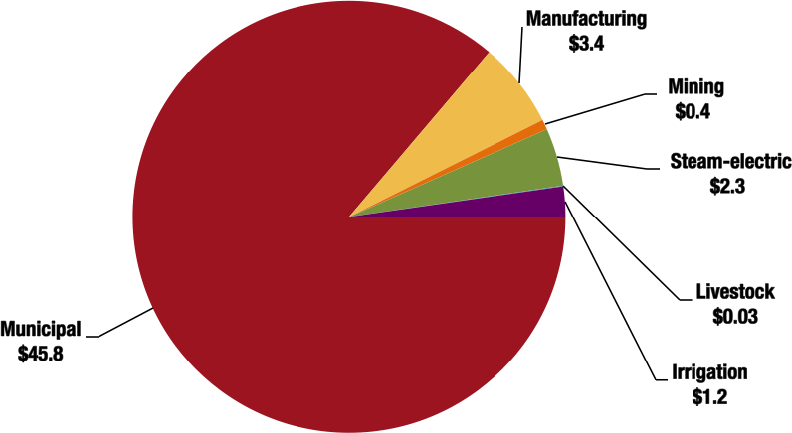
Costs by Water Use Category

Slide 22
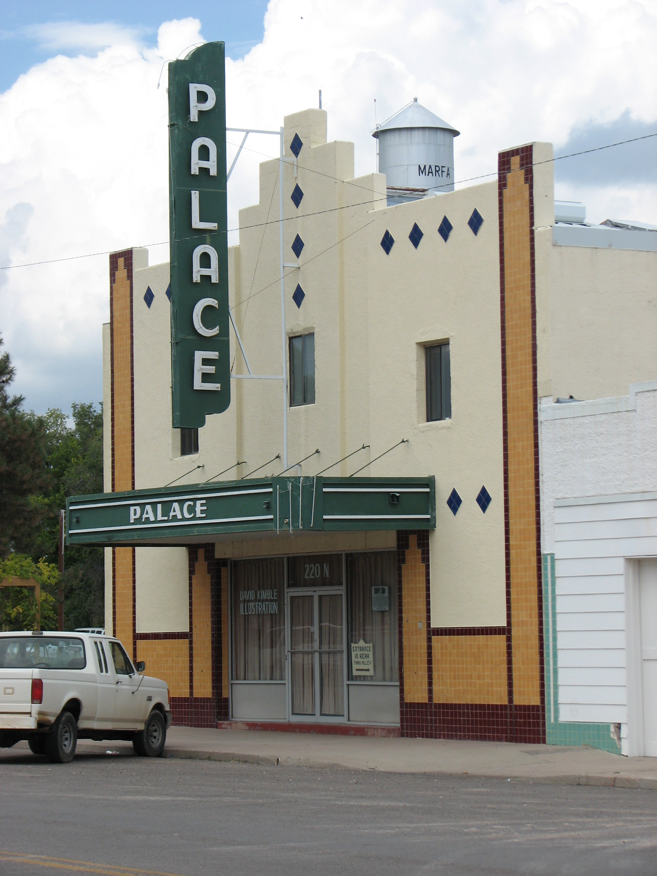
Cost of Not Implementing Plan Recommendations
$12 billion lost income - 2010
$116 billion lost income – 2060
State/local business taxes lost: $1 billion – 2010
State/local business taxes lost: $10 billion – 2060
Lost jobs : 115,000 – 2010
Lost jobs: 1 million – 2060
Lost population growth: 1.4 million - 2060

Slide 23

Policy Recommendations
Based on planning groups’ recommendations and other policy considerations, TWDB makes the following recommendations that are needed to facilitate the implementation of the 2012 State Water Plan.

Slide 24
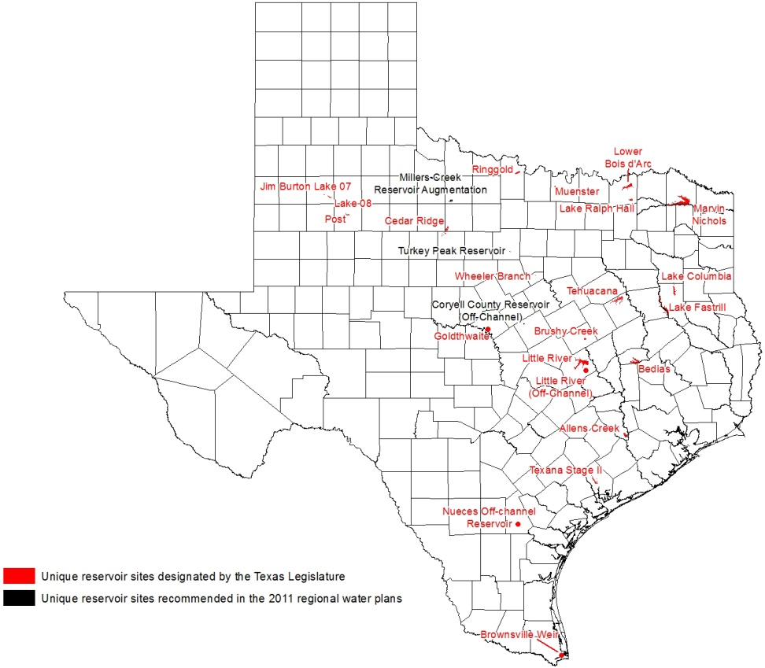
Unique Reservoir Site Recommendations

Slide 25
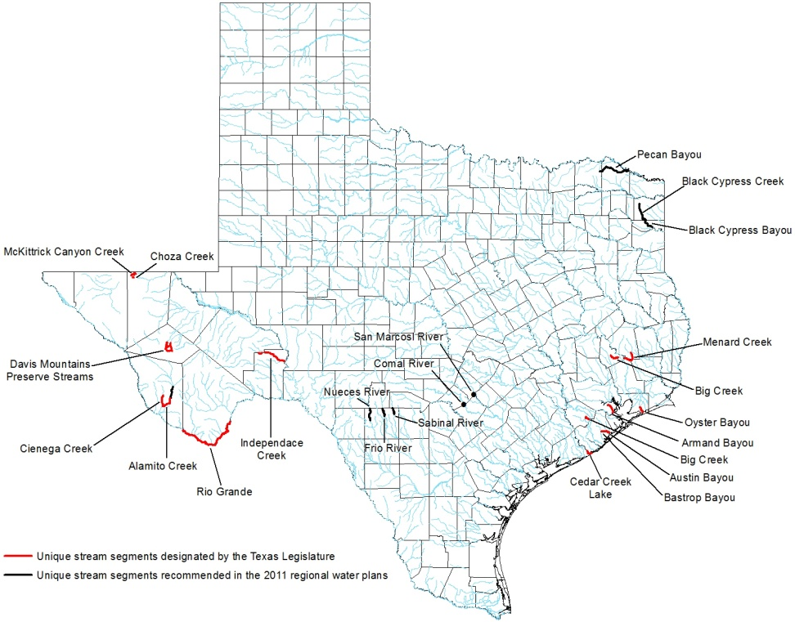
Unique Stream Segment Recommendations

Slide 26
Policy Recommendations
Acquisition of feasible reservoir sites
Interbasin transfers of surface water
Desired future conditions petition process
Water loss
Financing the State Water Plan
Notes:
The legislature should provide a mechanism to acquire feasible reservoir sites so they are available for development of additional water supplies to meet identified in the regional water plan and beyond.
The legislature should enact statutory provisions that eliminate unreasonable restrictions on the voluntary transfer of surface water from one basin to another.
The legislature should remove TWDB from the petition process concerning the reasonableness of a desired future condition except for technical review and comment.
The legislature should require all retail public utilities to conduct water loss audits on an annual basis, rather than every 5 years.
The legislature should develop a long-term, affordable, and sustainable method to provide financing assistance for the implementation of the state water plan.

Slide 27
Schedule
Public meetings October 3, 4, 6 & 11
Public hearing October 17 in Austin
Public comment period closes October 25
Board consider approval of 2012 State Water Plan November 17
Deliver approved plan to the Governor and Legislature January 5, 2012

Slide 28

Questions and Comments
Kathleen Ligon
TWDB
P.O. Box 13231
Austin, Texas 78711
Kathleen.ligon@twdb.texas.gov
www.twdb.texas.gov

