Slide 1
What is the appropriate balance between conventional treatment and environmental buffers?
Texas Water Development Board
Texas Innovative Water 2010 Seminar
October 11-12, 2010
Betty Jordan, P.E.

Slide 2
To treat or not to treat –
That is not the question.

Slide 3
So what is the question?

Slide 4
How much treatment is required for safe and effective water reuse ?
Historically
What is the end use of the water?
What quality requirements are needed for the end use?
Today
What is the end use of the water?
What quality requirements are needed for the end use?
Some things we know for certain.
Some things we don’t know.
What does the public require for the use?

Slide 5
What is being removed?
Conventional Pollutants
Nutrients
Minerals/Salts
Pathogens
Metals
Microconstituents

Slide 6
What processes remove what?
Activated Carbon
Biologically Activated Carbon
Clarification/Flocculation
Softening
Ozone
Ozone with Advanced Oxidative Processes
Ultraviolet Radiation
Chlorine/Hypochlorite
Microfiltration
Reverse Osmosis
Wetlands
Aquifer Sand Filtration
Activated Sludge
Membranee Bioreactors

Slide 7
Removal Efficiencies – Conventional Processes
PhAC Class | AC | BAC | C/F | Soft.
Antibiotics | 40-90% | >90% | <20-40% | <20-40%
Anti-depressants | 70->90% | 70->90% | <20-40% | <20-40%
Anti-infalamants | >90% | 70->90% | <20% | <20-40%
Lipid Regs. | >90% | >90% | <20% | <20-40%
X-ray contrast media | <70-90% | 70-90% | <20-40% | <20-40%
Psychiatric Control | 70->90% | 70-90% | <20-40% | <20-40%
Yoon, Westerhoff, Snyder, Song, Levine, AWWA WQQTC, 2004

Slide 8
Removal Efficiencies – Conventional Processes
EDC Class | AC | BAC | C/F | Soft.
Pesticides | >90% | >90% | <20 | 70-90%
Ind. Chem | >90% | >90% | <20-40% | <20-40%
Steroids | >90% | >90% | <20% | <20-40%
Metals | 70-90% | 70-90% | 40-90% | 40-90%
Inorganics | <20-40% | 40-70% | <20% | 70-90%
Organo-metalics | 70->90% | 70-90% | <20-40% | <20-40%
Yoon, Westerhoff, Snyder, Song, Levine, AWWA WQQTC, 2004

Slide 9
Removal Efficiencies – Oxidation & Membranes
EDC Class | O3/AOPs | UV | CL2/CLO2 | MF | RO
Pesticides | 20->90% | >90% | 70->90% | 70-90% | >90%
Ind. Chem | 40-90% | >90% | <20% | >90% | >90%
Steroids | >90% | >90% | >90% | 70-90% | >90%
Metals | <20% | <20% | <20% | 70-90% | >90%
Inorganics | <20% | <20% | <20% | 70-90% | >90%
Organo-metalics | 20-90% | 40-90% | 40-90% | 70-90% | >90%
Yoon, Westerhoff, Snyder, Song, Levine, AWWA WQQTC, 2002

Slide 10
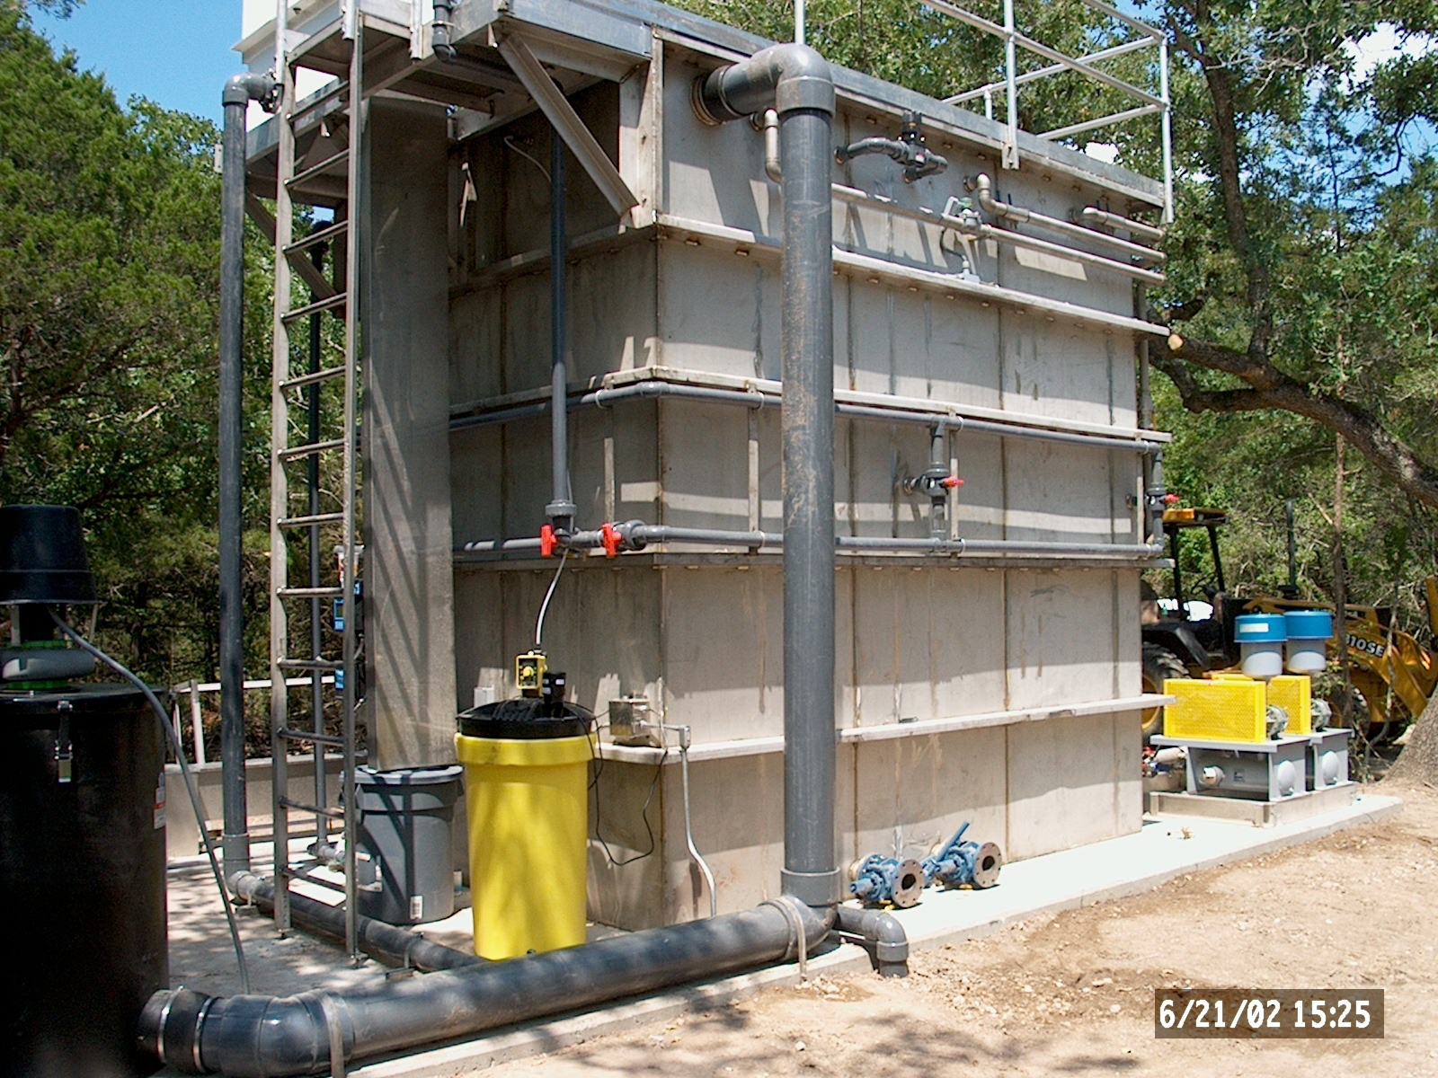
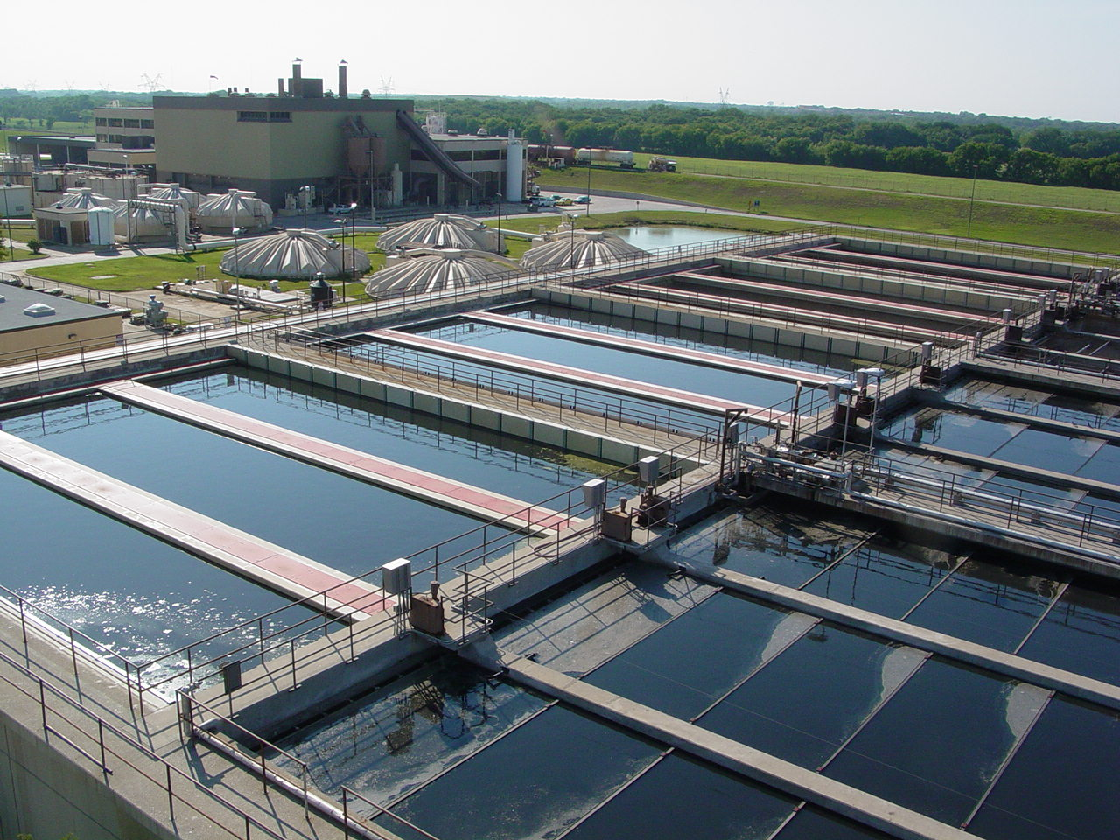
Activated Sludge/MBRs
Hydraulic Detention Time
Sludge Age

Slide 11
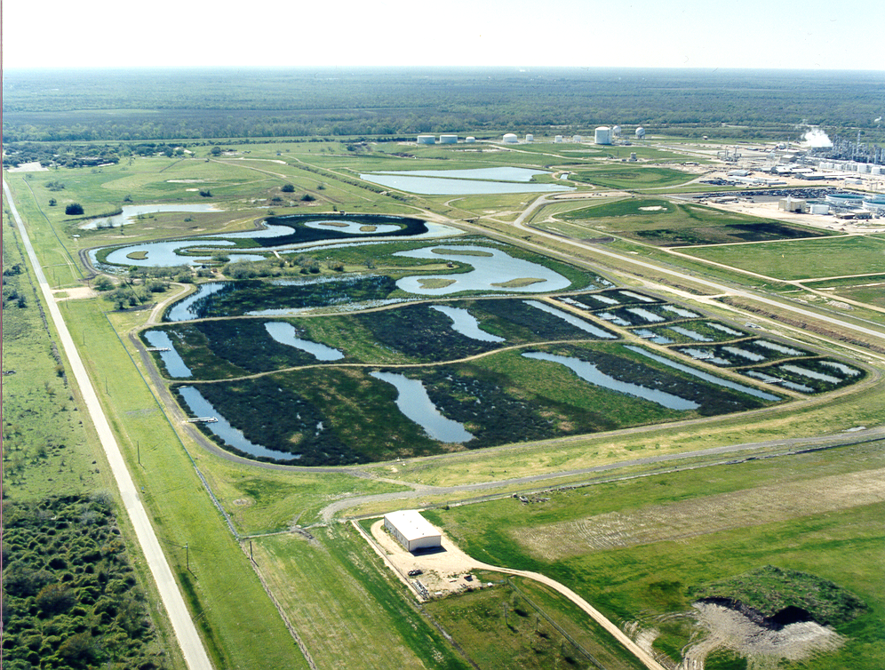
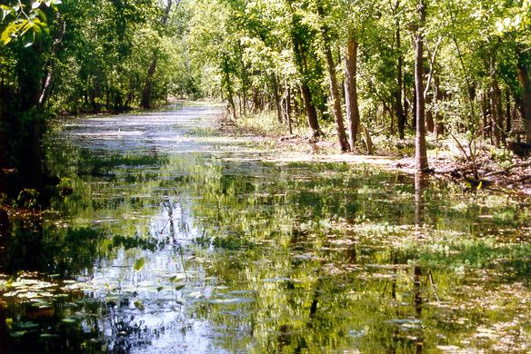
Natural Systems
Wetlands
Nutrients
Suspended solids
Organics
Microconsituents
Soil Filtration
Nutrients
Suspended Solids
Organics
Microconstituents

Slide 12
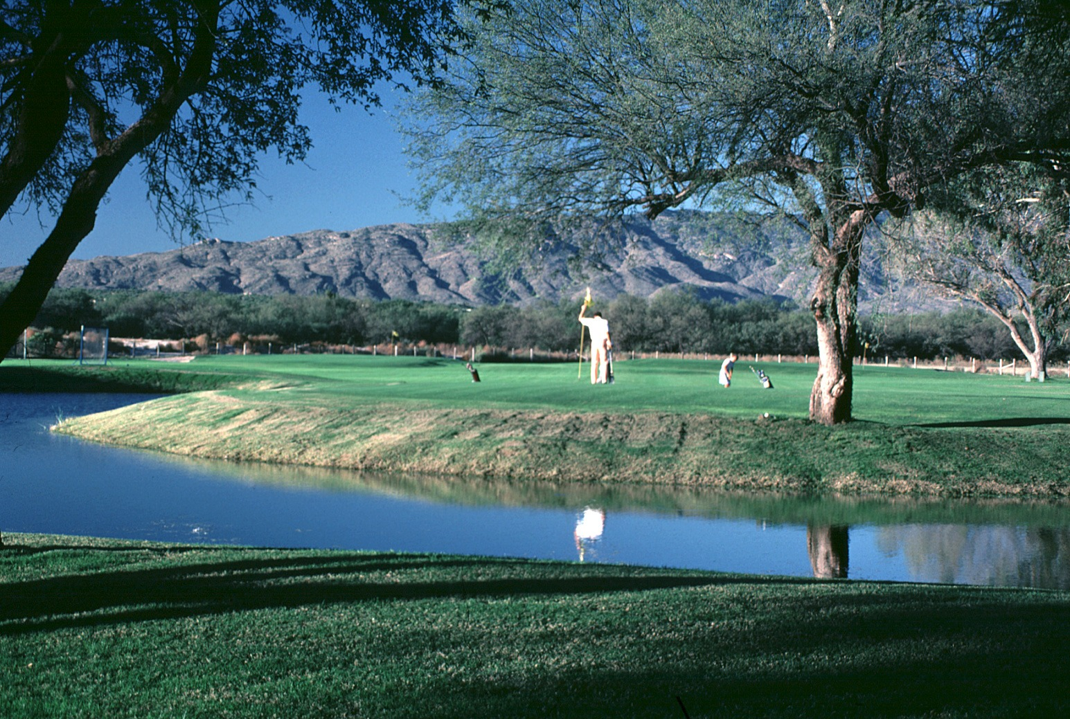
Conventional Direct Reuse
Bar Screens
Grit
Removal
Primary
Clarification
Activated
Sludge
Final Clarification
Filters
Disinfection
Conventional Reuse applications:
Landscape irrigation
Industrial supply

Slide 13
Indirect Potable Reuse
Carbon
Filtration
MF/UF
RO
AOP
Reservoir
Advanced
Secondary or
Tertiary
Effluent
Aquifer
Storage
Wetlands
Reservoir
Reservoir
Aquifer
Storage

Slide 14
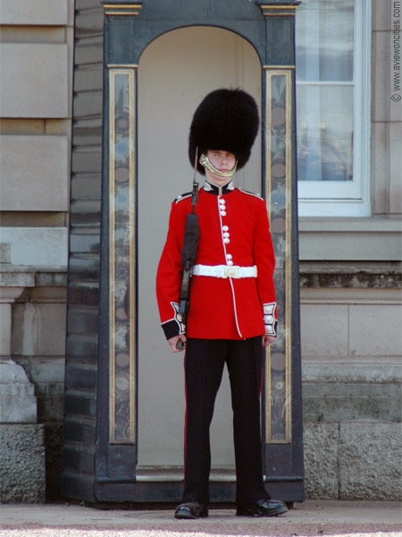
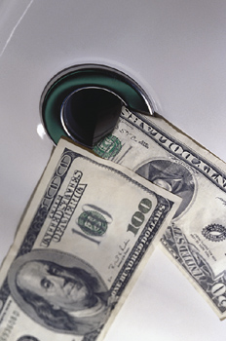
We are the guardians of public health.
We are the guardians of the environment.
We are the stewards of public finance.

Slide 15
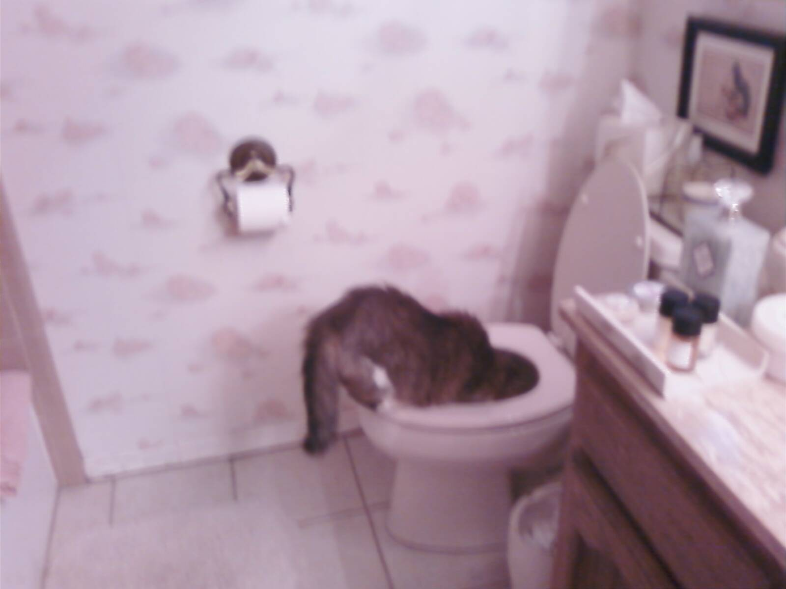
Contact information: Betty L. Jordan, P.E. Alan Plummer Associates, Inc. Phone: 214.631.6100 Email: bjordan@apaienv.com

