Slide 1

The State of Seawater Desalination in Texas
Jorge A. Arroyo P.E.
Innovative Water Technologies

Slide 2
The State of Seawater Desalination in Texas
Opportunities for seawater desalination
Texas Seawater Desalination Initiative
Regional water planning
Resources

Slide 3
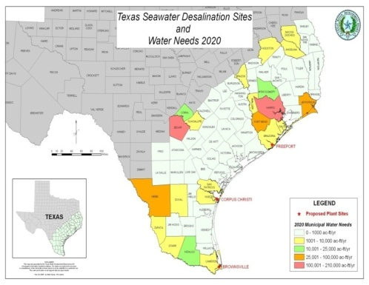
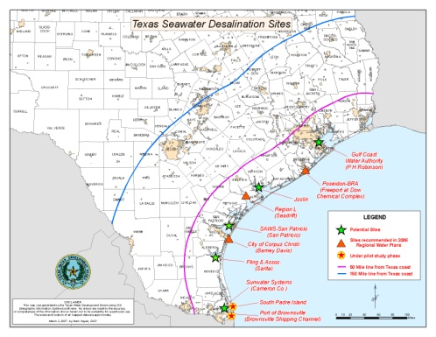
Opportunities for seawater desalination
Access to a plentiful source
  367 miles of coast
  Multiple sites for locating desalination plants
Proximity to [large] demand centers
  ~ 2/3 of the state’s population located within 150 miles of the coast
Need for supply diversity
  Vulnerability of existing sources
Cost-effective technology
  New water

Slide 4
Texas Seawater Desalination Initiative
Goal: To advance the development of seawater desalination supplies in Texas by implementing a large-scale demonstration plant
To-date:
  Feasibility studies: Brownsville, Corpus Christi and Freeport
  Pilot plant studies: Brownsville and South Padre Island
  Assessment of environmental issues and permitting strategies
Reporting
2002
2004
2006
2008
2010

Slide 5
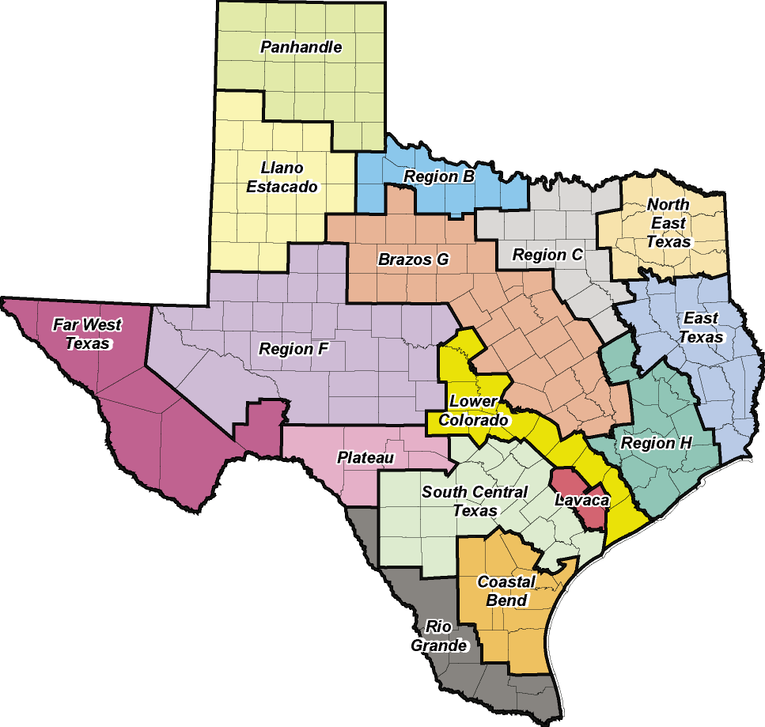
Seawater desalination and regional water planning
2001 Regional Water Plans
  Region N and Nueces River Authority: Membrane Technology and Cost Factors for Siting Seawater Desalination Facilities in Texas
  Region P and Lavaca-Navidad River Authority: Evaluation of Joslin Steam Electric Station as a site for a seawater desalination plant
  Region L: Seawater Desalination, recommended water management strategy for Bexar County (2040)

Slide 6
Seawater desalination and regional water planning
2006 Regional Water Plans
  Region H: Freeport (Dow Chemical)-Alternative water management strategy-Alternative water management strategy
  Region L: Seawater Desalination, recommended water management strategy for Bexar County (2040)
  Region M:
    Seawater Desalination, recommended regional water management strategy for Cameron County
    Seawater Desalination, recommended water management strategy for South Padre Island
  Region N: Corpus Christi Seawater Desalination Plant-Alternative water management strategy

Slide 7
Seawater desalination and regional water planning
2010 Initially Prepared Regional Water Plans
  Seawater desalination included as a recommended water management strategy in planning regions L and M
  Seawater desalination included as an alternative water management strategy in planning regions H and N

Slide 8
Seawater desalination in Texas: strengths and weaknesses
Strengths
Weaknesses
Vision
Opportunity
Leadership support
Regional/State Water Planning Process
Consensus
Technology
Lack of a precedent
Cost
Energy requirements
Funding strategy
Vulnerability of coastal facilities

Slide 9
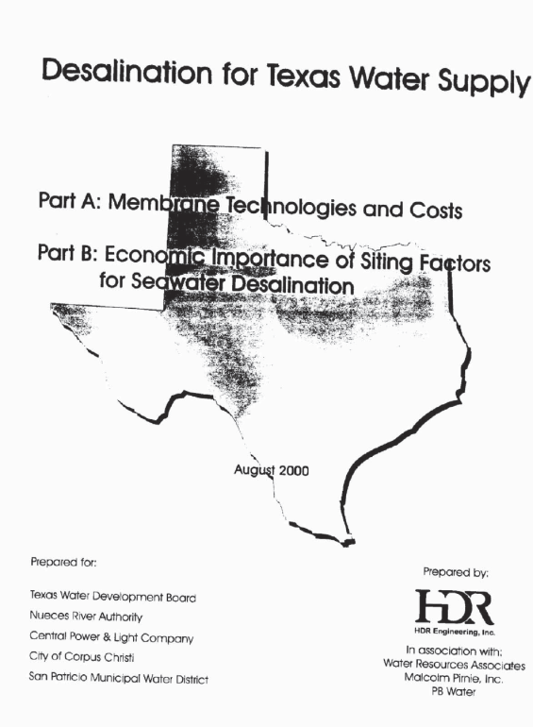
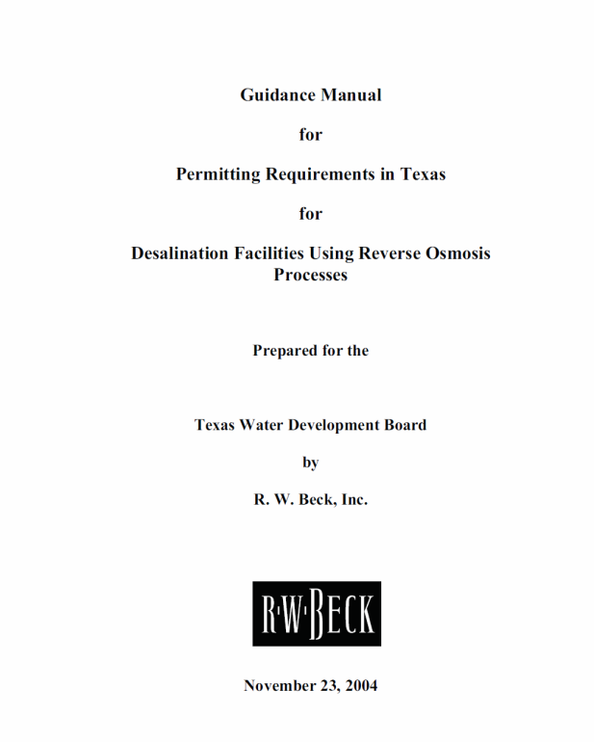
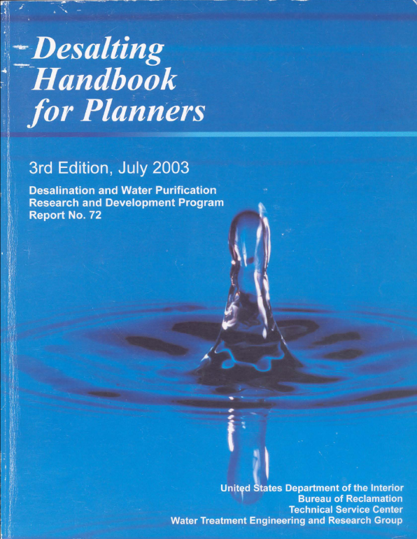
Resources
TWDB Contract No. 2000-483-328
Desalination for Texas Water Supply
Part A: Membrane Technologies/Cost
Part B: Economic Importance of Siting Factors for Seawater Desalination
TWDB Contract No. 2003-483-509
Guidance Manual for Permitting Requirements in Texas for Desalination Facilities
US Bureau of Reclamation 2003
Site for downloading completed TWDB reports:
http://www.twdb.state.tx.us/iwt/desal/projects.asp

