Slide 1
The State of Brackish Groundwater Desalination in Texas
Jorge A. Arroyo P.E.
Innovative Water Technologies

Slide 2
The State of Brackish Groundwater Desalination in Texas
Availability
Current Use
Projected Use
Challenges

Slide 3
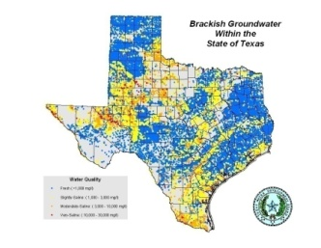
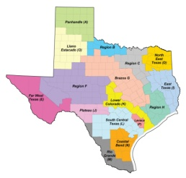
Availability of Brackish Groundwater in Texas

Slide 4
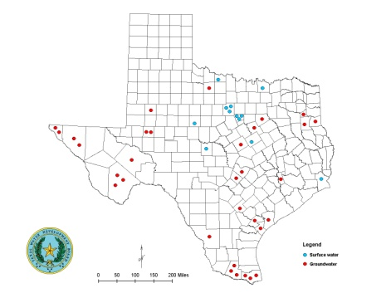
Existing Brackish Groundwater Desalination in Texas

Slide 5
Projected Brackish Groundwater Desalination in Texas
2007 Water For Texas
2010 Initially Prepared Plans
Region | New Water from BGW Desal by 2060 (acre-feet/year)
E | 50,000
F | 16,221
K | 29,568
L | 5,662
M | 69,962
O | 3,360
TOTAL | 174,773
Region | New Water from BGW Desal by 2060 (acre-feet/year)
E | 27,726
F | 16,050
K | 71,000
L | 40,216
M | 76,051
O | 3,360
TOTAL | 170,503

Slide 6
Challenges to Brackish Groundwater Desalination in Texas
Resource characterization
Source location
Quantity and quality
Sustainability
Concentrate management
Practical options
Potential impacts
Cost
Permitting
Energy requirements
Relative higher power demand
Strategies to reduce energy requirements
Alternative energy source
Funding
Planning and feasibility assessments
Pilot studies
Demonstration projects

Slide 7
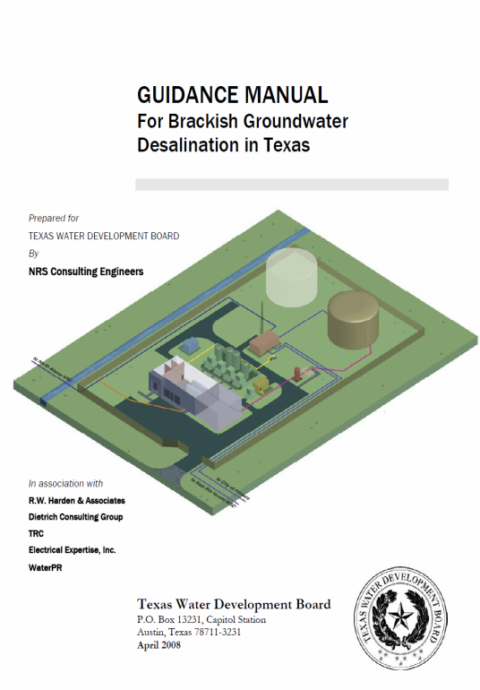
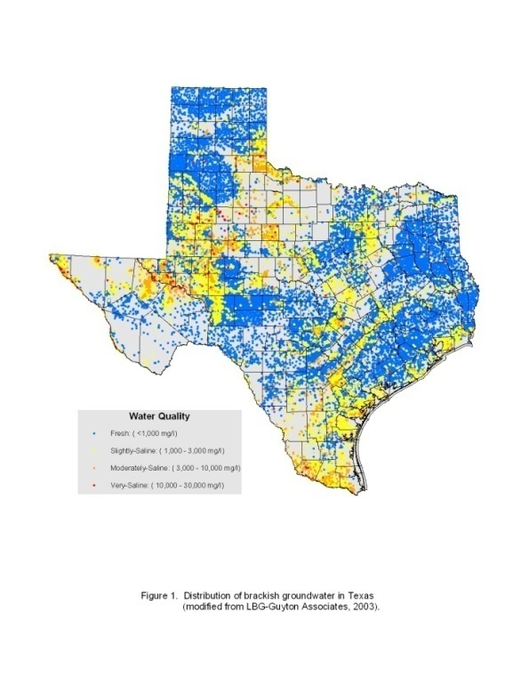
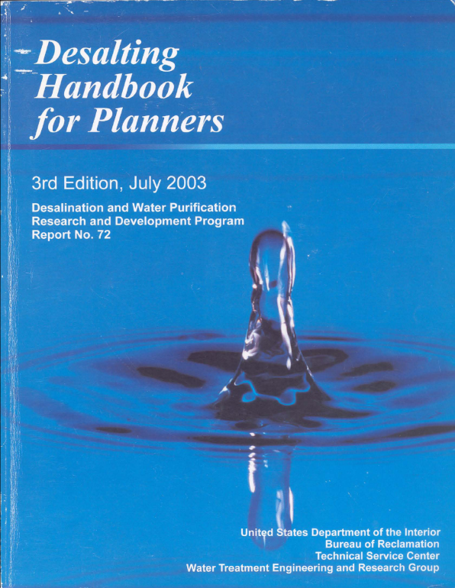
Resources for Brackish Groundwater Desalination
TWDB Contract No. 0604830581
Guidance Manual for Brackish Groundwater Desalination in Texas
TWDB Contract No. 2001483395
Brackish Groundwater Manual for Texas
Regional Water Planning Groups
US Bureau of Reclamation 2003
Site for downloading completed reports:
http://www.twdb.state.tx.us/iwt/desal/projects.asp

