Slide 1

The State of Aquifer Storage Recovery in Texas
Texas Innovative Water 2010
Advancing the Development of New Water Supplies in Texas
Fred M. Blumberg
Senior Associate
Malcolm Pirnie, Inc.

Slide 2
Discussion Outline
Introduction to ASR and its National Perspective
Current Texas ASR Projects
TWDB Priority Research
Preliminary Findings

Slide 3
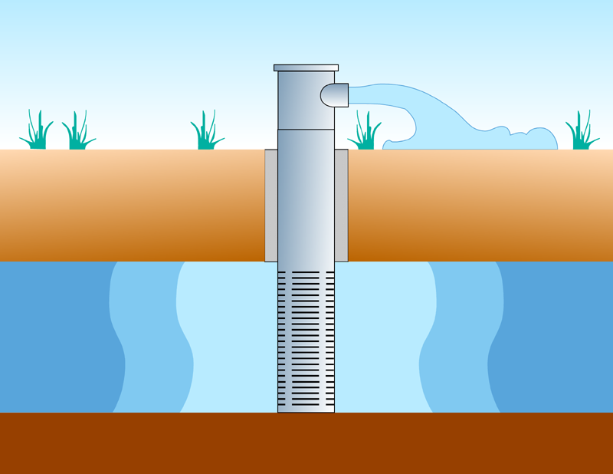
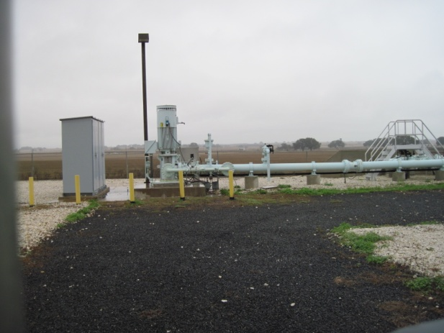
Aquifer Storage & Recovery (ASR)
  “…the storage of water in a suitable aquifer … during times when water is available, and recovery of that water … during times when it is needed.”
  David G. Pyne, P.E.
  ASR Systems, LLC
  Gainesville, FL
Notes:
Omit slide if David is included as a presentation author.

Slide 4
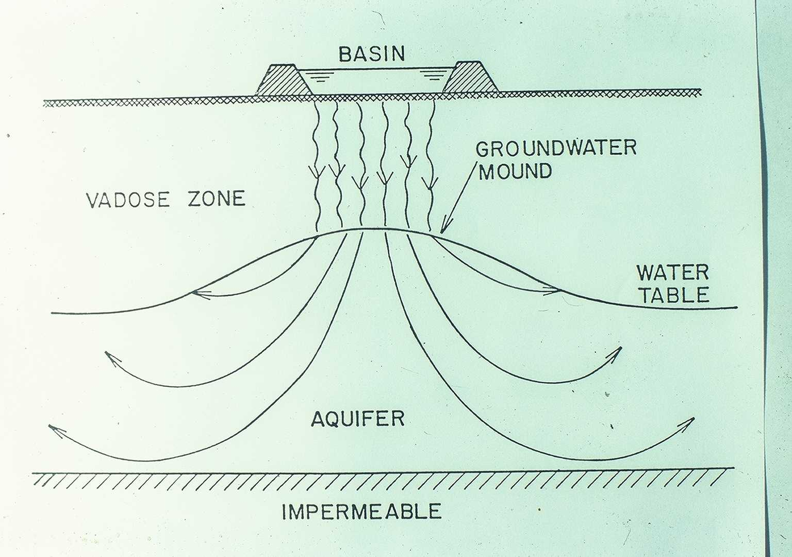
Recharge Alternatives Include…
  Basins, channels
  Vadose zone wells
  Injection wells
    Recovery from different well
    Recovery from injection well

Slide 5
ASR Well
ASR Well
Confining Layer
Confining Layer
Native
Ground
Water
Native
Ground
Water
Buffer
Zone
Stored
Water
Stored
Water
Buffer
Zone
Target Storage Volume
Confining Layer
Notes:
This shows that the TSV is the sum of the stored water volume and the buffer zone volume. The TSV can be developed in a series of cycles, each of which leaves some water underground to form the buffer zone, or it can be achieved in one continuous initial injection period. We are transitioning toward the latter in areas where ASR feasibility is already accepted. In other areas, we usually have to do successive cycles for clients and regulators to gain confidence in the data.

Slide 6
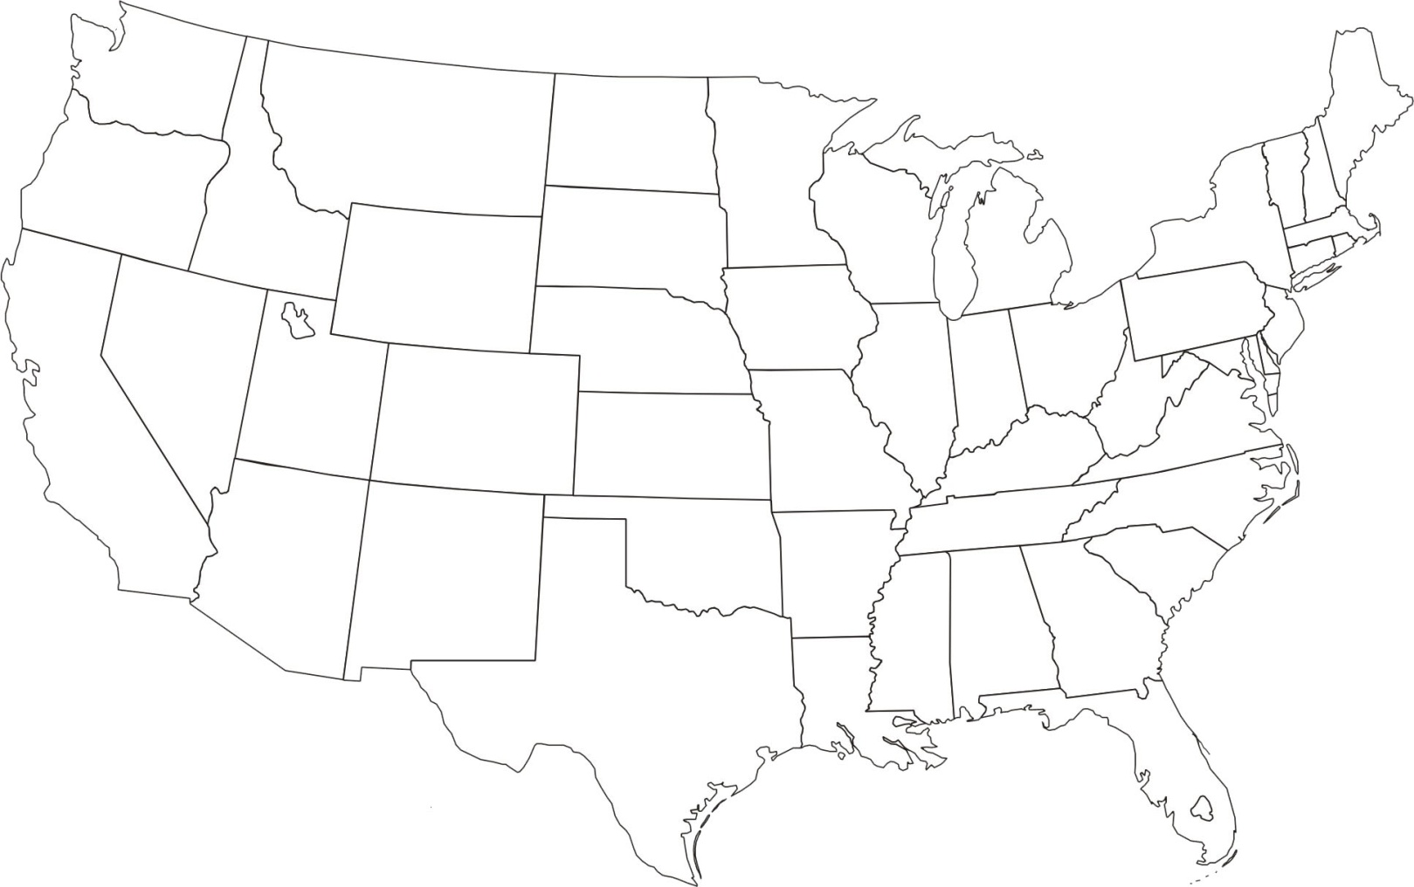
Operational ASR Wellfields (~ 95 in 2009)

Slide 7
Sources and Storage Zones
Water sources:
  Potable water
  Reclaimed water--treated
  Seasonally-available stormwater--treated
  Groundwater from overlying, underlying or nearby aquifers
Storage zones
  Fresh, brackish and saline aquifers
  Confined, semi-confined and unconfined aquifers
  Sand, clayey sand, gravel, sandstone, limestone, dolomite, basalt, conglomerates, glacial deposits
  Vertically “stacked” storage zones

Slide 8
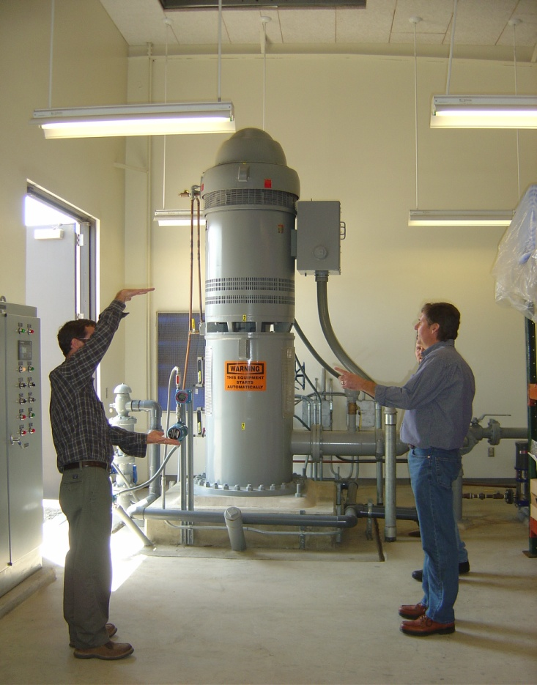
ASR Operating Ranges
Well depths
  30 to 2700 feet
Aquifer storage interval thickness
  20 to 400 feet
Storage zone TDS
  30 mg/l to 39,000 mg/l
Storage Volumes
  100 AF to >270,000 AF
Individual wells up to 8 MGD
Wellfield capacity up to 157 MGD
Calleguas MWD,
Thousand Oaks, California
ASR Well

Slide 9
Texas ASR Operations
Currently 3 active ASR operations
    San Antonio Water System (SAWS)
    El Paso Water Utilities– Public Service Board (EPWU)
    City of Kerrville
  Only 1 proposed project in current Water Plan
    Expansion of Kerrville WTP and ASR
  Few studies underway
    UGRA Water Supply Study in Kerr County
    SAWS Capacity and Capability RFP

Slide 10

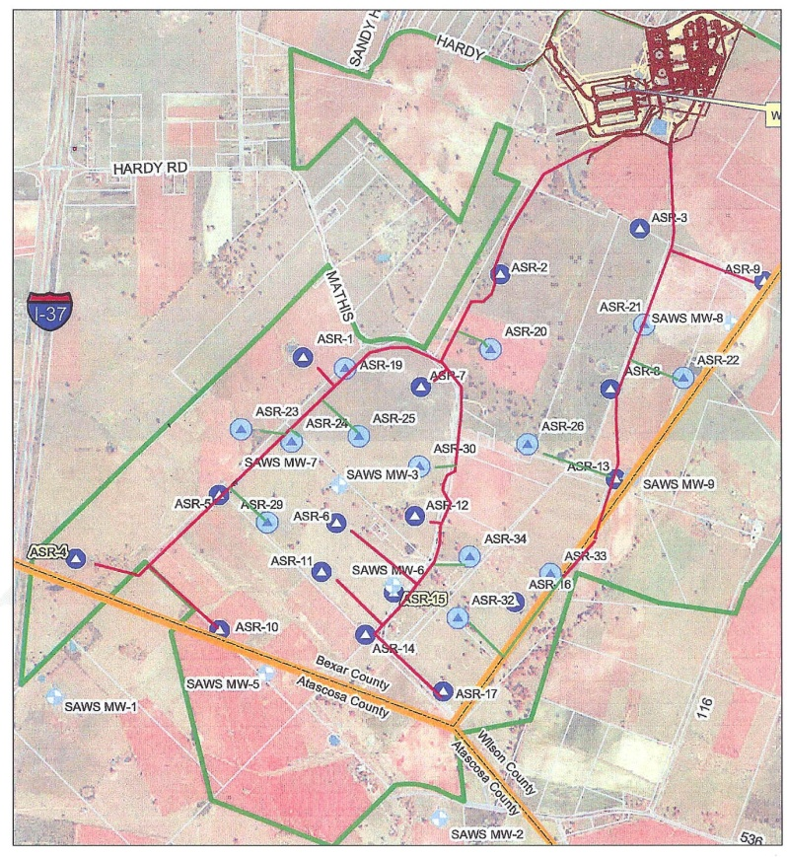
San Antonio Water System
Twin Oaks ASR Facility
  OBJECTIVES: Began as seasonal storage reserve; transitioned to long-term storage
  3rd largest ASR project in U.S.
  29 ASR wells
  Capacity: 60 mgd
  Source: Groundwater from the Edwards Aquifer
  Storage zone: Carrizo Aquifer
Operation began in 2004

Slide 11

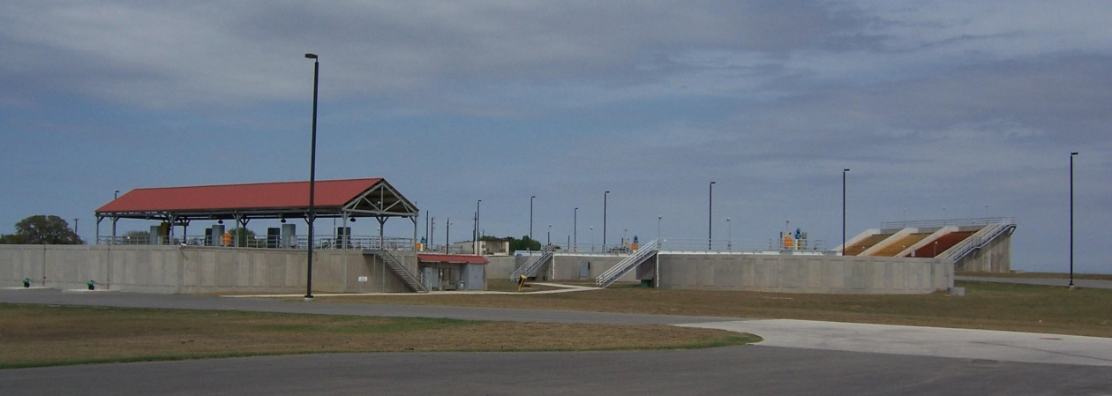
Twin Oaks ASR Facility
  Carrizo Aquifer
  Confined aquifer
  pH 5.5
  Elevated Fe/Mn and hydrogen sulfide
  Project includes 7 local Carrizo wells
Water treatment available to remove Fe/Mn, adjust pH, and provide disinfection
  To date, only disinfection has been needed for recovered ASR water

Slide 12
SAWS ASR Storage Volume

Slide 13

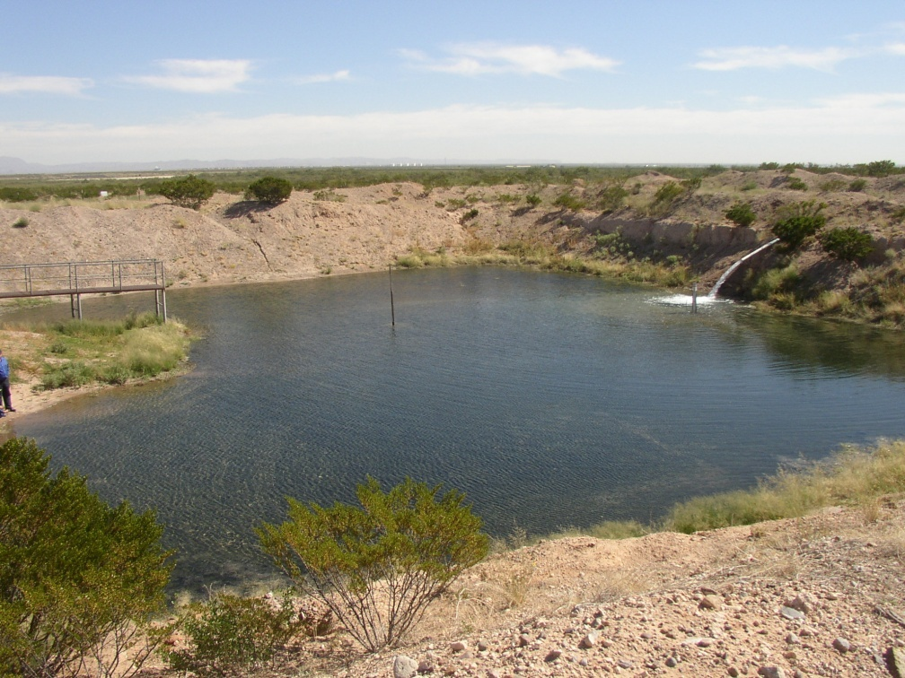
El Paso Water Utilities
  OBJECTIVES: Restore GW levels; store reclaimed water; improve WQ; supply peaking water
  1st ASR project in Texas
  4 ASR wells and 4 basins
  Capacity: ~10 mgd
  Source: Treated wastewater from Fred Hervey WRP
  Storage zone: Hueco Bolson Aquifer

Slide 14
EPWU—Fred Hervey WRP

Slide 15
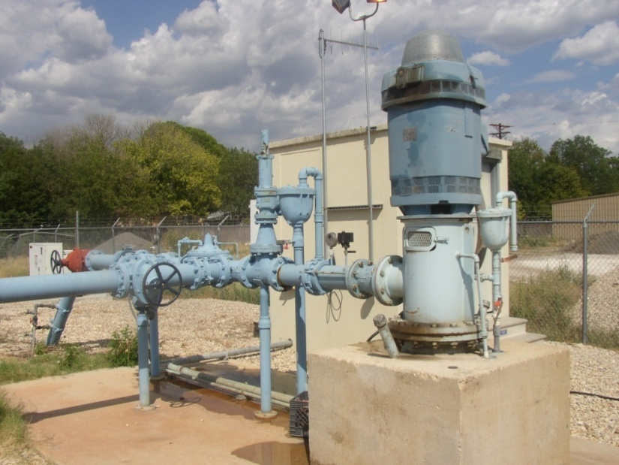
  OBJECTIVES: Storage for drought management and peaking
  2nd ASR project in Texas (1995)
  2 ASR wells (3rd in development)
  Current capacity: 2.65 mgd
  Source: Treated surface water from Guadalupe River
  Storage zone: Lower Trinity Aquifer
  Max stored volume to date: 2,100 AF

Slide 16
Summary
Component | EPWU (10 mgd) | Kerrville (2.65 mgd) | SAWS (60 mgd)
Date | 1985 | 1995 | 2004
Source Water | Treated Wastewater | Treated River Water | Groundwater
Storage | 300-835 feet Hueco Bolson | 495-613 feet Lower Trinity | 400-600 feet Carrizo
Issues | Original well design Customers for reclaimed water | Litigation during permitting Lack of source water | Single pipeline Distribution system limitations
Expansion Plans | Expanding FHWRP Constructing 4th spreading basin | Adding 3rd ASR well WTP expansion in Regional Plan | Part of 50-year Management Plan Evaluating TSV

Slide 17
TWDB ASR Research Project
  HB 1989 (1995) recognized ASR as a beneficial use
  Why is ASR not being implemented?
  What policy changes or technical studies are needed?
  Scope of Work:
    Legal white paper
    Interviews /site visits with 3 participating utilities
    Survey of other TX utilities
    Review of literature and US/global practices
    Presentations and guidance for implementation

Slide 18
Study Team
Malcolm Pirnie, Inc.
ASR Systems, LLC (Gainesville, FL)
Edmond McCarthy, Jr., JD
Existing ASR Utilities in Texas
  SAWS
  EPWU
  Kerrville

Slide 19
ASR Considerations
  Recharge water quality and treatment requirements
  Water quality in receiving aquifer
  Land availability and cost
  Recovery efficiency
  Project costs and public perception
  Legal / regulatory framework/permits
    Rule of capture
    Source water permit(s)
    TCEQ Class V injection well permit
Notes:
However, it’s important to consider the impacts on other DS water quality parameters if the pH is adjusted to controlled nitrification

Slide 20

ASR Advantages
  Minimal evaporation
  Fewer environmental impacts
  Competitive cost
  Flexibility--incremental well addition
  Broad public acceptance
  Ability to readily supplement other water supply strategies
  Broad range of applications and geographic settings
Notes:
However, it’s important to consider the impacts on other DS water quality parameters if the pH is adjusted to controlled nitrification

Slide 21
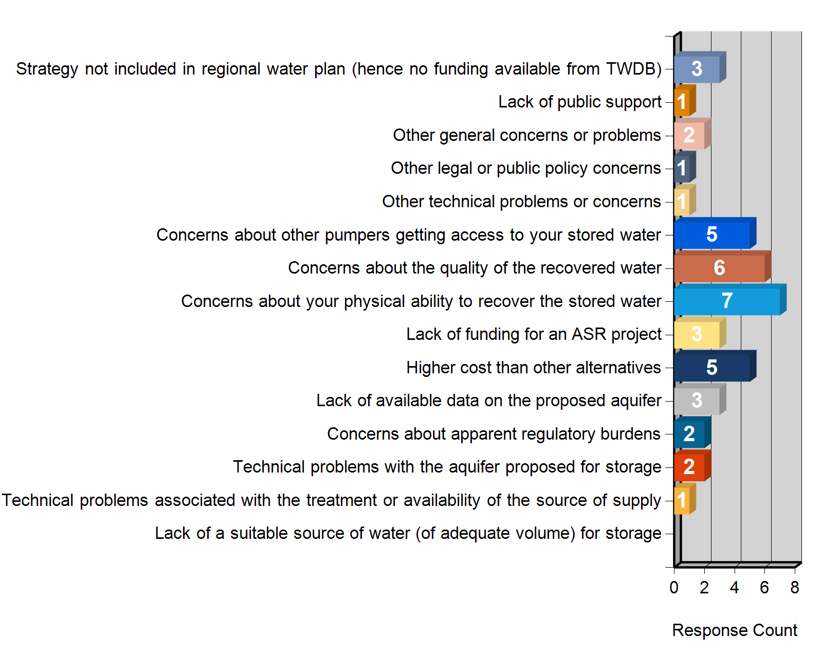
Initial Utility Survey—Why ASR Has Not Been Pursued

Slide 22
Preliminary Findings
Technical issues can usually be resolved
Capital and O&M costs are seldom realistically evaluated and documented
Public perception and acceptance of current ASR systems have been good to excellent
Current public policies and legal issues impose the major obstacles
Significant opportunities for the future
  Treated water stored in brackish aquifers
  Use of excess WTP capacity in winter months
  Peaking water to meet summer demands
  Temporary surface water permits
  Scalping surface water permits

Slide 23

Questions
Fred M. Blumberg
Senior Associate
Malcolm Pirnie, Inc.
512-584-4242
fblumberg@pirnie.com

