Slide 1
Stormwater Harvesting
Legal and Regulatory Issues
TWDB Innovative Water Seminar
Presented by:
Brad B. Castleberry
bcastleberry@lglawfirm.com
816 Congress Avenue
Suite 1900
Austin, Texas 78701
(512) 322-5800
(512) 472-0532 Fax
www.lglawfirm.com
Notes:
Brad Castleberry
Partner at LG
Immediate past president of WEAT
Upcoming WEAT conferences www.weat.org (CMOM and Biosolids/Odor)
Represent a number of utilities across the state in managing their pretreatment programs
Also deal with a number of utilities that are enforced against by EPA and TCEQ. See the enforcement side of things from both angles. More fun to be the regulator though ☺
Presentation was developed last night. Paper in cluded in conference materials as a resource afterwards. Hopefully something that you can hand your city attorney or manager in the event you are struggling with issues related to enforcement.

Slide 2
Topics to Address
History and evolution of surface water law
Mexican and Spanish law
English common law
Prior appropriation
Diffused surface water and exemptions from permitting
Water rights permitting at TCEQ
Other potential regulatory requirements
Federal permitting issues
Notes:
The Clean Water Act was passed to address significant pollution in waters across the United States
The goal was to restore the nation’s waterways to “fishable swimable” conditions
To implement this goal, EPA began to regulate point source discharges, especially those associated with POTWS
EPA adopted standards for surface water quality and began imposing technology based effluent limits to regulate discharges
Nested within regulating POTWS is a need to regulate those who are discharging to the POTW – the industrial users. The need to regulate industrial users is a function of the need to ensure the POTW can comply with its limits.

Slide 3
What is state water?
The water of the ordinary flow, underflow, and tides of every flowing river, natural stream, and lake, and of every bay or arm of the Gulf of Mexico, and the storm water, floodwater, and rainwater of every river, natural stream, canyon, ravine, depression, and watershed in the state is the property of the state.
Notes:
The Clean Water Act was passed to address significant pollution in waters across the United States
The goal was to restore the nation’s waterways to “fishable swimable” conditions
To implement this goal, EPA began to regulate point source discharges, especially those associated with POTWS
EPA adopted standards for surface water quality and began imposing technology based effluent limits to regulate discharges
Nested within regulating POTWS is a need to regulate those who are discharging to the POTW – the industrial users. The need to regulate industrial users is a function of the need to ensure the POTW can comply with its limits.

Slide 4
How did we get this definition?
Origin of surface water rights stems back to Spanish and Mexican civil law
Between 1840 and 1895, many land grants made with riparian rights to surface water
Riparian doctrine began to merge with prior appropriation doctrine in series of Irrigation Acts
1889 Irrigation Act
1895 Irrigation Act
1913 Irrigation Act
Notes:
The Clean Water Act was passed to address significant pollution in waters across the United States
The goal was to restore the nation’s waterways to “fishable swimable” conditions
To implement this goal, EPA began to regulate point source discharges, especially those associated with POTWS
EPA adopted standards for surface water quality and began imposing technology based effluent limits to regulate discharges
Nested within regulating POTWS is a need to regulate those who are discharging to the POTW – the industrial users. The need to regulate industrial users is a function of the need to ensure the POTW can comply with its limits.

Slide 5
Confusion with Dual System
Many permits were issued under the various Irrigation Acts.
Confusion over dual riparian and prior appropriation scheme (normal vs. flood flows)
Like many things, drought drives change…
1967 Water Rights Adjudication Act
All parties required to file claims under single system
All claims adjudicated (1970-2000+)
Notes:
The Clean Water Act was passed to address significant pollution in waters across the United States
The goal was to restore the nation’s waterways to “fishable swimable” conditions
To implement this goal, EPA began to regulate point source discharges, especially those associated with POTWS
EPA adopted standards for surface water quality and began imposing technology based effluent limits to regulate discharges
Nested within regulating POTWS is a need to regulate those who are discharging to the POTW – the industrial users. The need to regulate industrial users is a function of the need to ensure the POTW can comply with its limits.

Slide 6
Usufructury Rights
State owns all water – normal and flood waters
Through permitting, State can grant right to use state water, or acknowledge exemptions
Currently few exemptions to state water
Domestic and livestock exemption
Ag land and wildlife farming exemption
Gulf of Mexico exemption
Surface mining exemption
Notes:
The Clean Water Act was passed to address significant pollution in waters across the United States
The goal was to restore the nation’s waterways to “fishable swimable” conditions
To implement this goal, EPA began to regulate point source discharges, especially those associated with POTWS
EPA adopted standards for surface water quality and began imposing technology based effluent limits to regulate discharges
Nested within regulating POTWS is a need to regulate those who are discharging to the POTW – the industrial users. The need to regulate industrial users is a function of the need to ensure the POTW can comply with its limits.

Slide 7
When is a permit not required?
Domestic and livestock exemption . . .
“Without obtaining a permit, a person may construct on the person’s own property a dam or reservoir with normal storage of not more than 200 acre-feet of water for domestic and livestock purposes. A person who temporarily stores more than 200 acre-feet of water in a dam or reservoir described by this subsection is not required to obtain a permit for the dam or reservoir if the person can demonstrate that the person has not stored in the dam or reservoir more than 200 acre-feet of water on average in any 12-month period.” TWC 11.042(a).

Slide 8
But what about “private water”?
Diffused Surface Water
State water does not include percolating groundwater; nor does it include diffuse surface rainfall runoff, groundwater seepage, or springwater before it reaches a watercourse. Hoefs v. Short
Water Course
A definite channel of a stream in which water flows within a defined bed and banks, originating from a definite source or sources. (The water may flow continuously or intermittently, and if the latter with some degree of regularity, depending on the characteristics of the sources.)
Notes:
The Clean Water Act was passed to address significant pollution in waters across the United States
The goal was to restore the nation’s waterways to “fishable swimable” conditions
To implement this goal, EPA began to regulate point source discharges, especially those associated with POTWS
EPA adopted standards for surface water quality and began imposing technology based effluent limits to regulate discharges
Nested within regulating POTWS is a need to regulate those who are discharging to the POTW – the industrial users. The need to regulate industrial users is a function of the need to ensure the POTW can comply with its limits.

Slide 9
Off-Channel Impoundment

Slide 10
Watercourse is Key!!
Natural Watercourse
Diffused surface water belongs to the owner of the land so long as it remains on that land prior to its passage into a natural watercourse. Turner v. Big Lake Oil
Un-natural Watercourse??
No legal definition or standard for artificial watercourse
Consideration for drainage ditches in existing permits
Consideration for storm sewers and scalping
When is there a continuous flow and defined channel?
What about hydraulic connectivity?
Notes:
The Clean Water Act was passed to address significant pollution in waters across the United States
The goal was to restore the nation’s waterways to “fishable swimable” conditions
To implement this goal, EPA began to regulate point source discharges, especially those associated with POTWS
EPA adopted standards for surface water quality and began imposing technology based effluent limits to regulate discharges
Nested within regulating POTWS is a need to regulate those who are discharging to the POTW – the industrial users. The need to regulate industrial users is a function of the need to ensure the POTW can comply with its limits.

Slide 11
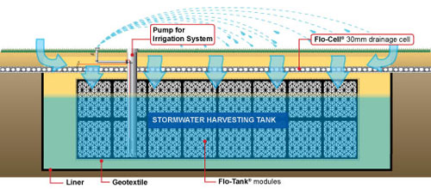

Slide 12
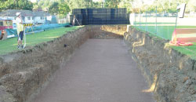
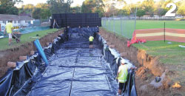
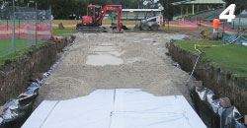

Slide 13
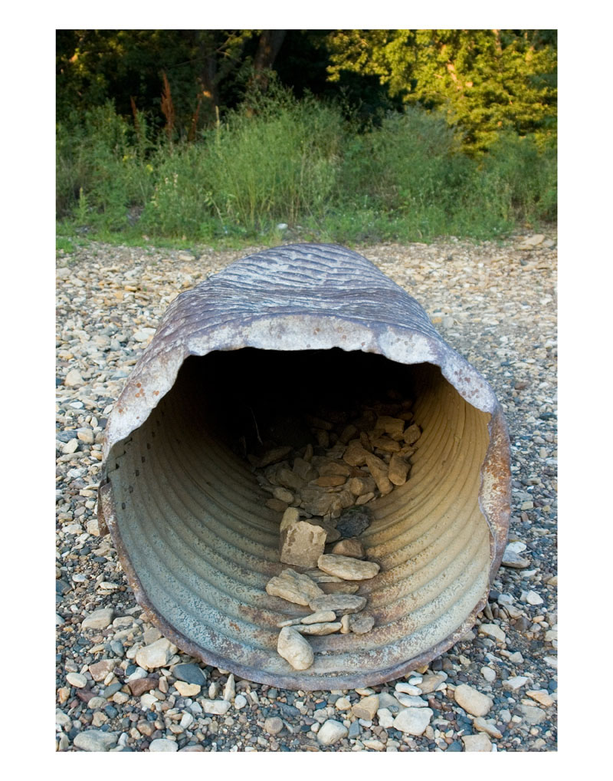
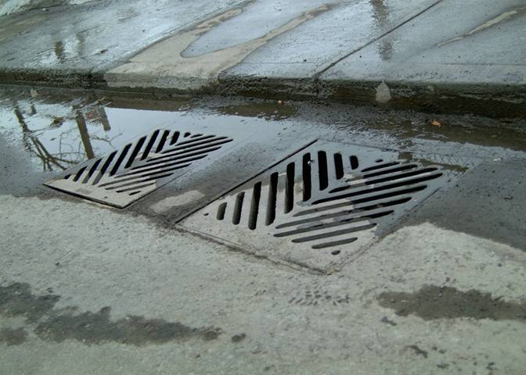

Slide 14
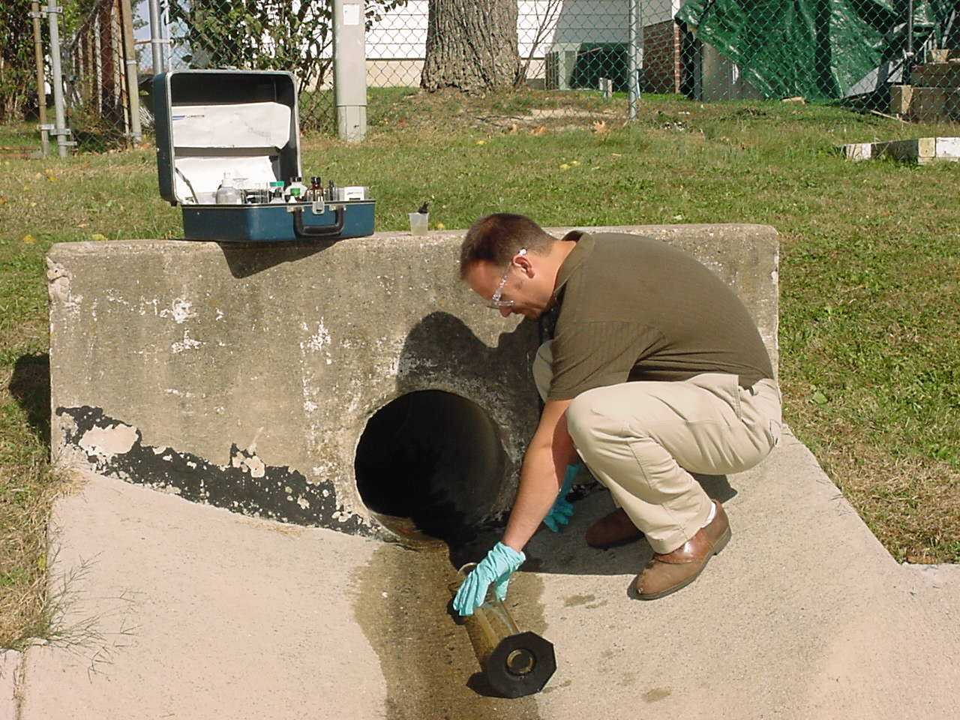
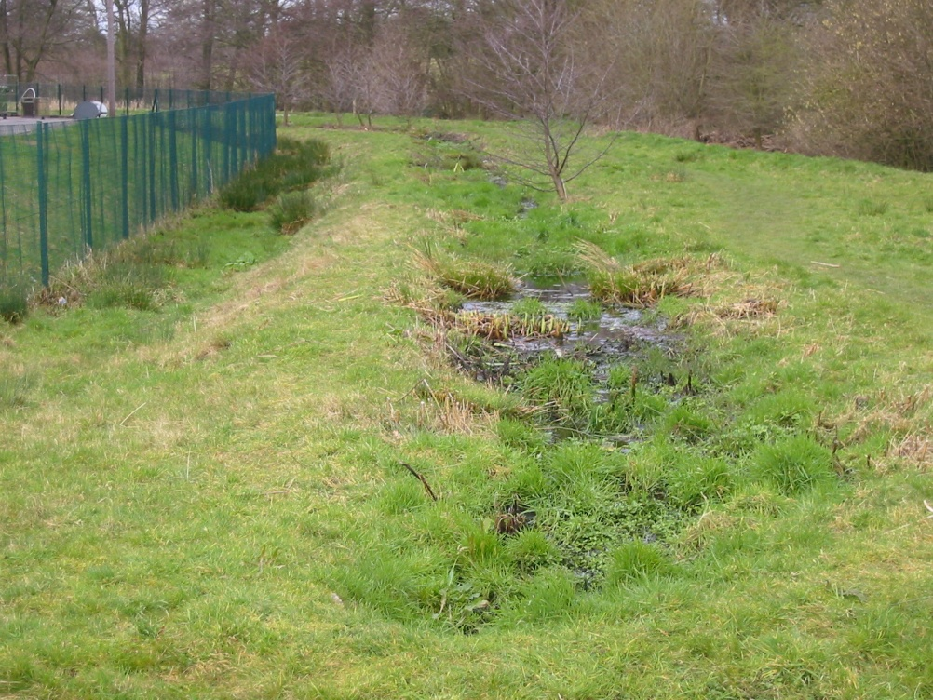

Slide 15
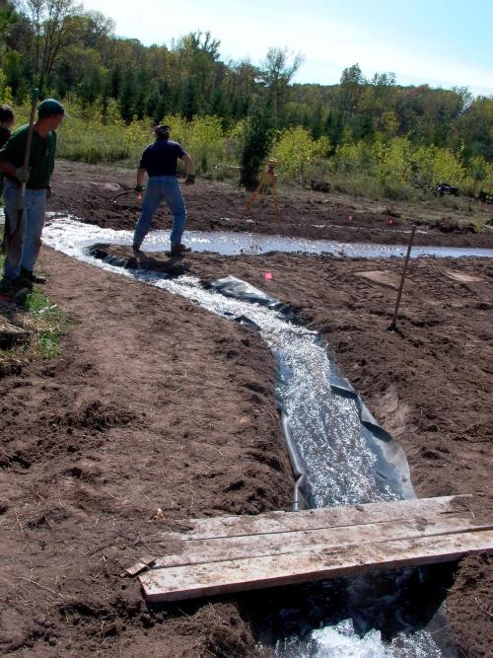
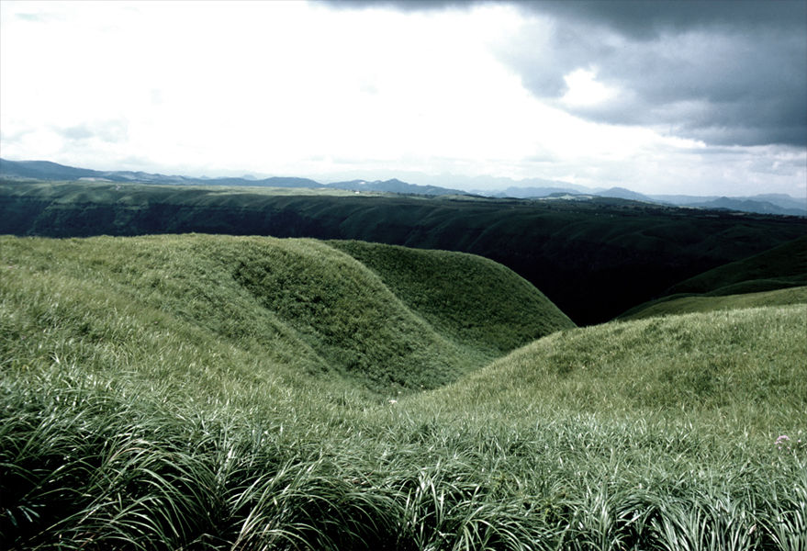

Slide 16
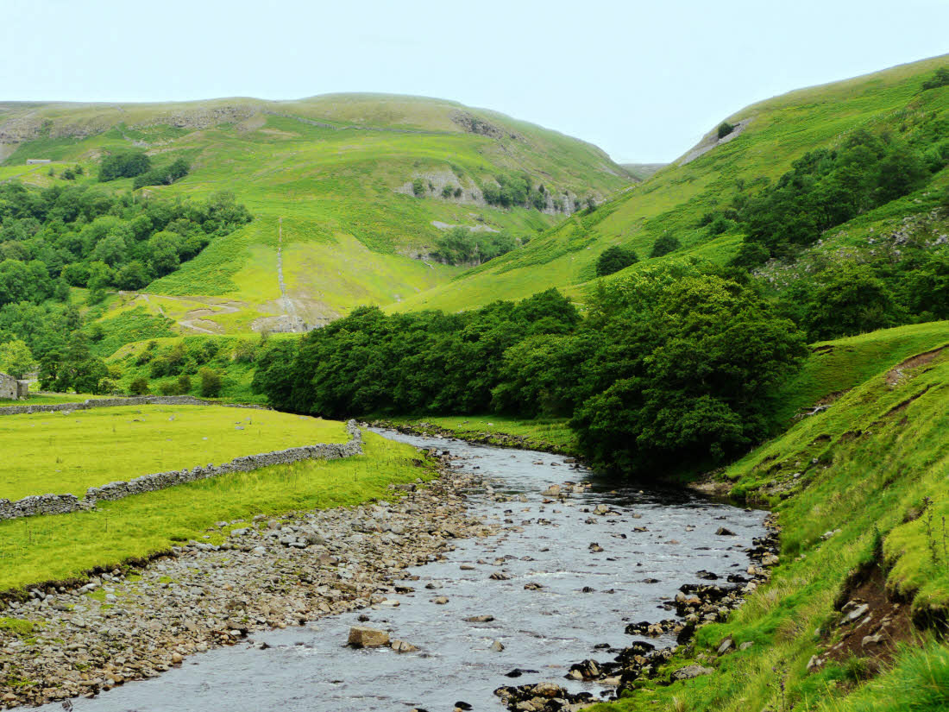

Slide 17
So why do I still hear about riparian rights?
Only remaining riparian rights are domestic and livestock
TWC 297.21(a) states that “a person may directly divert and use water from a stream or watercourse for domestic and livestock purposes on land owned by the person and that is adjacent to the stream without obtaining a permit. Manner of diversion may be by pumping or by gravity flow. Such riparian domestic and livestock use is a vested right that predates the prior appropriation system in Texas and is superior to appropriative rights. A vested riparian right is only to the normal flow in the stream, not to the storm water, floodwater, or authorized releases from storage for downstream use.”
Standard of “reasonable use” for riparians
What constitutes reasonable use???
As between riparians
As between riparians and appropriators

Slide 18
WATER RIGHTS PERMITTING

Slide 19
When is a permit required?
The diversion of state water requires a permit
The use of the bed and banks of any state watercourse to convey privately held or other water requires a permit
The construction of a non-exempt impoundment on a state watercourse requires a permit
Conversion of what was an exempt impoundment to a non-exempt purpose of use requires a permit
Pretty much anything that you want to do with state water requires some permit
Notes:
The Clean Water Act was passed to address significant pollution in waters across the United States
The goal was to restore the nation’s waterways to “fishable swimable” conditions
To implement this goal, EPA began to regulate point source discharges, especially those associated with POTWS
EPA adopted standards for surface water quality and began imposing technology based effluent limits to regulate discharges
Nested within regulating POTWS is a need to regulate those who are discharging to the POTW – the industrial users. The need to regulate industrial users is a function of the need to ensure the POTW can comply with its limits.

Slide 20
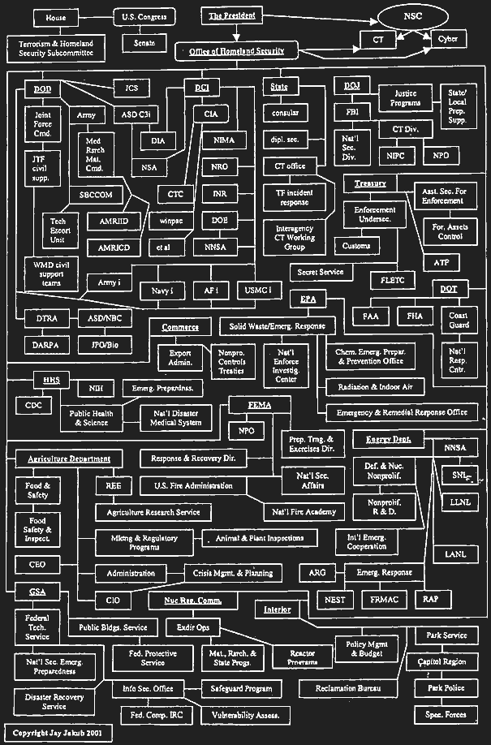
Sometimes you think it’s like this…

Slide 21
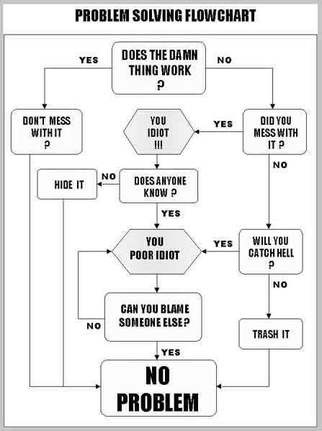
And other times it seems like this…
But really…

Slide 22
Water Rights Processing
Submit Application
Administrative Review
Conservation
Availability
Environmental
Draft Permit
Notice

Slide 23
Administrative Review Phase
General provisions for reviewing all administrative actions
Provisions of 30 TAC Chapter 281
Application must include information necessary for staff to review and fully consider request
Provisions of 30 TAC §295.1 - §295.16
Applicant must remit appropriate fees
Provisions of 30 TAC §295.131 - §295.140
Commission must be able to prepare notice of application

Slide 24
Technical Review Phase
Resource Conservation Review
Water conservation standards
Consistency with State Water Plan
Environmental Review
Water quality impacts of project
Protection for aquatic and riparian habitat
Water Availability Review
Water available vs. no-injury analysis

Slide 25
Developing a Draft Permit
All technical disciplines prepare memoranda regarding their review of the application
Permit writer prepares a draft permit that includes recommendations and grants the permit if water is available and other findings of TWC 11.034
Special conditions included to impose restrictions on use of water to protect seniors and environment

Slide 26
What about other requirements?
Potential municipal control for stormwater (volume and quality)
Potential regulatory control for water quality in Phase I or Phase II permits
What about ASR and “private water”?
What about a bed and banks transfer?
Environmental flows – the next frontier…

Slide 27
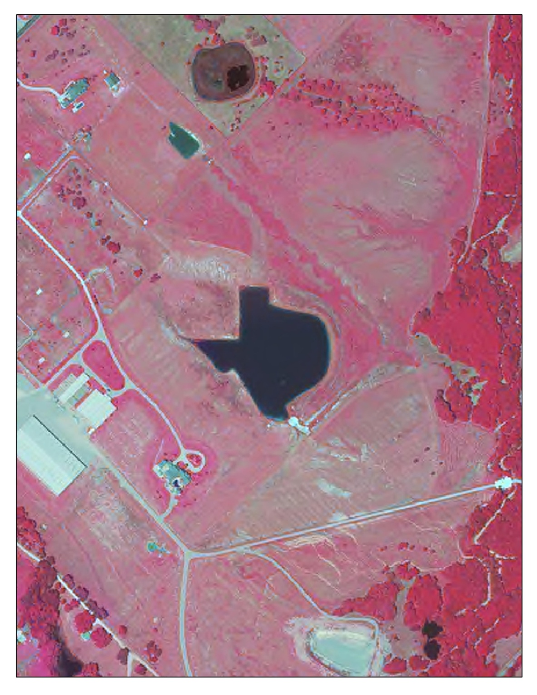
The ultimate vanity lake…
Notes:
The Clean Water Act was passed to address significant pollution in waters across the United States
The goal was to restore the nation’s waterways to “fishable swimable” conditions
To implement this goal, EPA began to regulate point source discharges, especially those associated with POTWS
EPA adopted standards for surface water quality and began imposing technology based effluent limits to regulate discharges
Nested within regulating POTWS is a need to regulate those who are discharging to the POTW – the industrial users. The need to regulate industrial users is a function of the need to ensure the POTW can comply with its limits.

