Slide 1
Margaret Nellor Texas Innovative Water 2010 Advancing the Development of New Water Supplies in Texas October 12, 2010
Direct Potable Reuse (DPR) – Has It's Time Come?
DPR

Slide 2
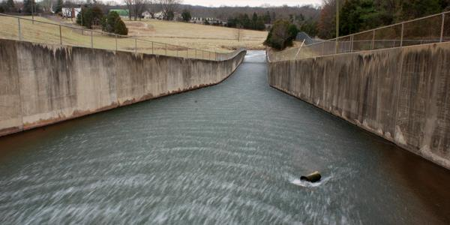
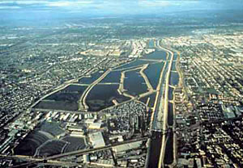
What We’re Not Talking About
Indirect Potable Reuse:
Planned introduction of RW into a water supply
Provides an environmental buffer (time & blending)
Surface Water Augmentation
Groundwater Recharge

Slide 3
What We’re Not Talking About
Unplanned Indirect Potable Reuse:
Introduction of wastewater into a water supply
Provides an environmental buffer
City B
City A

Slide 4
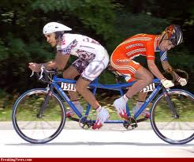
What is Direct Reuse?
RW introduced downstream of WTP (pipe-to-pipe)?
RW introduced in raw water supply upstream of WTP?
Both of the above?
No agreement on definition ☹
NRC Water Reuse Committee 2011 Report

Slide 5
Why Do It?
NPR not an option
IPR not option
No reservoir
Groundwater hydrology not suitable
Treatment technology available
Could be more cost effective
Eliminating/reducing distribution infrastructure

Slide 6
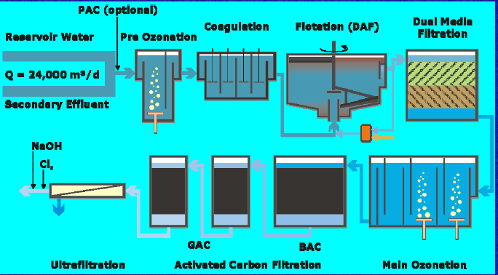
Pipe to Pipe - Is It Going on Now?
Windhoek, Namibia
Started in 1968
Divert industrial discharges
35% water supply
50% water supply drought
4.4 mgd AWTP

Slide 7
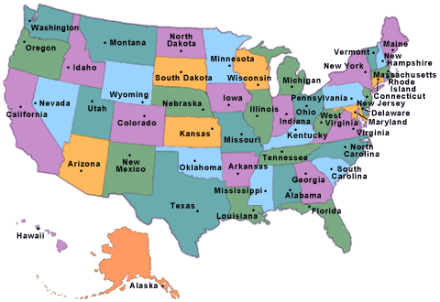
DPR: has its time come in the U.S?

Slide 8
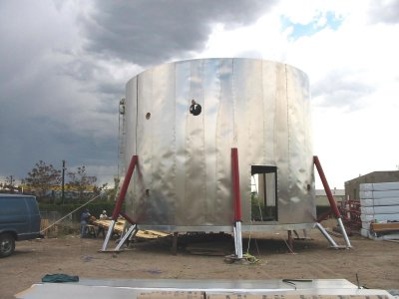
The Next
Martha Stewart?
Less Likely
More Likely
Everyone Loves EPA’s
Rules
LA Getting the Raiders
Back
Living On Mars
Relative Scale of Possibility (M. H. Nellor, 2001)

Slide 9
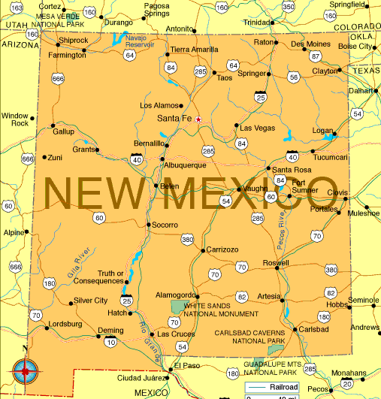
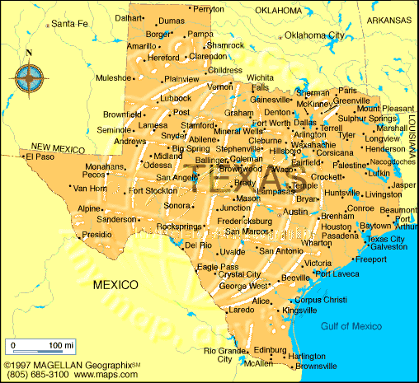
It Will be State Dependent

Slide 10
California Approach
WRA Potable Reuse Committee
White Papers
April 2010 Workshop
Public Acceptance ➔ 5 Tasks
Develop appropriate terminology
Survey stakeholders
Develop messages
Develop a communications strategy
Implement the communications strategy
Regulatory Issues ➔ 7 Tasks
Is it allowed under existing state laws/regs?
If not what regulatory changes are needed?
Under CA law RW is a “waste” ☹

Slide 11
California Approach
Treatment and Monitoring ➔ 13 Tasks
WQ treatment performance goals
Performance monitoring
Substitution of the environmental buffer
Monitoring for public health assurance
Define direct potable reuse
System design considerations
Need for enhanced source control
Diversity of treatment barriers for constituents
Data reporting
Operational guidelines
Blending
Concentrate and residual management
Monitoring for environmental impacts
Work plan (2010/2011)
Unlike IPR – not total agreement on DPR ☹

Slide 12
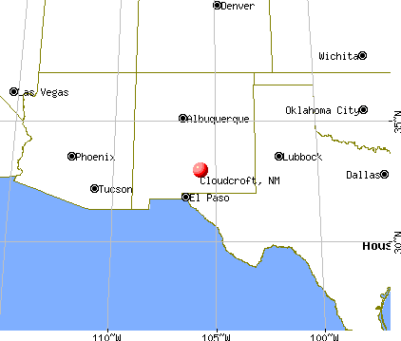
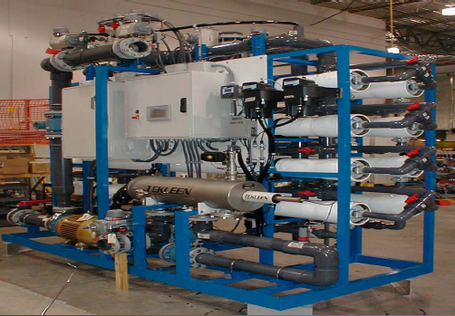
New Mexico – Cloudcroft (2009)
Augment potable water system w/ AWT RW
RW: 100,000 GPD (MBR/RO/AOP)
Blend up to 50/50 with natural spring/well water in covered reservoir
Treat blend (UF/GAC/Cl₂)
Place into distribution system
NMED Drinking Water Bureau approved
Public outreach ☺

Slide 13
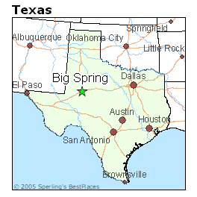
Texas – CRMWD (2012)
Drivers
NPR seasonal and limited demand
(climate issues & customers)
NPR distribution systems expensive
High WW TDS limits reuse (> 3,500 mg/L)
Lack of other water sources
2005 Feasibility study + public outreach
2009 Pilot testing
May 2010 TCEQ granted request for exception as raw water source
2012 First Phase – 2.5 mgd
Goal 3 projects – 13 mgd

Slide 14
10 – 30%
MF/RO/AOP
David W. Sloan, Freese and Nichols, Inc., Fort Worth, TX
Chris Wingert, Colorado River MWD, Big Spring, TX
Ignacio Cadena, Freese and Nichols, Inc., Fort Worth, TX

Slide 15
The Next
Martha Stewart?
Less Likely
More Likely
Absolutely
DPR in CA
DPR in Texas
& New Mexico
LA Getting the Raiders
Back
Revised Relative Scale of Possibility (2010)

Slide 16
Questions?
Margaret Nellor
Nellor Environmental Assoc.
margie@nellorenvironmental.com
512-374-9330
NWRI White Paper: www.nwri-usa.org/pdfs/NWRIPaperDirectPotableReuse2010.pdf
WRA White Paper: dsmith@WateReuse.org
DPR Workshop: dsmith@WateReuse.org

