Slide 1
Joint Groundwater Planning
The Basics
Groundwater Division, TWDB
Updated January 2024

Slide 2
This presentation was created by TWDB Groundwater Division staff for general educational purposes.
We hope this slide deck is useful in communicating the joint groundwater planning process, and the steps required to get from desired future conditions to modeled available groundwater.

Slide 3
We’ll cover…
Groundwater management areas
What is joint groundwater planning?
What does the desired future condition process look like?
Notes:
In this presentation, you’ll find information on what groundwater management areas are, what joint groundwater planning is, and what the process is to get from desired future conditions to modeled available groundwater.

Slide 4
GMAs, GAMs, MAGs…OMG!
GCD
GMA
DFC
TWDB
GAM
MAG
RWPG
Groundwater conservation district
Groundwater management area
Desired future condition
Texas Water Development Board
Groundwater availability model
Modeled available groundwater
Regional water planning group
Notes:
There are lots of acronyms involved in the joint groundwater planning process. Here’s a list for your reference.

Slide 5
Groundwater management areas
Notes:
This section explains what groundwater management areas are.

Slide 6
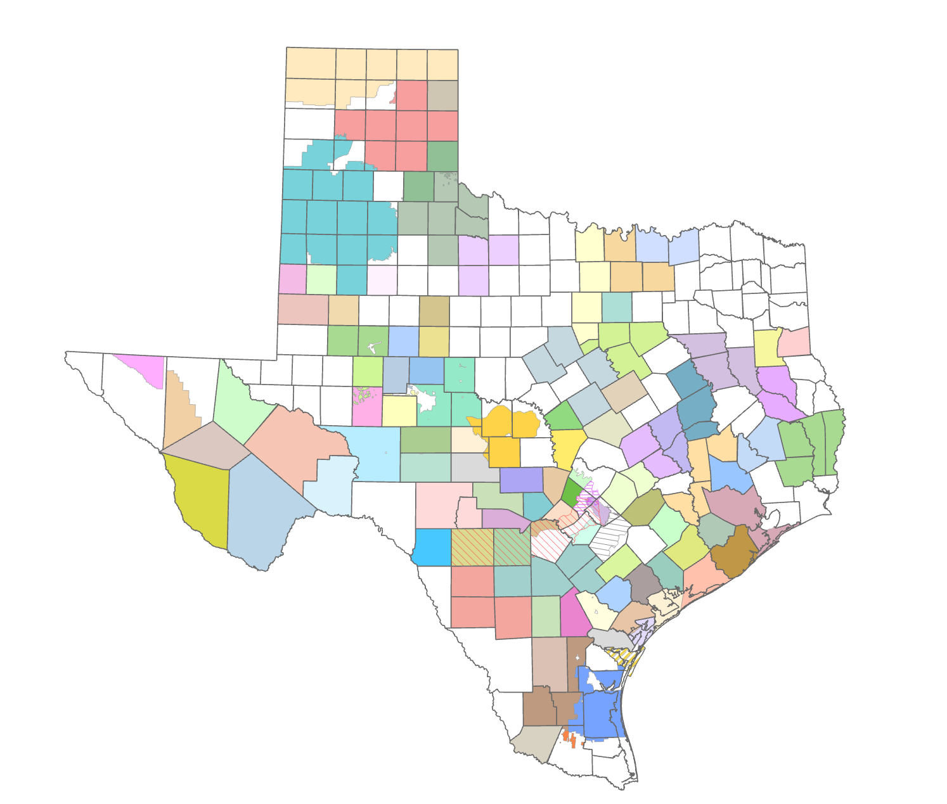
Groundwater conservation districts (GCDs)
Preferred method of groundwater management in Texas
Notes:
Groundwater conservation districts (GCDs) are the entities that manage groundwater at the local level in Texas. There are about 100 GCDs in Texas, shown on this map as the counties filled with color. GCDs are the state’s preferred method of groundwater management.
A GCD’s powers and duties are outlined in Chapter 36 of the Texas Water Code, but their fundamental mandate is to manage groundwater in order to protect property rights, balance conservation and development of groundwater to meet the needs of Texas and use the best available science in the conservation and development of groundwater through rules developed by each district.

Slide 7
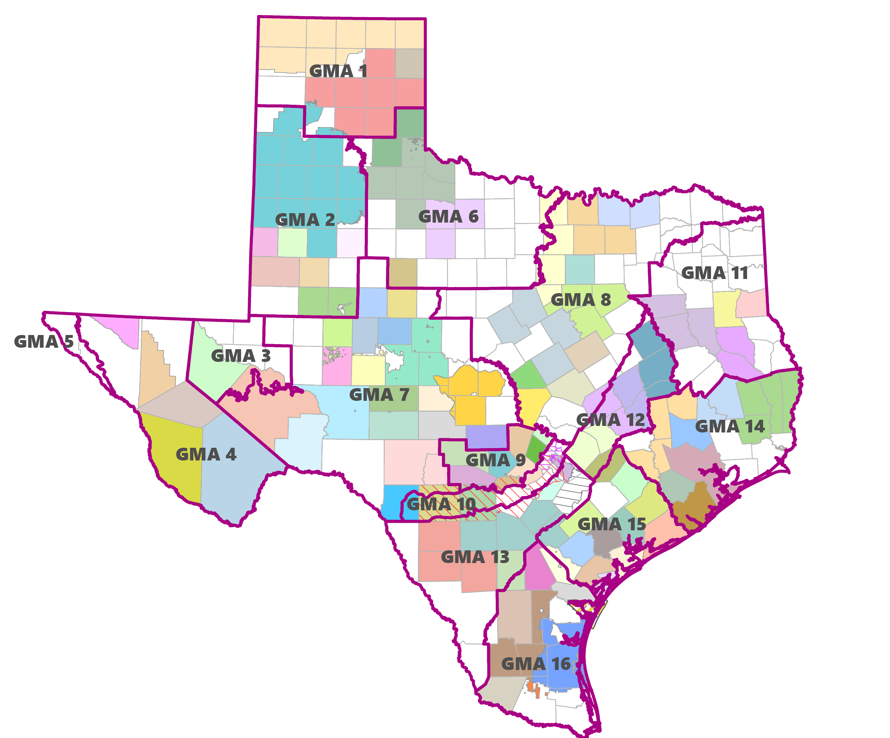
Groundwater management areas (GMAs)
Groups of groundwater conservation district (GCDs)
Notes:
GCDs are grouped into groundwater management areas (GMAs). There are 16 GMAs that cover all the aquifers in the state. The idea behind GMAs is so that districts overlying a shared aquifer can plan regionally for the future of those groundwater supplies.

Slide 8
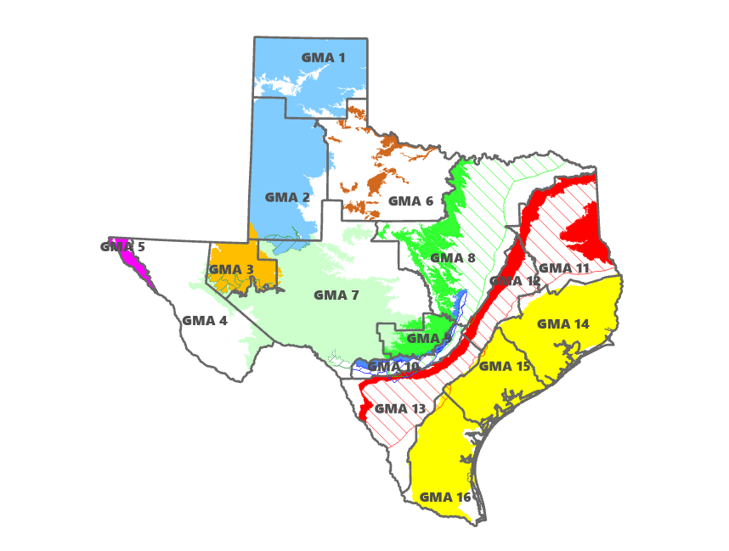
Groundwater management areas (GMAs)
Generally follow major aquifer boundaries
Notes:
GMAs are delineated by the TWDB, and generally follow major aquifer boundaries.

Slide 9
The TWDB maintains webpages for each groundwater management area.
And many GMAs also have their own websites to share information with the public.

Slide 10
Joint Groundwater Planning
Notes:
This section explains joint groundwater planning and desired future conditions (DFCs).

Slide 11
What is joint planning?
District representatives in a GMA meet at least annually to:
conduct joint planning
propose to adopt new or amended desired future conditions
review management plans and GMA accomplishments
Texas Water Code § 36.108
Notes:
District representatives in a GMA are required by law to meet at least annually to conduct joint planning, propose to adopt new or amended desired future conditions, and review groundwater management plans and any GMA accomplishments.
Funding for joint planning comes from districts, unlike funding for regional water planning groups, which is funded by TWDB grants.

Slide 12
Most joint planning activities are related to
desired future conditions (DFCs)

Slide 13
Desired future conditions
DFCs
Broad policy goal
Quantitative description
Updated at least every 5 years
Used to determine future groundwater availability
Texas Water Code § 36.108
Notes:
Desired future conditions (DFCs) are a broad policy goal established by GCDs within a GMA. DFCs are a quantitative description of aquifer conditions at some point in the future.
Texas Water Code Chapter 36 required DFCs to be updated in 5-year joint planning cycles.
Ultimately, the DFCs are used to determine future groundwater availability.

Slide 14
Desired future conditions
DFCs
Drawdown, springflow, storage volume, etc.
For relevant aquifers
May be established for:
aquifer
aquifer subdivision
geologic strata
geographic area
Notes:
DFC policy statements can be expressed in various ways. Some examples include drawdown, springflow, storage volume, and subsidence. DFCs are established for aquifers deemed relevant by GCDs for joint groundwater planning. Texas Water Code Chapter 36 allows DFCs to be established for whole aquifers, subdivisions of aquifers, geologic strata, or geographic areas.
DFC statements are often expressed in ways that districts can monitor and track over time and are also reflective of hydrogeology and groundwater issues specific to each GMA.

Slide 15
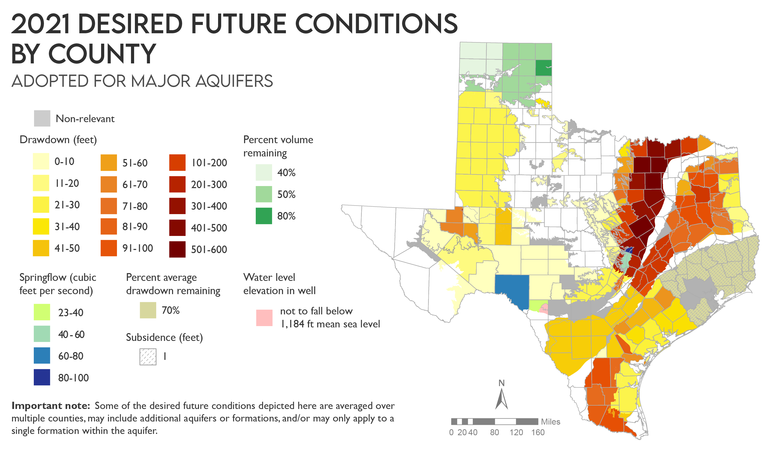
Notes:
The types of DFC statements vary across the state. This map shows the variety of DFCs for major aquifers from the 2021* round of joint planning. DFC statements from 2021 included drawdown, percent volume remaining, springflow, percent average drawdown remaining, subsidence, and elevation in a particular well. The grey areas on the map are areas where the aquifer was deemed non-relevant for joint planning purposes.
*The year for each joint planning round is marked by the year districts are required to propose DFCs for adoption.

Slide 16
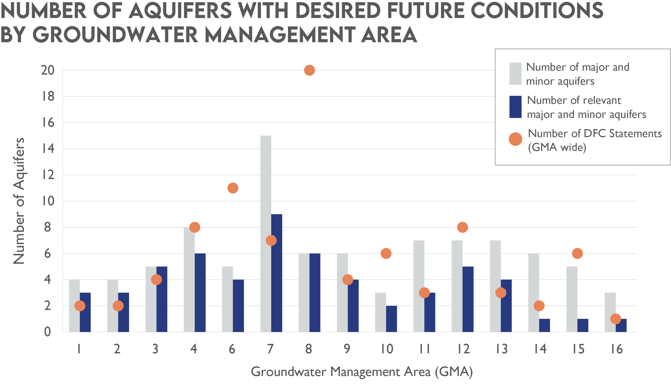
Notes:
This chart shows the number of aquifers with DFCs in each GMA for the 2021 round of joint planning. The grey bars indicate the number of major and minor aquifers in each GMA. The dark blue bars indicate the numbers of major and minor aquifers deemed relevant for joint planning purposes in each GMA. The orange dots indicate the number of DFC statements for the relevant aquifers in each GMA.
This chart is useful to see how DFCs vary across the GMAs. Here are a couple observations:
GMA 3 has five aquifers, all deemed relevant for joint planning purposes. GMA 3 only has four DFC statements because two of the aquifers are grouped together for modeling and monitoring DFC achievement.
GMA 8 has six aquifers, all deemed relevant for joint planning purposes. GMA 8 has 20 DFC statements for these six aquifers, largely because the districts in the GMA chose to establish DFCs for the different geologic formations within the Trinity Aquifer.

Slide 17
Relevant vs. Non-relevant
for joint planning purposes
Relevant
Official major or minor aquifers or any local aquifers deemed relevant by GMA
Non-relevant
Parts of a relevant aquifer that do not warrant a DFC based on aquifer characteristics, GW demands, and current GW uses
Notes:
Districts within a GMA an decide which aquifers are relevant and non-relevant for joint planning purposes. Relevant aquifers include all official major and minor aquifers and any local aquifer deemed relevant by the GMA (Buda Limestone in GMA 10 is an example). Districts within a GMA can deem parts of a relevant aquifer non-relevant based on aquifer characteristics, groundwater demands, and current groundwater uses.

Slide 18
Non-relevant
an unfortunate name
Technical justification required
Local aquifer management is still happening
Regional water planning groups determine groundwater availability
Notes:
“Non-relevant” is an unfortunate name for these aquifers. Local aquifer management by a district is often still occurring even if the part of the aquifer is non-relevant for joint planning. Technical justification is required to support deeming parts of an aquifer non-relevant for joint planning purposes. In some situations, very small slivers of major or minor aquifers exist within a GMA but do not have any groundwater use, so those portions may be deemed non-relevant.
In areas that have non-relevant aquifers with no desired future conditions, regional water planning groups determine groundwater availability for those area. The TWDB will provide DFC-compatible availability volumes based on groundwater availability model runs when determining modeled available groundwater in the relevant aquifers, but regional water planning groups may choose to adjust that availability.

Slide 19
Why DFCs matter
Districts must manage production to achieve desired future conditions
A criteria for GCD planning and rule making
Results in modeled available groundwater that can be used to evaluate permit applications
Notes:
Texas Water Code Section 36.1085 requires districts to ensure their management plans contain goals and objectives consistent with achieving DFCs.
Texas Water Code Section 36.1132 requires districts to manage total groundwater production to achieve DFCs. The modeled available groundwater (we’ll get to that more here in a few slides) estimated using the DFCs can be used in consideration of permit applications.

Slide 20
Why DFCs matter
Modeled available groundwater = water availability components that feed into regional water plans and state water plan
Influence policy and resource management decisions that affect all Texans
Notes:
Modeled available groundwater estimated from DFCs becomes the groundwater availability values used in regional water plans, and ultimately the state water plan. The state water plan projects long-term water demands and needs for all regions of the state and proposes water management strategies to meet those demands based on water availability.
Ultimately, DFCs have significant influence on the policy and resource management decisions that affect all Texans.

Slide 21
DFC Process
Notes:
This section explains how we go from DFCs to future groundwater availability (modeled available groundwater).

Slide 22
Desired future conditions
TWDB groundwater availability models
Modeled available groundwater
GCDs & RWPGs
GCDs &
advisors
GMA
Policy
Science
Groundwater availability
Notes:
To summarize the process, GCDs within a GMA, and any advisory committees appointed by the GMA members, determine desired future conditions that districts within the GMA adopt. Those DFCs are then run through the TWDB groundwater availability models to produce estimates of modeled available groundwater, which are then sent back to the GCDs and provided to the regional water planning groups (RWPGs) for use in regional water planning.
Groundwater availability (modeled available groundwater) is determined by combining the DFC policy statements with the science of groundwater availability models, which are considered the best available scientific tool.

Slide 23
90-day public comment period
Each district has a public hearing
GMA submits
explanatory
report to TWDB
with model files
GMA proposes
to adopt DFCs
by May 1, 2026
GMA adopts
DFCs
by January 5, 2027
Notes:
Texas Water Code Chapter 36.108 outlines the DFC process. GMA’s propose DFCs for adoption and go through a 90-day public comment period, during which each GCD holds a public hearing. Then they finally adopt DFCs and submit a report called an explanatory report that documents all the work the districts did during the joint planning round. The GMA also submits any modeling files they used in determining DFCs.
The dates shown on this and the following slides are for the 2026 round of joint planning.

Slide 24
90-day public comment period
Each district has a public hearing
GMA submits
explanatory
report to TWDB
with model files
GMA proposes
to adopt DFCs
by May 1, 2026
GMA adopts
DFCs
by January 5, 2027
Good time for stakeholder involvement is now, at the beginning of joint planning round, far before any DFC proposals happen
Joint planning meetings leading up to DFC proposal
Notes:
The beginning of the process, if you’re looking at statute, starts when a GMA proposes to adopt DFCs, but the process begins far before DFC proposals happen.
Each GMA has many joint planning meetings leading up to the deadline to propose DFCs for adoption.

Slide 25
9 factors
GMA proposes
to adopt DFCs
by May 1, 2026
Aquifer uses and conditions
Environmental impacts
Property rights
State water plan
Land subsidence
Feasibility
Hydrologic conditions
Socioeconomics
Any other information
Notes:
Before voting on proposed DFCs, districts within a GMA are required to consider nine factors outlined in the Texas Water Code.
Some of these factors are more straightforward than others to consider with available data and information. Factors such as property rights and socioeconomics are often the more challenging factors to consider.

Slide 26
A balancing act
GMA proposes
to adopt DFCs
by May 1, 2026
Highest practicable level of groundwater production
Conservation, preservation, protection, recharging, prevention of waste of groundwater, and control of subsidence
Notes:
Districts within a GMA also have to balance the highest practicable level of groundwater production with conservation, etc. Each GMA has multiple stakeholder interests and different types of water users, and it can be a challenge to balance all these different interests.

Slide 27
Assessing DFC scenarios
GMA proposes
to adopt DFCs
by May 1, 2026
GMAs often hire consultants to use groundwater availability models to assess various DFC scenarios
Active participation in the process could get a scenario you want to see on the decision table.
Notes:
To assess and consider the nine factors and the balancing test, districts within a GMA often hire consultants to use the TWDB groundwater availability models to assess various DFC scenarios.
As a stakeholder, active participation in the process will keep you informed of what the districts are considering and could get a scenario you want to see on the decision table.

Slide 28
DFC Explanatory Report
GMA submits
explanatory
report to TWDB
with model files
Needs to include
Each desired future condition
Policy and technical justification
Consideration of 9 factors
Other desired future conditions considered and why those were not adopted
Discussion of recommendations from advisory committees and relevant public comments
Non-relevant aquifer documentation
Notes:
The DFC explanatory report documents all the work the districts did during the joint planning round. Texas Water Code Chapter 36.108 outlines all the elements that need to be included in an explanatory report.

Slide 29
GMA submits
explanatory
report to TWDB
with model files
TWDB determines if administratively
complete
Notes:
After the GMA submits the DFC package, including the DFC explanatory report and any model files used to establish the DFC, to the TWDB for an administrative completeness review

Slide 30
TWDB determines if administratively
complete
MAGs
Notes:
Then the TWDB takes the DFCs and estimates modeled available groundwater (MAGs).

Slide 31
Modeled available groundwater
MAG
Amount of water that may be produced on an average annual basis to achieve a desired future condition
Calculated by the TWDB using GAMs
Used in permitting decisions, among other information
Provided to regional water planning areas as groundwater availability
Notes:
Modeled available groundwater (MAG) is the amount of water that can be produced on an average annual basis to achieve a DFC. The TWDB uses the most recently available groundwater availability model (GAM) to estimate MAGs.
GCDs can consider MAGs (along with estimates of production from wells exempt from permitting, estimates of how much groundwater is produced under existing permits, the amount of groundwater authorized under permits previously issued by the district, and yearly precipitation and production patterns) in issuing permits to manage groundwater production to achieve DFCs (Texas Water Code Chapter 36.1132).
MAGs are also provided to regional water planning groups for use as groundwater availability in regional water plans.

Slide 32
TWDB determines if administratively
complete
GMA notified
Districts
update
management
plans
Districts
adopt DFCs
Districts
update
rules
MAGs
2 years
1 year

Slide 33
GMA
Propose to
adopt DFCs
by May 1, 2026
90-day public
comment period
Each district has a public hearing
Adopt DFCs
by January 5, 2027
TWDB
60 days
GCD
Submit
explanatory
report
with model files
Administratively
complete
GMA notified
180 days
90 days
MAGs
Districts
adopt DFCs
Deficiencies

Slide 34
TWDB DFC Resources
DFC webpage
Guidance documents
2021 joint planning documents
Groundwater Technical Assistance staff

Slide 35
Natalie Ballew, P.G.
Slides prepared by
Groundwater Division Director, TWDB
512-463-2779
natalie.ballew@twdb.texas.gov

